Slide 1
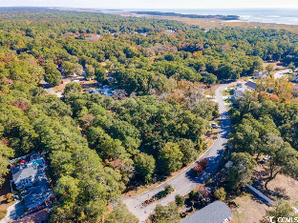
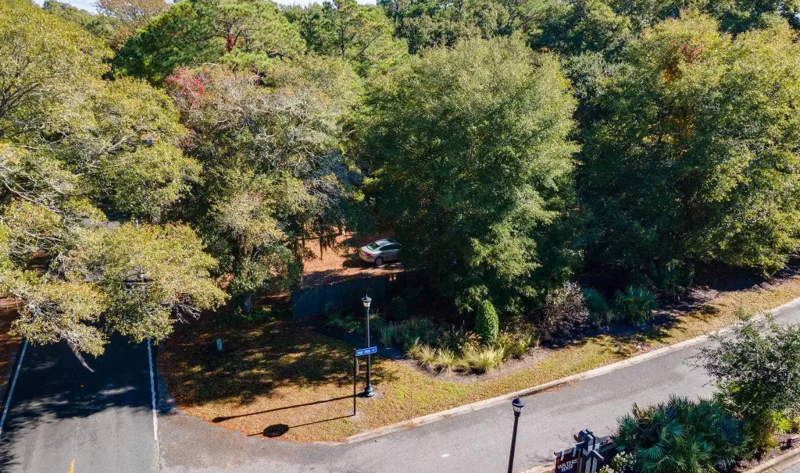
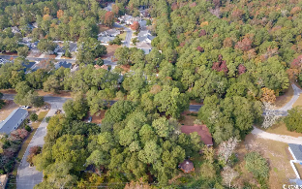
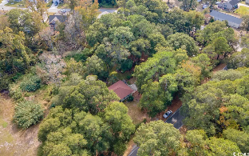
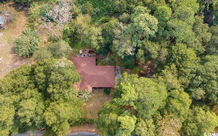
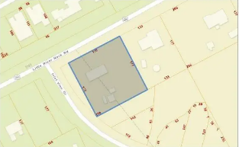
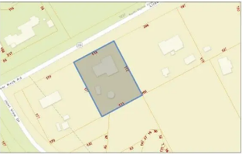
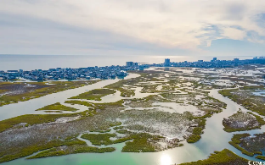
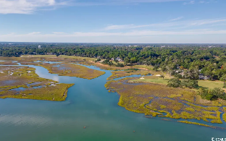
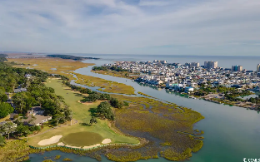



Rare, acre-plus 2-lot parcel with commercial potential and flex usage now available!
5218 Little River Neck Rd
North Myrtle Beach, SC 29582 | MLS# 2402180 | $625,000
This two-lot parcel with significant road frontage is on Little River Neck Rd., a tree-lined road to oceanfront Anne Tilghman Boyce Coastal Reserve, a nature conservancy, including Waties Island, with access for managed recreational use. Little River Neck itself is on an elevated peninsula of live oaks and southern pines between the Intracoastal Waterway and the Cherry Grove Inlet to the Atlantic Ocean. The area also preserves the singular look of its own historic origins. It is minutes from the beach, shopping & dining, schools, medical services, entertainment and access to major highways. Nearby public amenities include the ability to golf cart to the beach; close proximity to public/world-class Tidewater Plantation Golf Course and Grill, NAMED BEST IN THE U.S. in 2022, restaurants and bar, driving range, putting greens, event facilities overlooking the 18th hole; and access to Waties Island, one of the last accessible barrier islands in the world! This section of Horry County has a full range of things to do and to enjoy which really reflects a "way of life" nearby in safe, popular, affordable North Myrtle Beach, a Top 5 Beach Town in the nation; but with low, low county taxes. Property is zoned CFA. Allowed zoning uses should be verified by Buyer and Buyer's agent with Horry County as should all measurements. Subdivision: LD & Hope Willard and Little River Neck. Adjoining Waters Edge Subdivision. Flood zone X, minimal. Sold As Is. Home and manufactured home convey unfurnished. There are two inter-connected wells on the property. One is a deep well of 400 ft.; the other is of unknown depth. There are two septic tanks. Hope Point Subdivision is approved for development across the street, and Little River Neck Rd. has been widened with a multi-purpose path. Future improvement may be for golf-cart tunr-outs. There is discussion of a state park on neighboring Waties Island. With CFA Zoning, about 303 ft. of road frontage on Little River Neck Rd, and more than 60,000 sq. ft. of land (1.38 acres), this rare offering has numerous possible uses. Easy to find, 3 signs on the two lots in the parcel. Both the stick-built the manufactured homes are tenant-occupied and require appointment. Two residential communities are now being developed on Little River Neck Rd., so allow for periodic light traffic for some time.
Video Tour
Connie Ross-Karl
702-306-2643
conniesross@aol.com
Ronnie Nichols
Realtor / BIC
ronnienichols8@aol.com
NEW WAY PROPERTIES MYRTLE BEACH

