Slide 1
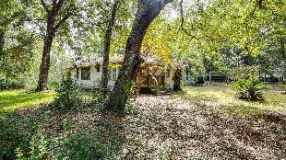
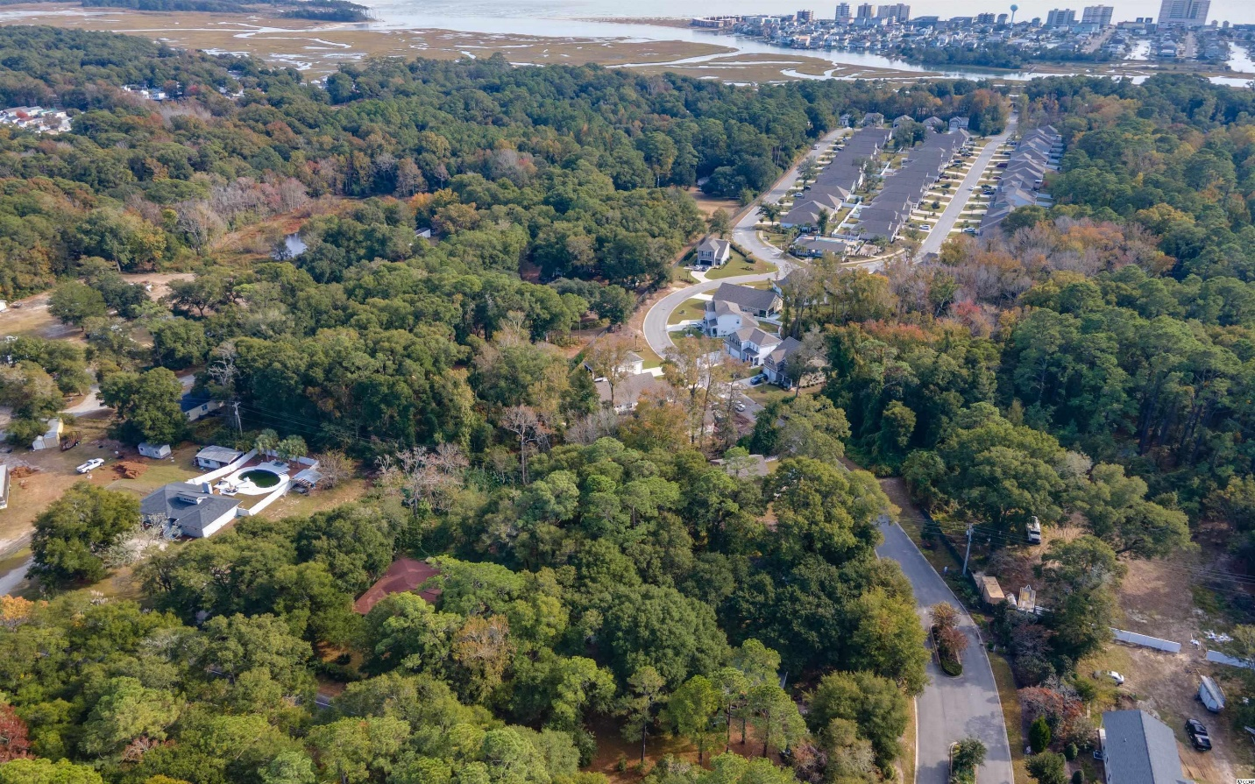
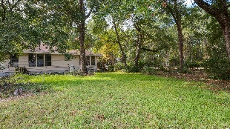
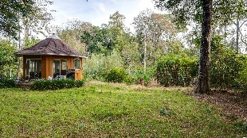
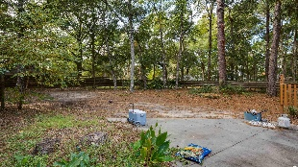
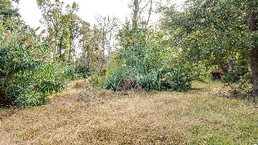
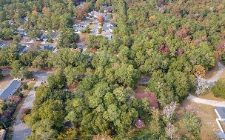
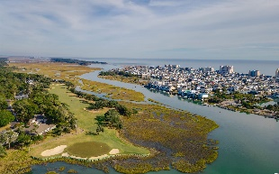
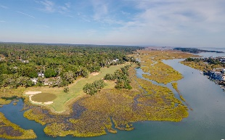
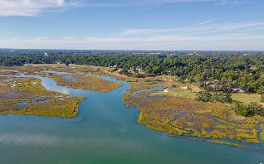
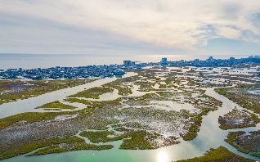



This Two-lot 1.38-acre Parcel Near
Oceanfront Nature Conservancy
5218 Little River Neck Rd
North Myrtle Beach, SC 29582
MLS# 2125522 ~ $500,000
This two-lot parcel with significant road frontage is on Little River Neck Rd., a tree-lined road to oceanfront Anne Tilghman Boyce Coastal Reserve, a nature conservancy, including Waties Island, with access for managed recreational use. Little River Neck itself is on an elevated peninsula of live oaks and southern pines between the Intracoastal Waterway and the Cherry Grove Inlet to the Atlantic Ocean. The area also preserves the singular look of its own historic origins. It is minutes from the beach, shopping & dining, schools, medical services, entertainment and access to major highways. Nearby public amenities include the ability to golf cart to the beach; close proximity to world-class Tidewater Plantation Golf Course, pro shop and restaurants and bar, driving range, putting greens, and event facilities overlooking the 18th hole; and access to Waties Island, one of the last accesible barrier islands in the world! This section of Horry County has a full range of things to do and to enjoy which really reflects a "way of life" nearby safe, popular, affordable North Myrtle Beach, a Top 5 Beach Town in the nation; but with low, low county taxes. Property is zoned CFA. Allowed zoning uses should be verified by Buyer and Buyer's agent with Horry County as should all measurements. Subdivision: LD & Hope Willard and Little River Neck. Adjoining Waters Edge Subdivision. Flood zone X, minimal. Land only, home, manufactured home and other structures will be removed prior to closing, requested in 2022. However, structures are negotiable. There are two inter-connected wells on the property. One is a deep well of 400 ft.; the other is of unknown depth. There are two septic tanks. Hope Point Subdivision is approved for development across the street, and Little River Neck Rd. will be widened with a multi-purpose path. There is discussion of a state park on neighboring Waties Island. With CFA Zoning, about 303 ft. of road frontage on Little River Neck Rd, and more than 60,000 sq. ft. of land (1.38 acres), this rare offering has numerous possible uses. Easy to find, well-signaged directionals & signs on property. To walk the property, park on the driveway to the home. The manufactured home is tenant-occupied. Listing agents are always willing to accompany. Do not miss out on this unique opportunity!
Connie Ross-Karl
702-306-2643
conniesross@aol.com
Ronnie Nichols
Realtor
Broker in Charge
NEW WAY PROPERTIES MYRTLE BEACH

