Slide 1
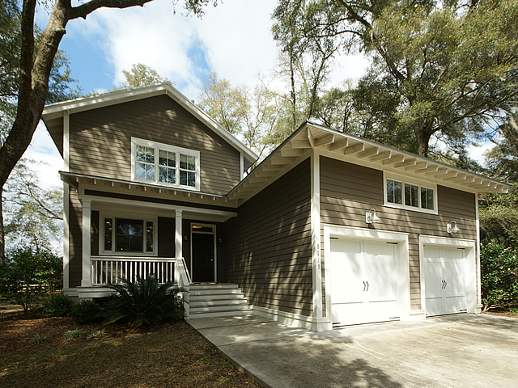
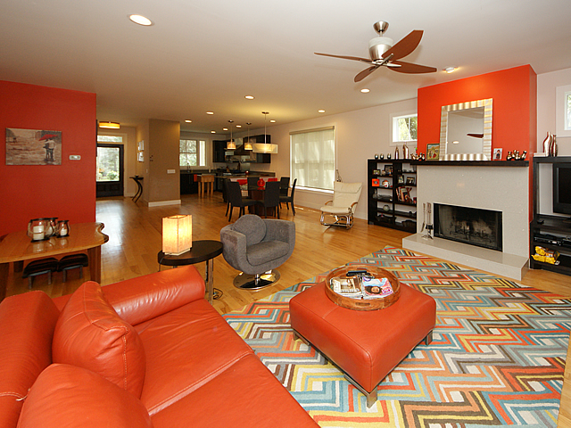
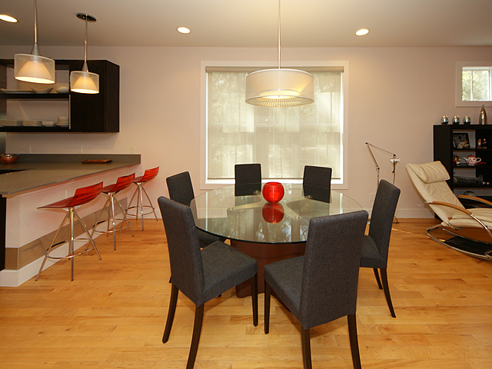
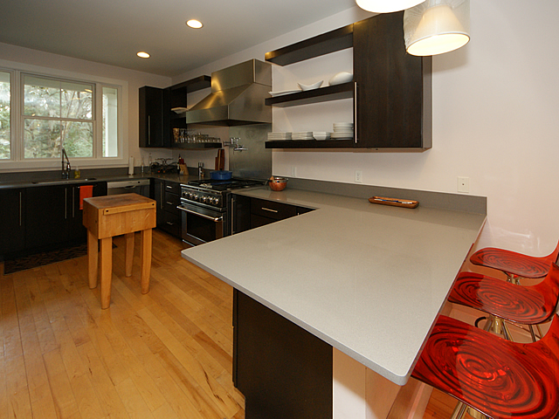
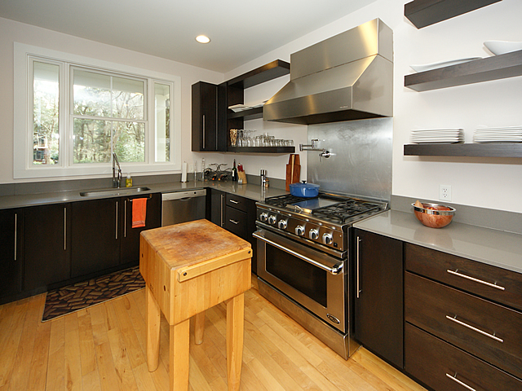
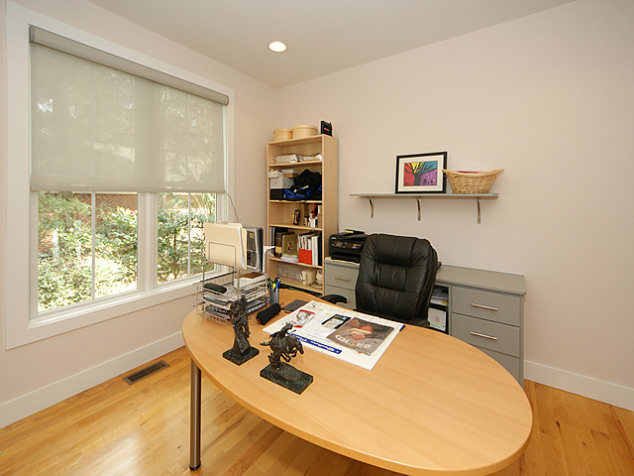
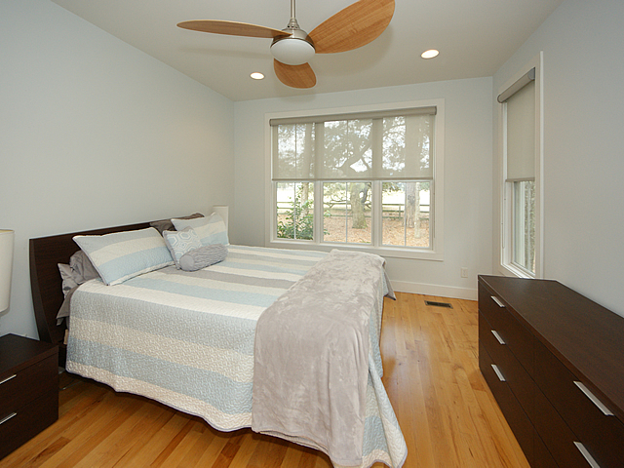
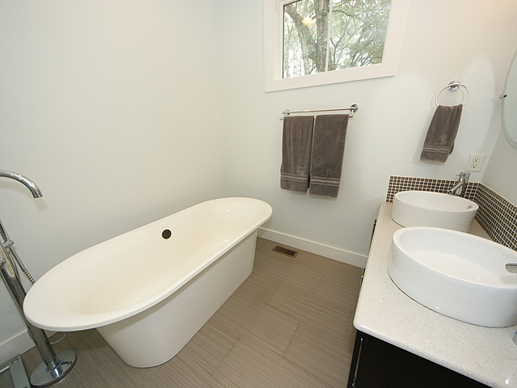
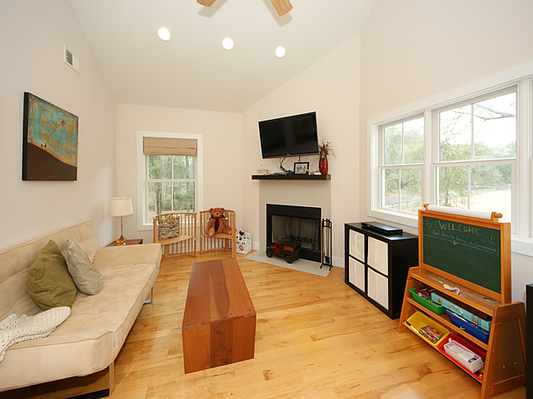
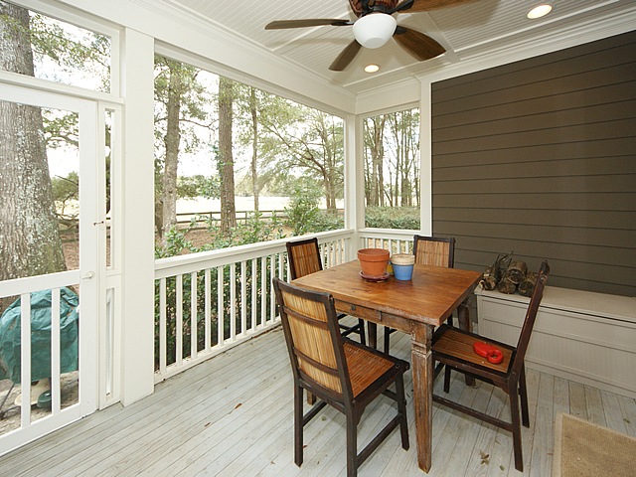
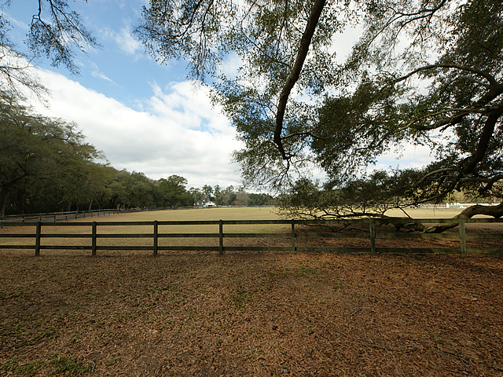


Gated Golf/Equestrian Community!!
5219 Old Washington Course
Plantation at Stono Ferry ~ Hollywood ~ MLS# 17011889 ~ $474,900
Beautiful, home in the gated Plantation at Stono Ferry neighborhood. This quaint neighborhood boasts large lots, gorgeous trees, golf, an equestrian center, neighborhood pool and so much more. The house itself touts very bright and sunny rooms with windows galore! The spacious open floor plan allows for great entertaining. The chef in the family will love the upscale kitchen with its silestone counters and custom cabinetry. The stove is a professional grade DCS Fisher & Paykel. A Jenn Air frig and Bosch dishwasher round out the appliances. The master bedroom is downstairs and has a lavish spa-like bathroom with soaking tub and multiple head shower. It is also conveniently connected to the laundry room. A screened porch overlooks the oak draped backyard and handsome horse pastures. Upstairs, a second living area with a fireplace has been converted into a fourth bedroom with an oversized closet. There is enough space to add another bathroom here and have a second master! The other two bedrooms are also on this level and are generous in size. Also on the main floor is another room currently with a built in desk that makes for a perfect home office! Could also be a great playroom or den. This home will not disappoint! If square footage is important please measure
Keller Williams Realty Charleston West Ashley
1180 Sam Rittenberg Ste 105
Charleston, SC 29407
Amy Zonarich
Realtor
(843) 534-3523
amy@amyzonarich.com
www.liveandlovecharleston.com

