Slide 1
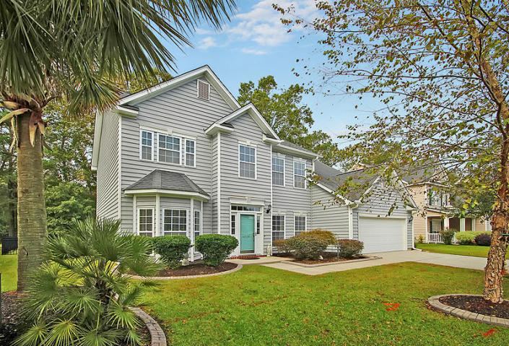
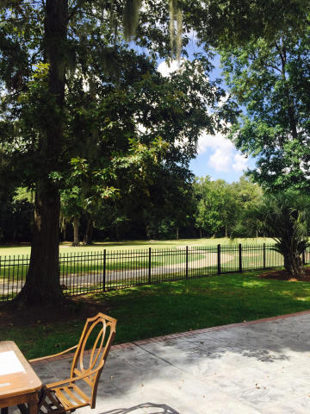
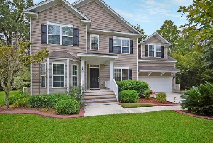
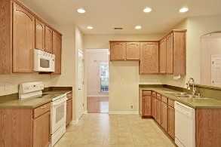
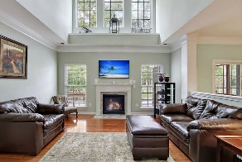
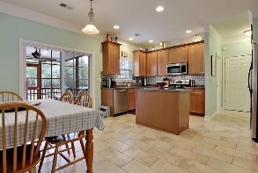
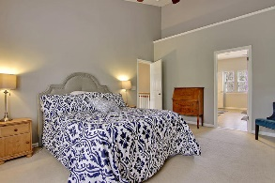
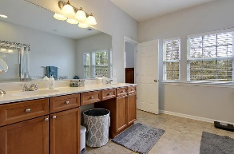
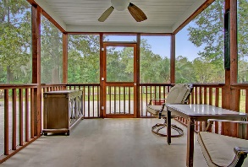
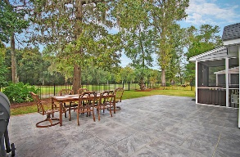
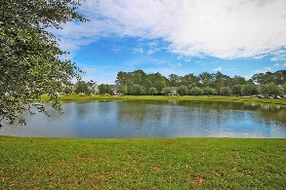

5219 Stonewall Drive Wescott Plantation | Summerville, SC 29485 MLS# 16027119 | $303,975
Huge Private Dock! Breathtaking Views!
Loaded with Updates
A Wescott Golf Course home located on the 4th tee box, with a large pond in front of the house, and is situated in a cul-de-sac setting. Gorgeous 4 bedroom, 2.5 bath, meticulously maintained, freshly painted, and updated home. Hardwoods welcome you throughout the first floor, along with a tiled eat-in kitchen. The spacious rooms including formal living room, formal dining room, office/study, 2-story great room with 20ft ceiling and full of windows, and an eat-in kitchen, are laid out in a perfectly smooth flow. This open floor plan allows for ease of entertaining large groups, and comfortable living. The kitchen is a cook's dream with 42'' cabinets, solid surface counters, stainless steel appliances, built-in microwave, and an island for extra storage and counter space. Two large pantries in the kitchen also allow for plenty of storage. Laundry room is over-sized with a separate sink and cabinet. Spacious master bedroom has vaulted ceilings, and the spa-like master bath is large with two closets, garden tub, separate shower, water closet, and solid surface double vanity. Three secondary rooms are large, and upstairs flex room could be an office, media room, play room, or craft room. The backyard is a manicured oasis with palm trees, a stamped concrete patio, and is surrounded by a wrought iron fence. You can enjoy the backyard or your screened-in porch while watching the golfers tee off on the 4th tee box on Wescott's Oak Forest. It is easy to imagine sitting in the screened-in porch enjoying a morning cup of coffee, or relaxing after work, enjoying the view. The garage is finished, and the floor has been painted with epoxy giving the garage that look of perfection. Hurricane panels and hardware convey and only require placing panels on windows and tightening with nuts and bolts. Wescott Plantation in Summerville is a wonderfully landscaped community with a clubhouse, golf course, play park, tennis courts, and community pool! The neighborhood is central to local shopping, grocery stores, and is a short drive to downtown Charleston where you will find 5-star dining, world class shopping, and iconic history. Wescott is also a quick and easy drive to the beaches, the airport, Boeing, and Daniel Island. What else could you ask for? Nothing!!! This home has everything; call today to see!
Stan Huff
843-670-2835 stan.huff@agentowned.com
Jill Marcacci
843-297-5590 jill@agentowned.com
www.agentownedrealty.com
AgentOwned Realty Co. Preferred Group, Inc. | 824 Johnnie Dodds Blvd | Mt Pleasant, SC 29464

