Slide 1
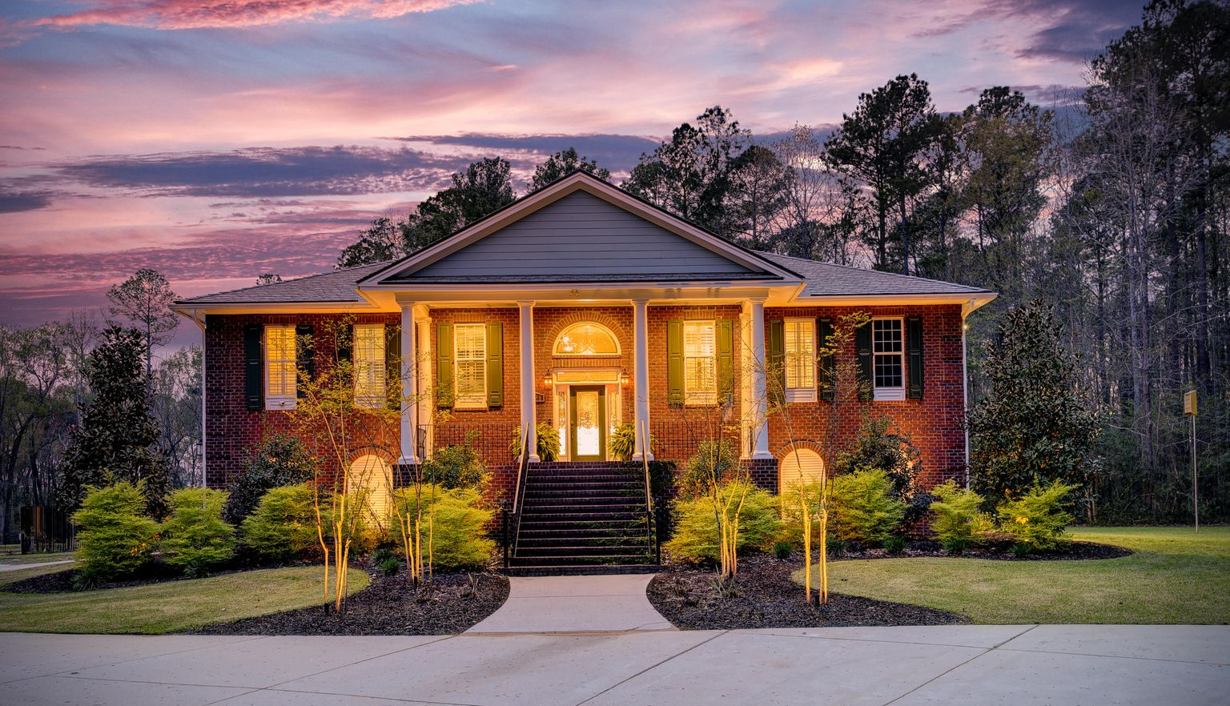

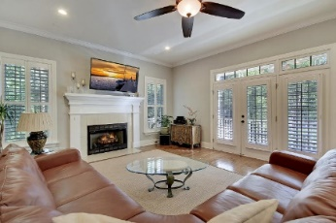
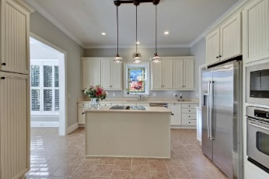
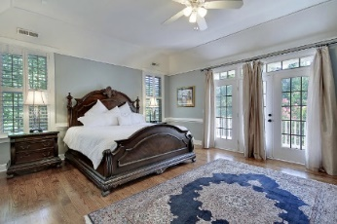
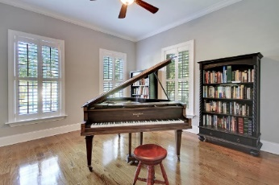
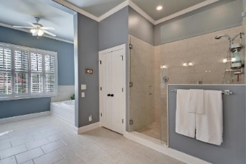
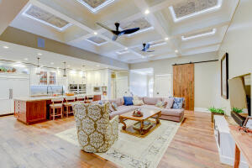
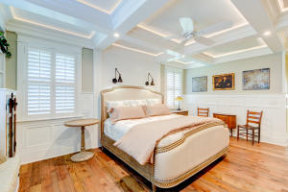
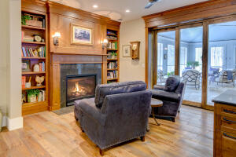
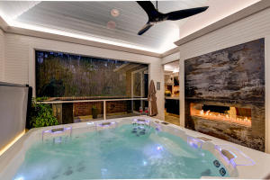
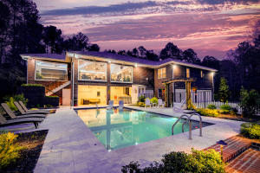
Price Reduced!
One of a Kind Beauty
$25.00 gas card giveaway. Chicken Salad Chick lunch provided by Warren Armstrong of Fairway Mortgage
521 Cypress Point Drive
Cypress Point Plantation ~ Summerville, SC 29486 ~ MLS# 21008522 ~ $2,499,900
Every now and then, a property comes along that is so special that it simply leaves you speechless. This incredible home is just such a property. With state-of-the-art features, impeccable design, and impressive details everywhere you look, you will never want to leave! As you pass through the gated entry, you will take in the wooded lot and beautifully manicured yard as you approach the home. The stately exterior of this Georgian-style home greets you with a rich, red brick, beautiful landscaping, and a grand staircase leading to the columned front porch. Step inside and ascend the LED lighted stairs with 54'' wainscoting to discover reclaimed hickory flooring throughout most of the first floor. The splendid great room has a coffered ceiling with LED lighted embossed panels and convenient storage space tucked away by a barn door...perfect for stashing holiday decor without the hassle of breaking it all down. The great room flows into the study/library with a fireplace and built-ins on either side. The kitchen is nothing short of amazing. A massive 148" x 65" island has loads of features including a 60" galley work station, a built-in knife holder, two galley taps, an air switch for the garbage disposal, 30" induction cooktop, 15" gas cooktop, 30" warming drawer, toaster drawer, and multiple built-in accessories. One side of the island houses a bake center with mixer pull-up and storage of all your baking pans and tools. On the opposite side of the island, you'll find walnut drawers for dishes and flatware as well as 18" deep cabinets. The top-of-the-line appliances include a 48" Subzero built-in refrigerator, two Miele 30" steam ovens, a Miele built-in combo steam oven, a Miele built-in coffee machine with a warming drawer for coffee cups, a Miele Diamond Series dishwasher, and a built-in vacuum sealing drawer. Quartzite countertops, elegant, tall cabinets, and a 14" deep pantry are just a few more features in this unbelievable space. The dining room has a 12' built-in buffet on one side and a wet bar, wine cooler, refrigerator, and ice maker on the other, both with ample storage space. From the dining room, pocket doors lead to an awe-inspiring outdoor kitchen and living area fit for royalty! Here you will find a two-tap Kegerator, an ice-maker, and under-counter refrigerator, a pizza oven, a built-in 42" Luxury Series Alfresco Grille and Griddle with a rotisserie and searing unit, a Versa Burner for Lowcountry Boils or steaming crabs, a built-in Big Green Egg, and three commercial stainless steel vent hoods. This space also includes a 148" x 51" deep island with two galley taps and room for seating. Just off the kitchen, you'll find brick planters with an irrigation system to grow your own herbs. A dining area complete with a see-through fireplace provides the perfect ambiance for special gatherings or intimate meals. You will love watching 38 different species of birds from the large seating area that looks out to the pond and fountain. The spa deck with Ipe decking overlooks the woods and pond and also enjoys the see-through fireplace. Step down the hall to find the owner's retreat with a lit coffered ceiling, a large window bench with storage, built-in shelving, wainscotting, and the custom walk-in closet with a sensor switch to light the clothing rods. The en-suite bath is nothing short of magnificent. This space has heated floors in the bath and shower, a substantial dual vanity, a linen cabinet with adjustable shelves and drawers, a built-in seat, and a 60" x 82" double shower. Two additional bedrooms on the main level offer walk-in closets and private bathrooms with large vanities and Cambia Quartz countertops. Head outside the incredible backyard to find a brick fire pit area with teak benches, the pool deck with ample room for guests, a sparkling swimming pool with a lounge deck, built-in seats in the deep end, four umbrella holders, and an auto pool cleaning system. and of course, the stunning pond. By the pool is a lounge area and a bar with a sink, an ice maker, a grill, and a two-tap Kegerator. There is also plenty of storage for towels as well as pool bathroom. The ground level has two additional bedrooms, a bathroom, a hobby/exercise room, and a kitchen-prep space complete with a dining area. Some additional noteworthy items are a 400 amp whole house generator, custom LED lighting throughout, multiple built-in TVs, an elevator, a laundry room with lots of built-in storage, five garages, Smart Home, a 29'x29' workshop/2 car garage, an attached 4 car garage, an attached 2 car garage, an attached golf car garage, and a 16'x16' storage room for pool or general storage needs. Clearly, this home is beyond special. Book your viewing today!
Video Tour: https://youtu.be/RKJrzPPLe9U
3D Matterport Tour: https://my.matterport.com/show/?m=e6MRxMhKPA9
True Edwards true@trueedwards.com 843-442-6253

