Slide 1
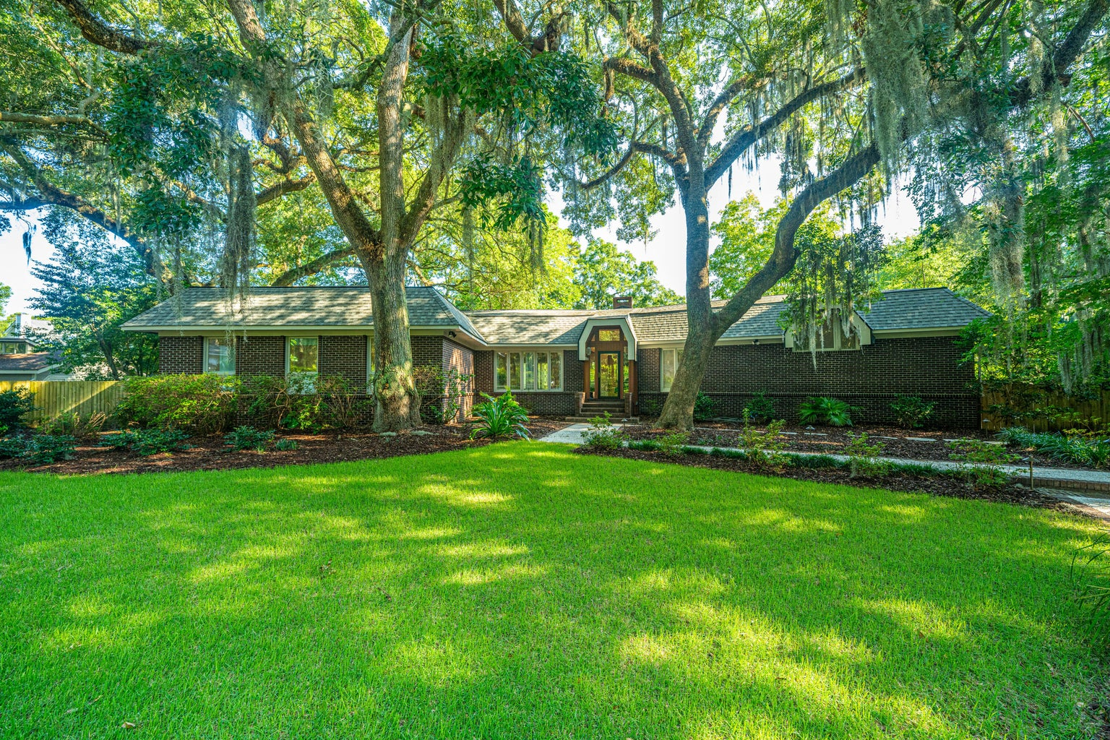
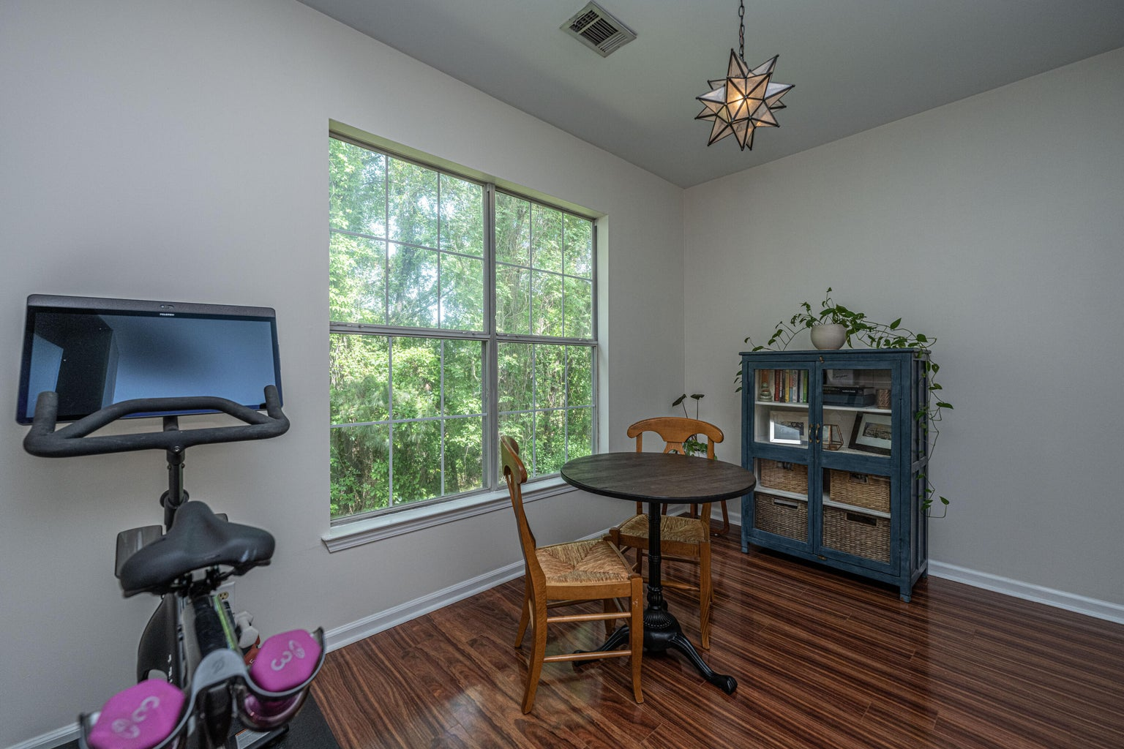
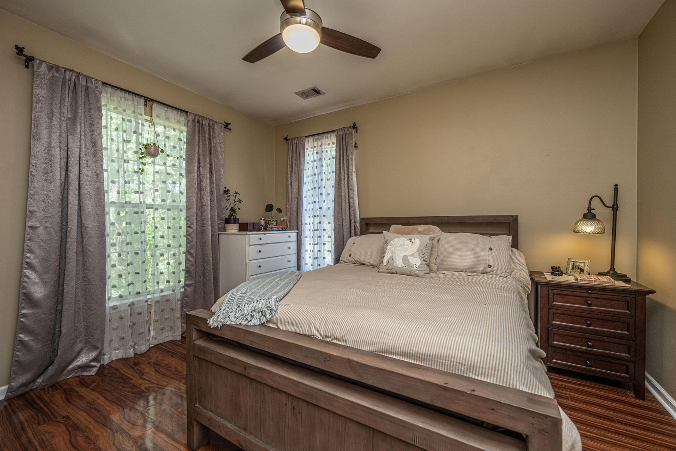
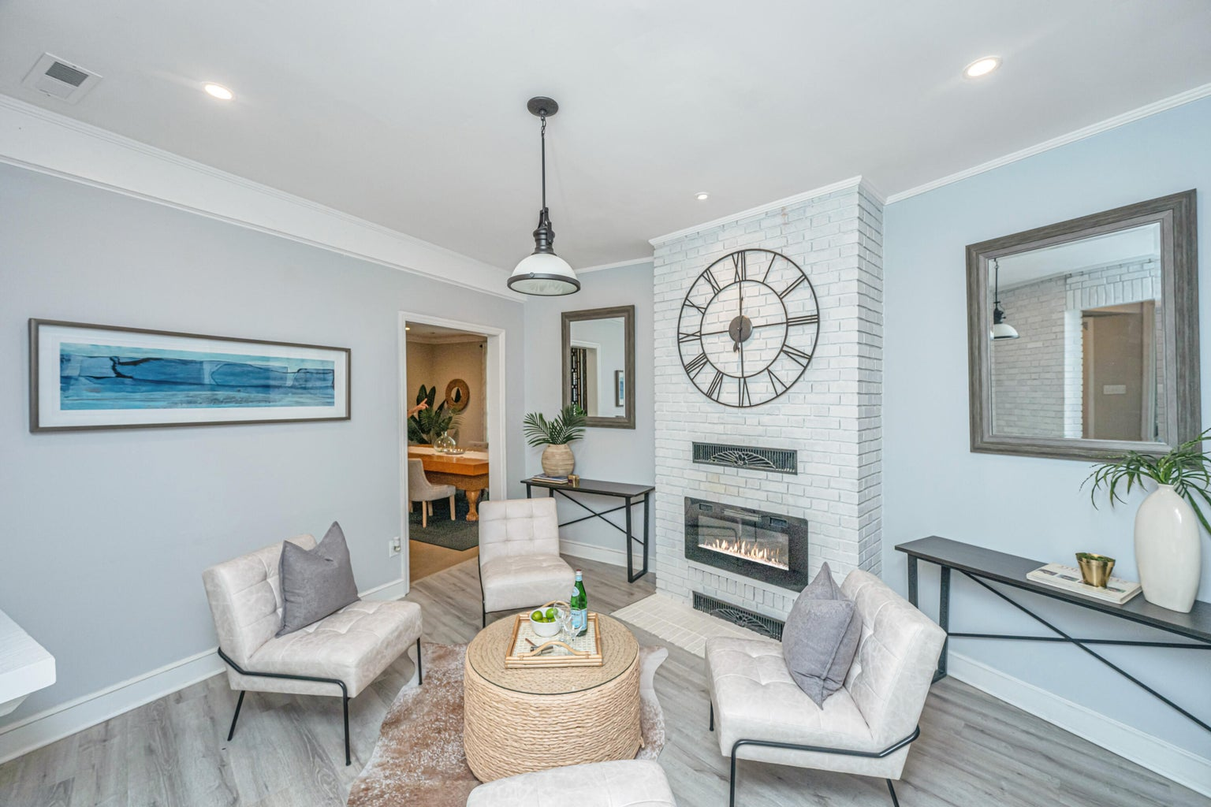
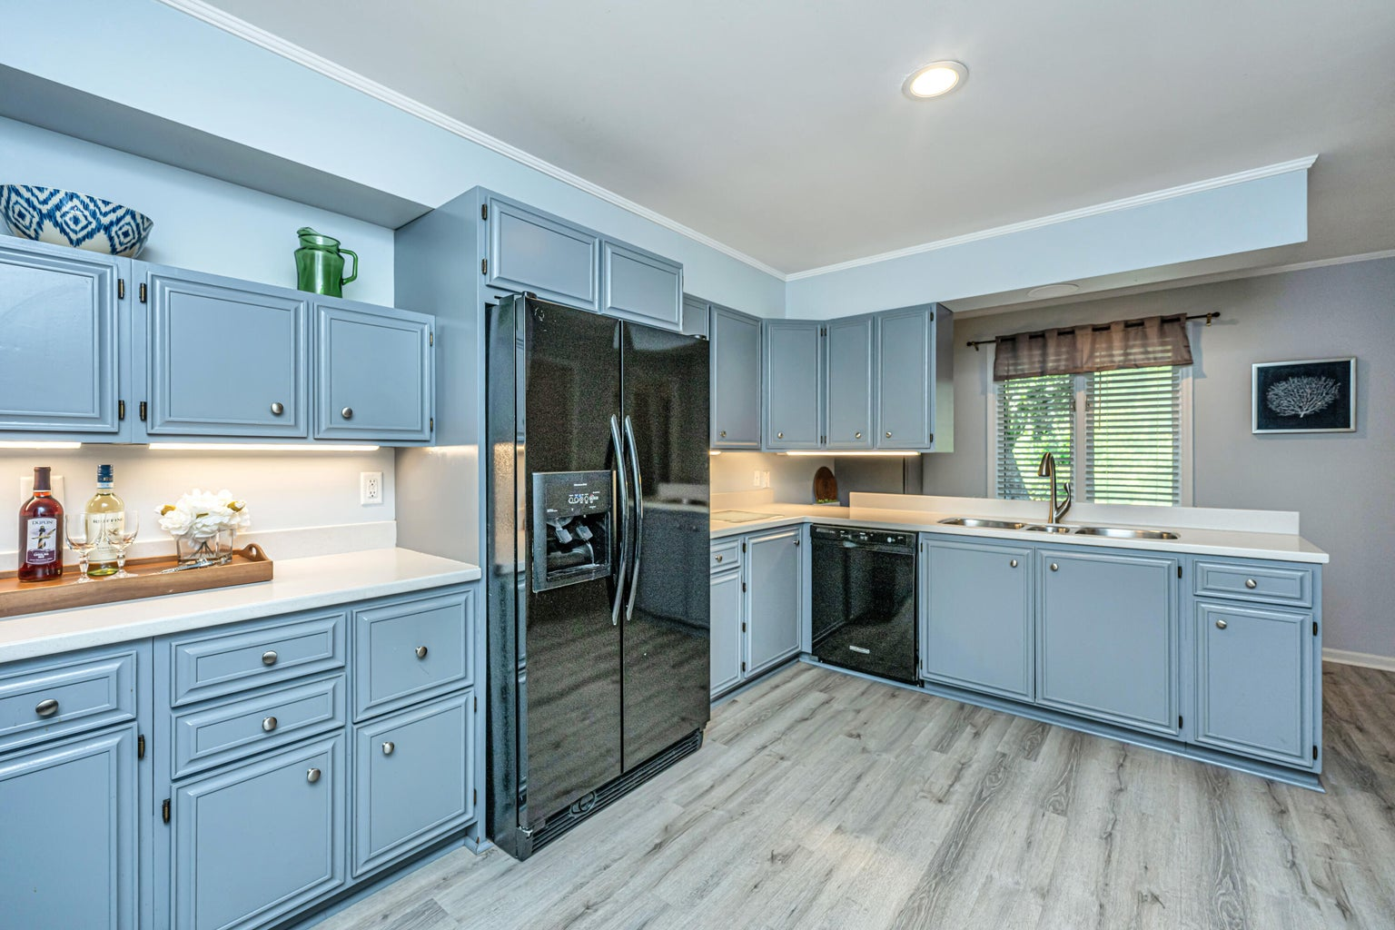
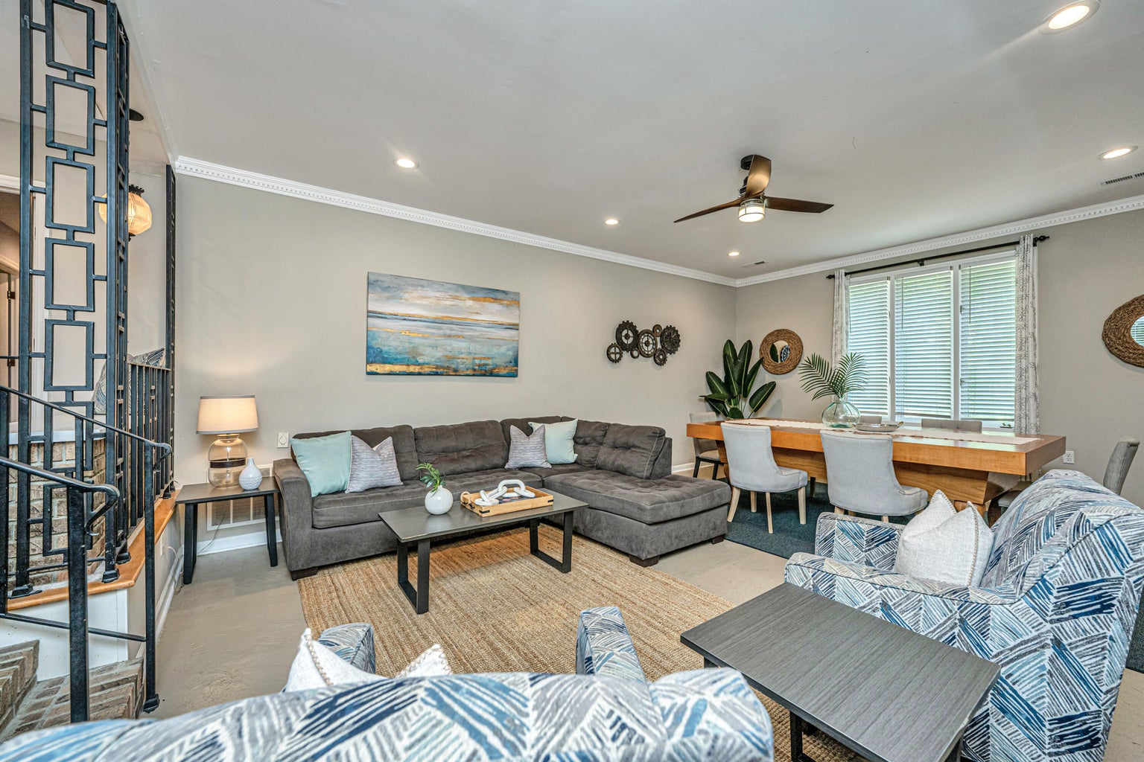
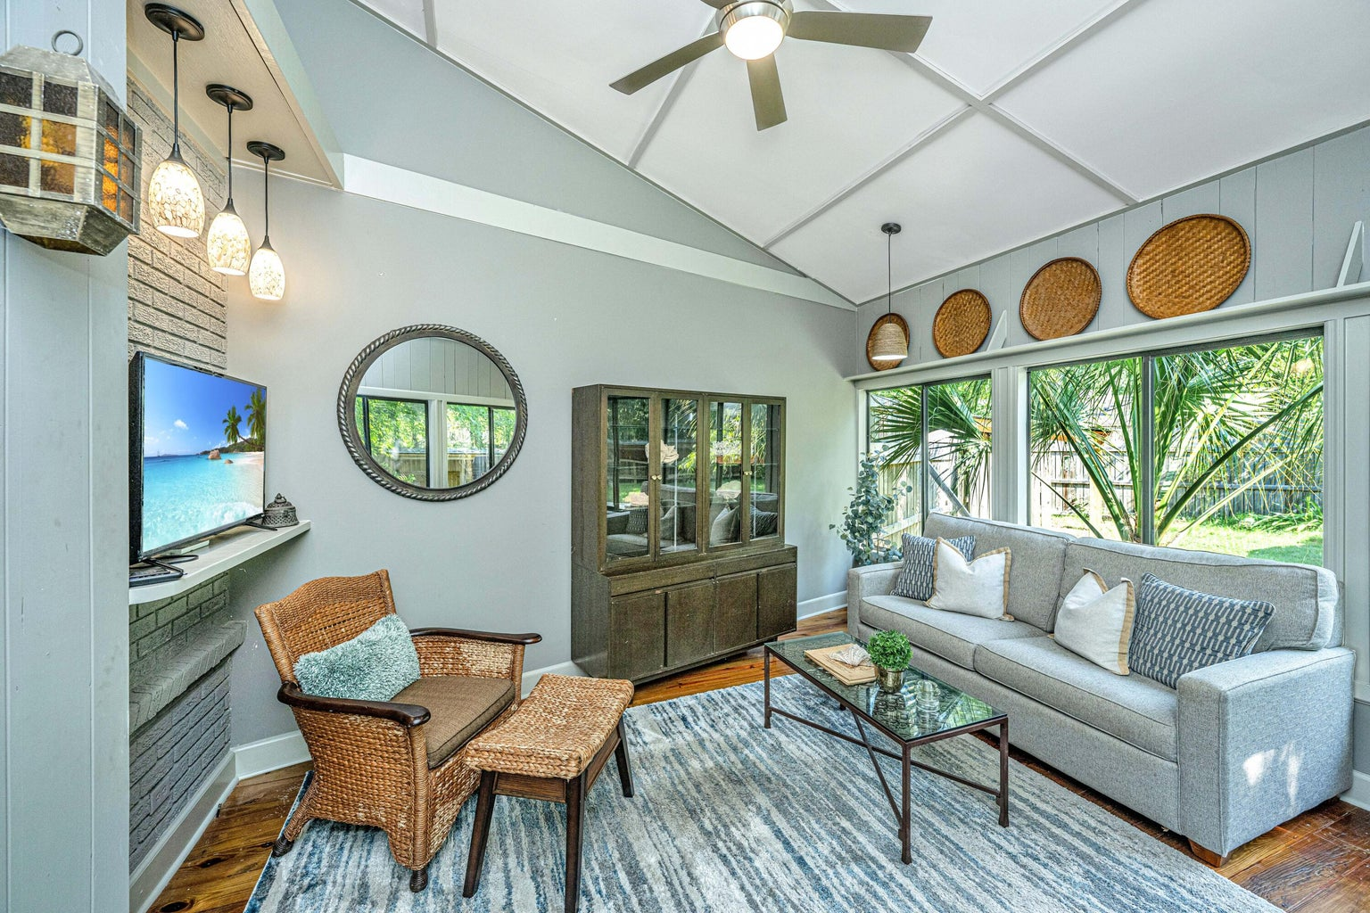



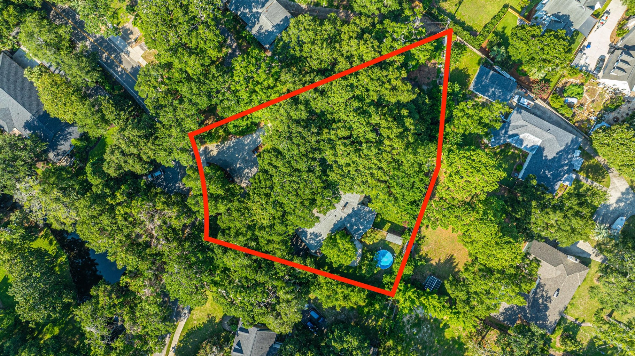
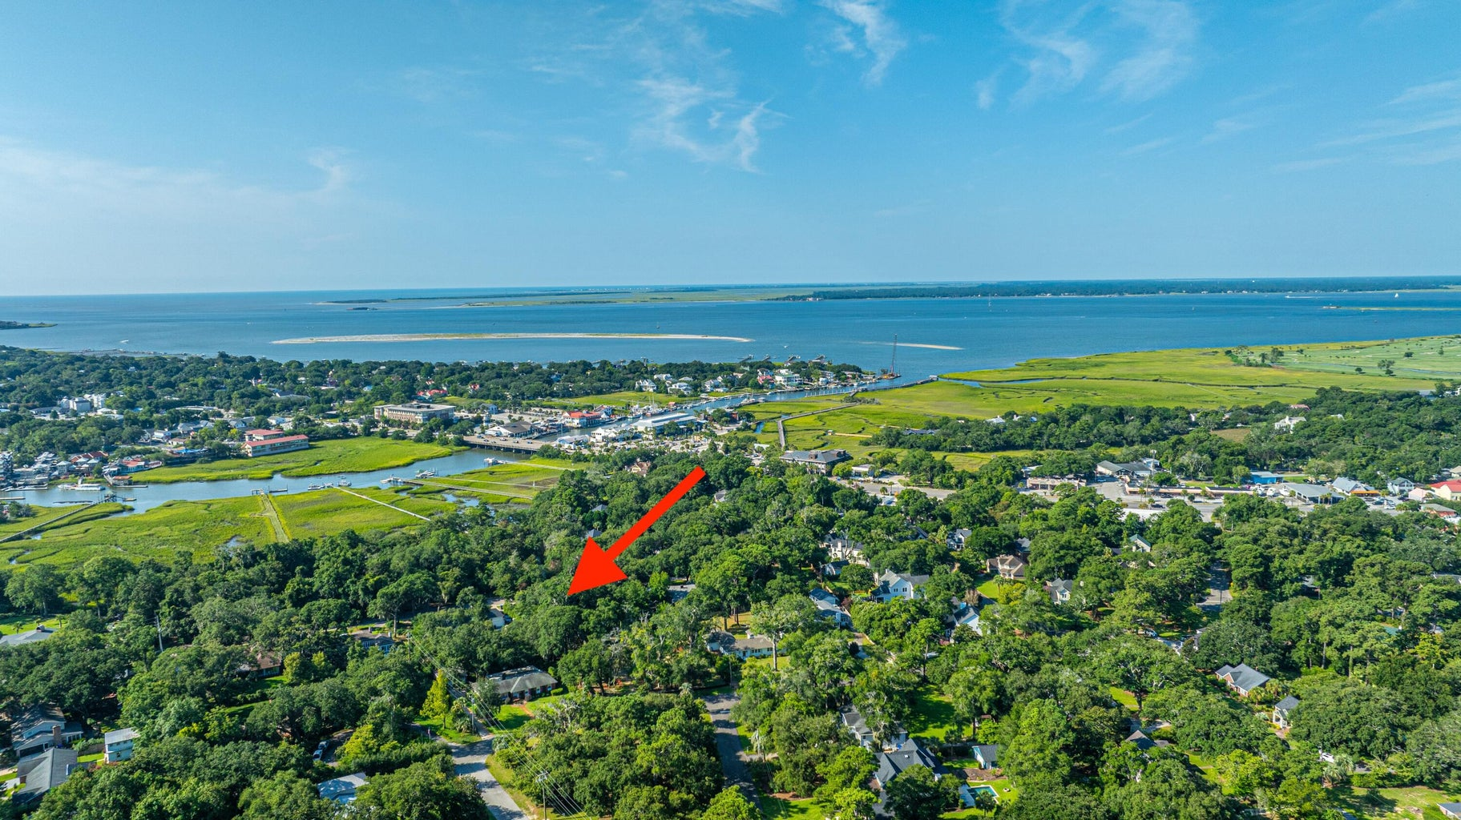


Open House Luncheon, Wednesday, August 14th 11-1
Come for Lunch & $100 to Swig & Swine!
521 Pelzer Drive
Millwood/Cooper Estates | Mount Pleasant, SC 29464 | MLS# 24019772 | $2,400,000
This one-of-a-kind gem on .82 ac in the heart of Mt. Pleasant is about a 5-minute walk to the Shem Creek Bridge! Graced w/live oaks, the circular drive & overflow parking is very accommodating. Charming sunken sitting area w/electric fireplace is past flagstone entry. To the right is a large kitchen w/generous storage & workspace. A breakfast bar overlooking the backyard is past the kitchen. Step down into a handsome game room wired for an electric fireplace. A relaxing sunroom overlooks the back deck & spacious backyard. A small bath is near the backdoor & garage entry, perfect for clean-up. The FROG measures approx. 514sqft & is included in the square footage. It's currently used as a 4th bedroom w/its own bath & could be dual master, guest space, etc. The main living area is to the left of the entry & runs nearly the depth of the home; perfect for large gatherings! A beautiful 2nd sunroom is tucked away & looks over a smaller, private portion of the yard. The primary bedroom is spacious with a walk-in closet & separate flex space: a sitting area, office, nursery, etc. Attached bath has a step-down tub/shower & separate vanity. 2 large secondary bedrooms have access to a hall bath & have walk-in closets, vanities & comfortably accommodate 2 full size beds. Laundry is conveniently located near bedrooms. The backyard is spacious with a lean-to & built in storage. The septic tank & drain field (installed approx. 2020) are in front, so an inground pool is a possibility. Endless potential!
Bring your business card for a drawing to Swig & Swine!
Click here to see more of this home!
4
3
1,844
Dianne Broom ABR, CRS, SRES
843-343-6207 | dbroom@carolinaone.com www.diannebroom.com
Carolina One Real Estate | 2713 Hwy. 17, North | Mt. Pleasant, SC 29466

