Slide 1
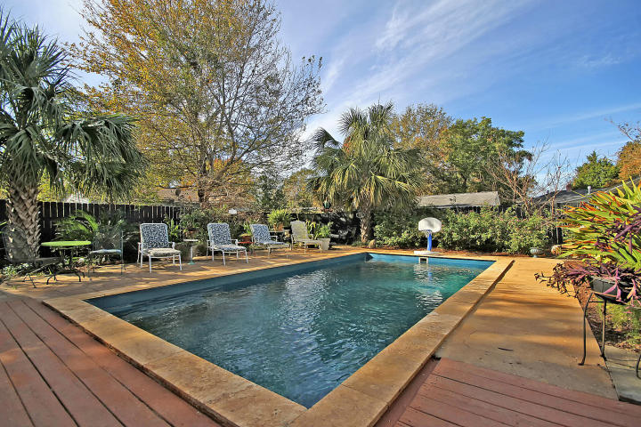
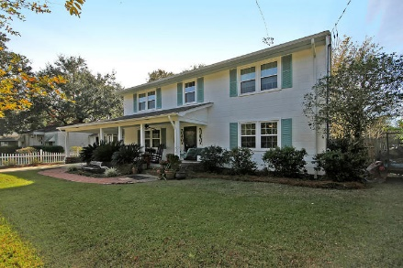
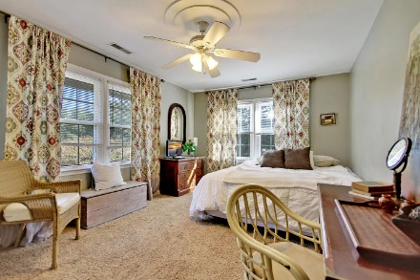
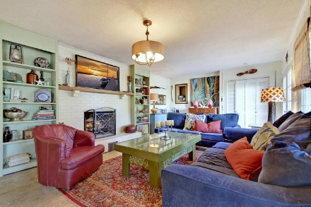
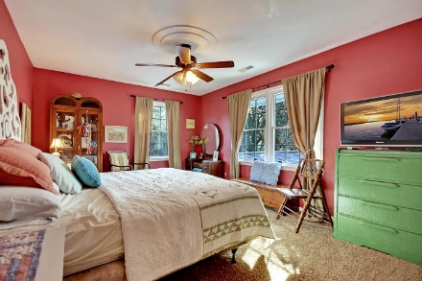
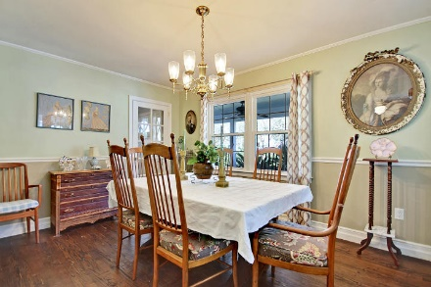
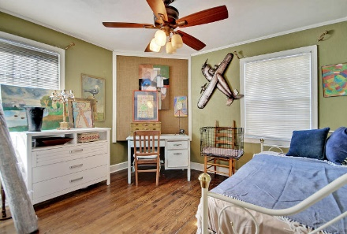
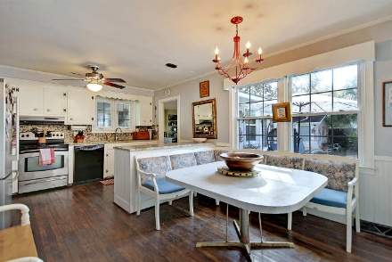
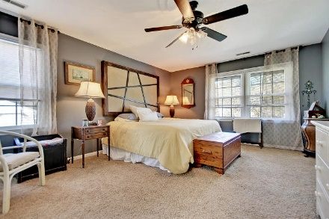
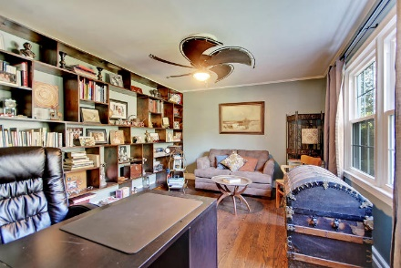
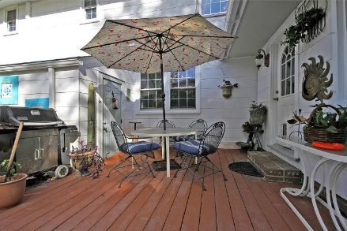

Price Reduced
For Quick Sale
5225 Parkside Drive
Park Circle ~ North Charleston ~ MLS# 17031373 ~ $382,000
Come home everyday to your very own Park Circle paradise with this custom home and its backyard oasis. Travertine tile and tropical palm trees surround the sparkling, salt water pool. A patio area and fire pit help complete this relaxing haven that you can enjoy with family and friends for years to come.
Inside the home are many features which include the beautiful granite kitchen with the picture window in the eat-in area, the built-in china cabinet in the dining room, the wall of built-ins in the living room and the amazing den with fireplace and wet bar.
The spacious front porch is another great spot to enjoy the outdoors! The deep driveway and car port leaves plenty of room for off street parking. Enjoy the sights, sounds and tasty food found at close by Park Circle.
Additional features include:
HVAC and roof less than 5 years old
New windows
New electric
Book your showing soon!
Katie Wishneff kwishneff@mattoneillteam.com 843-870-8784

