Slide 1

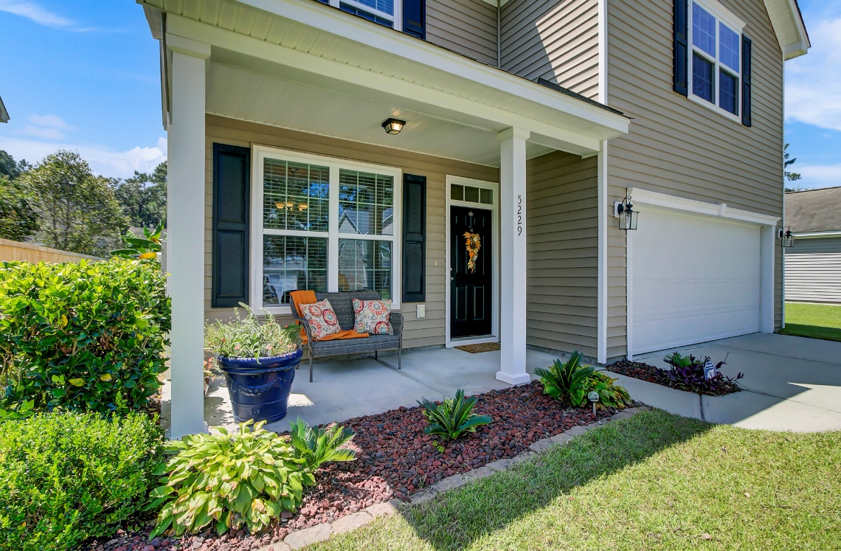
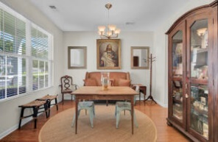
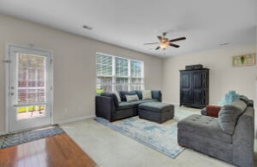
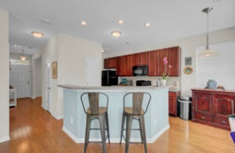
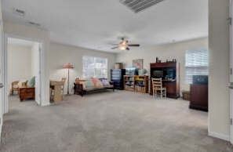
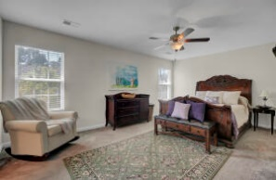
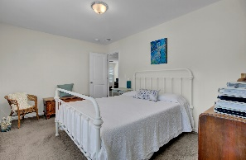
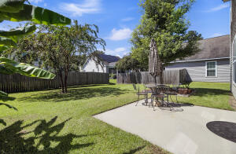
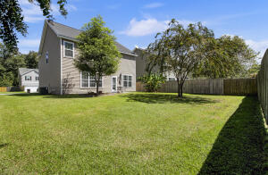

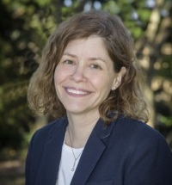
5K Buyer Interest Rate Buy Down, Under 400K
Price Reduced
5229 Fallow Fawns Road
Less than 10 min from West Ashley
MLS# 22024261 | $394,900
Like New, spacious home & original owner! Downstairs is a large welcoming living area & kitchen with tons of oversized cabinets & Beautiful Hardwoods & Brand New Custom Tile. Upstairs is a massive family/office/work combo space w/large closet, per original build options can be converted to a fourth bedroom! Huge master bedroom w/large en-suite & double vanity, large walk-in closet & second closet! Lots of extra closet space throughout home! Largest backyard in the community, 2 Car Garage & Central Vac! Love golf? Stono Ferry is directly across 162! LLC Charter (K-12) is 5 minutes away & central to Downtown & Kiawah & Edisto Beach, less than 10 minutes from West Ashley/526. If Buyer uses preferred lender, SELLER WILL PAY $5k TOWARD INTEREST RATE BUY DOWN, this could reduce interest rate by 1/2% or more saving a potential $125+ a month in payments per Lender, Call Jamie Minster w/CMG Financial 843-302-6271 or jminster@cmgfi.com for more information.
Leslie Tester
(843) 901-1971
leslietester.realestate@gmail.com
Charleston First Real Estate, Inc | 1922 Capri Dr | Charleston, SC 29407

