Slide 1

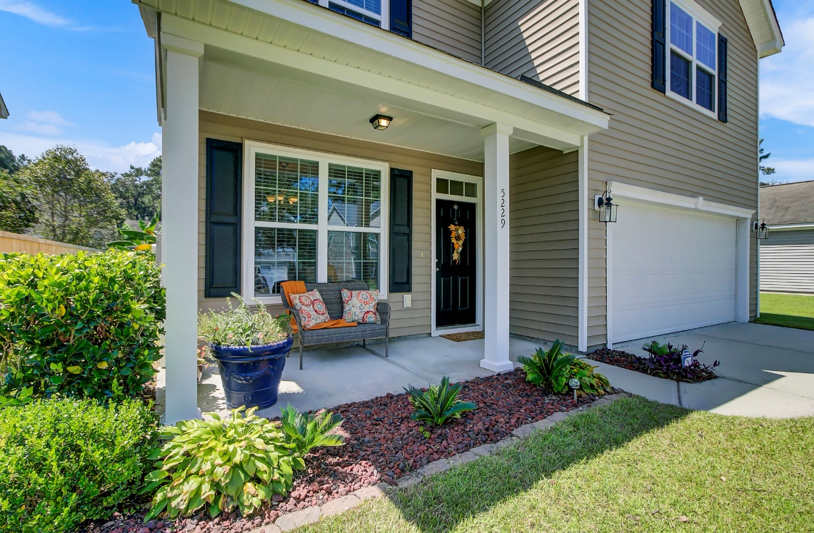
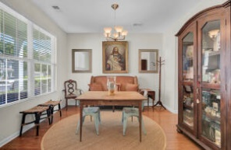
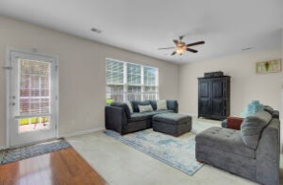
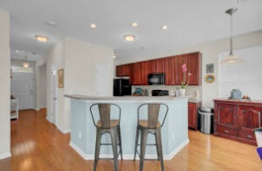
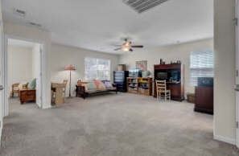
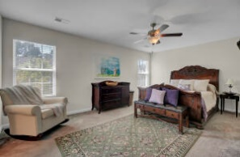
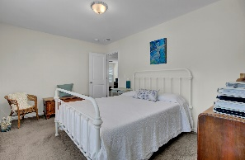
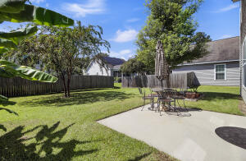
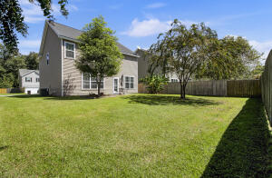

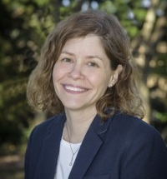
Buyer's Agent Commission 3.5%
Price Reduced
5229 Fallow Fawns Road
Less than 10 Minutes from W Ashley
MLS# 22025543 | $364,900
Like New, spacious home & original owner! Downstairs you will find a large welcoming living area & kitchen with tons of oversized cabinets & Beautiful Hardwoods & Brand New Custom Tile. Upstairs is a massive family/office/work combo space with large closet, per original build options can be converted to a 4th bedroom! Huge master bedroom with large en-suite & double vanity, large walk-in closet & second closet! Lots of extra closet space throughout home! Largest backyard in the community, 2 Car Garage, custom storage & Central Vac! Love golf? Less than 10 minutes from West Ashley/526. Stono Ferry is directly across 162! LLCS (Charter, K-12) is 5 minutes away. Central to Downtown, Kiawah & Edisto Beach.
*HOME LOCATION QUALIFIES FOR 100% USDA FINANCING!
Leslie Tester
(843) 901-1971
leslietester.realestate@gmail.com
Charleston First Real Estate, Inc | 1922 Capri Dr | Charleston, SC 29407

