Slide 1
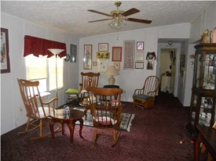
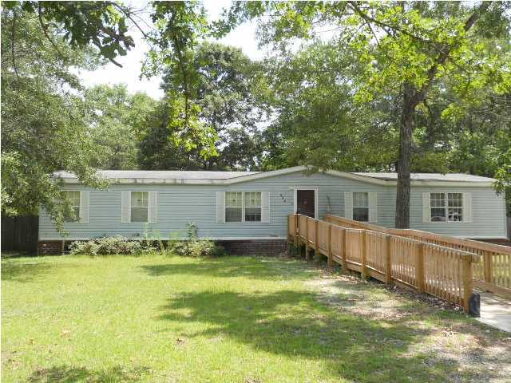
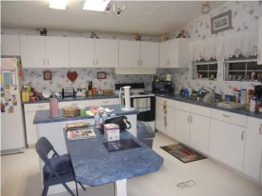
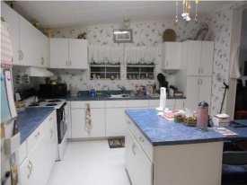
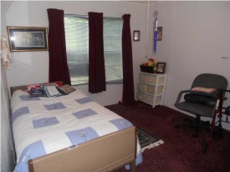
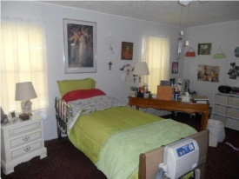
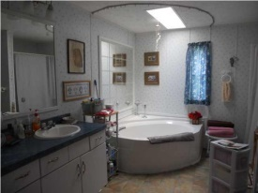

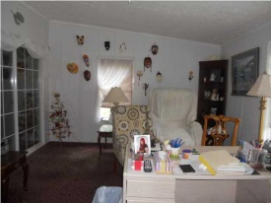

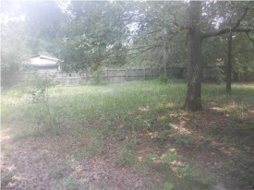
quiet country neighborhood
522 Midway Court
Crystal Shores
Moncks Corner, SC 29461
MLS# 1419997 | $89,900
3 Bed | 2 Bath
Come view this lovely, spacious double wide home on a permanent brick foundation. The kitchen is over sized showcasing plenty of cabinet space and a center island with connecting kitchen table. More than enough room for two cooks to be in this kitchen! Master bath is a focal point with separate shower and garden tub (with mirror) perfect for soaking after a hard day at the office! Additional rooms include a formal living, dining and den area with sliding glass doors. The sliding doors lead to a deck that was built by the manufactured home company but the seller had it enclosed and is currently using as a storage area. Crystal Shores is minutes away from Goose Creek, Summerville and I26. Seller is motivated and will look at all offers! Septic tank was drained May of 2014 by Knights Septic Service.
Connie White, Broker
C: 843-532-3356
conniesyouragent@gmail.com
Charleston Homes
111 Spring Hall Dr
Goose Creek, SC 29445

