Slide 1
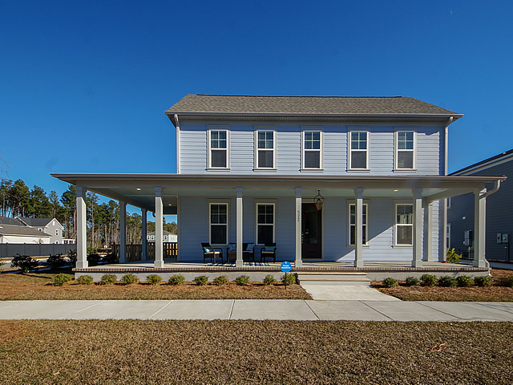
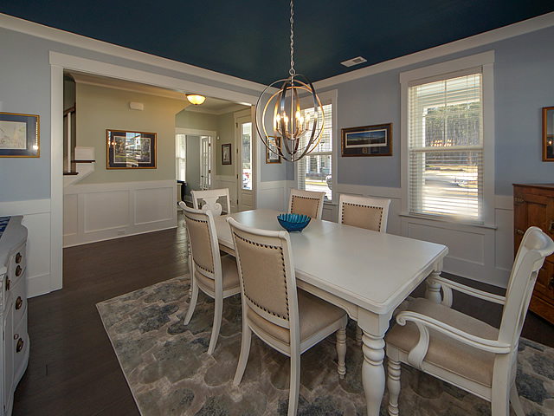
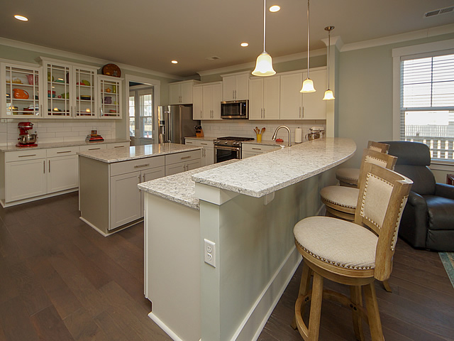
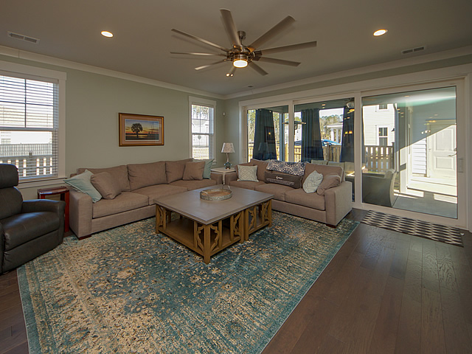
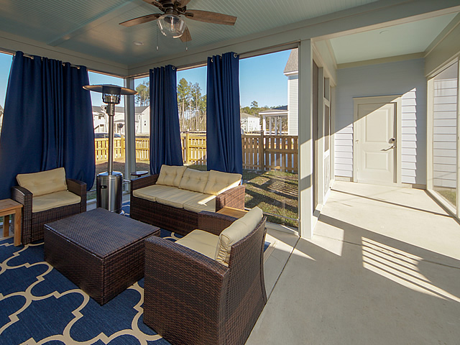
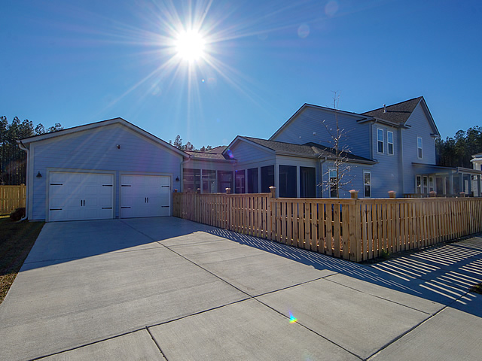


Open House
January 20th from 1 to 4pm
522 Scholar Way
Nexton | Summerville | MLS# 19001080 | $525,000
Welcome to 522 Scholar Way in Nexton, Summerville's most desirable neighborhood. This beautiful 2 story home has 4 bedrooms, 3 full and 1 half baths and a large loft. This home features everything you could want and more. Enjoy the evenings in this porch community from the beautiful wrap around porch. The first floor hosts a wonderful dining room with a beautifully painted ceiling. Adjacent to the dining room is a perfect room for home office, media room or studio. The cooks dream kitchen boasts an oversized quartz island, cabinets galore and a gorgeous tile back splash. All stainless KitchenAid appliances convey (6 months old). The quartz kitchen counter seats 3 comfortably. The large open great room is accented with a 6 ft. ceiling fan and a wall of sliders that open to the back porch, extending the room and bringing the outside in. First floor master suite is complete with spa like shower, his and her soap stone sinks and a beautiful walk in closet with California Closet organization system. The second floor, with 3 large bedrooms, 2 full bathrooms and a large loft provides more than enough space for the family or guests. Hardwoods throughout the home (except in the upstairs bedrooms) and beautiful tile round out this spectacular home. The 2-car garage with a driveway for 4 vehicles is connected via screened breezeway and screened back porch. This highly sought after corner lot provides for parking without having an alleyway behind the house. Natural gas line on back patio, tank-less water heater, ceiling fans in all rooms, soft close cabinetry throughout and a professionally painted interior are all part of this beautiful home. New construction home without the new home wait.
Milinda Sullivan
(843) 259-0739
masullivan16@gmail.com
Horne Realty, LLC PO Box 3199
Summerville, SC 29484

