Slide 1
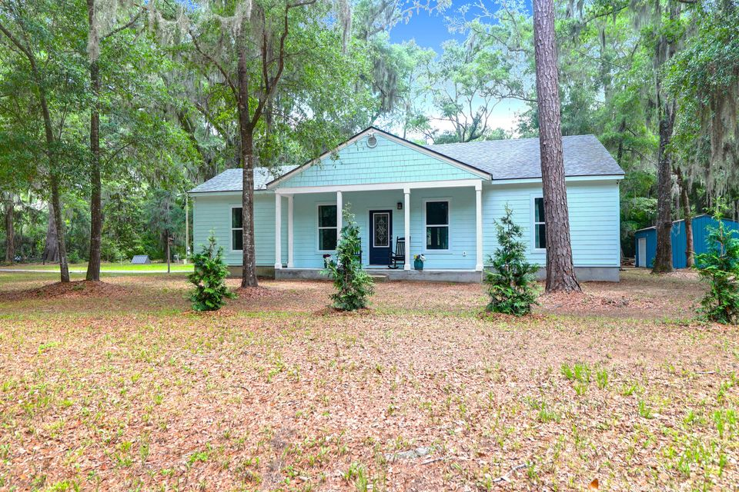
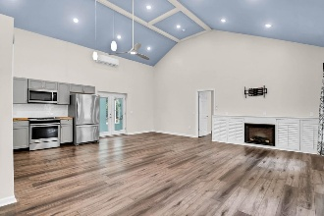
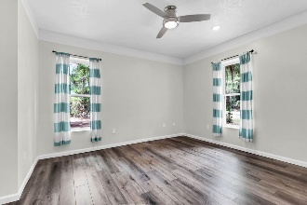
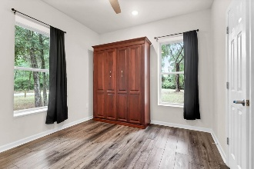
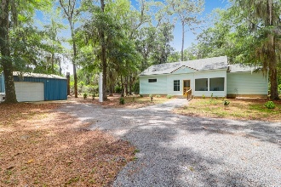
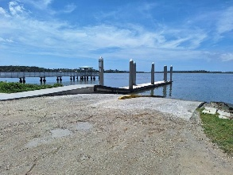


Open House Sunday 12-2PM!
5233 Maybank Highway
Pt New Cut | Wadmalaw Island, SC 29487 | MLS# 25014947 | $483,000
Situated among the towering oaks and Spanish moss of Wadmalaw Island this like new ranch home is that getaway place or primary residence you've been searching for! This 2br 2ba 1284sf ICF constructed home sits on an acre of land featuring cement plank siding and a screened in back porch. Inside you'll be greeted by an open floor plan, vaulted ceilings, and LVP flooring throughout. The kitchen is highlighted by butcher block countertops, shaker cabinets and top of the line Whirlpool appliances. The primary bedroom features 2 large walk-in closets, a double vanity, and a large walk-in tile shower. The second bedroom has a full bathroom as well! A detached garage with water & power serves as a great workspace, storage room, or place to park your rider mower. This is the perfect property for the boating enthusiast located just 10 minutes from the Cherry Point boat landing. A beautiful dual concrete boat ramp giving you direct access to the Bohicket and North Edisto River. No HOA to do deal with here, plenty of room to park the boat or RV right outside the backdoor! If country living is what you're looking for Wadmalaw Island and 5233 Maybank Hwy. is the place you want to call your new home!
John Nugent
(843) 304-2061
john.nugent@carolinaone.com
nugentknowsrealestate.com
Carolina One Real Estate | 628 Long Point Rd | Mt Pleasant, SC 29464

