Slide 1
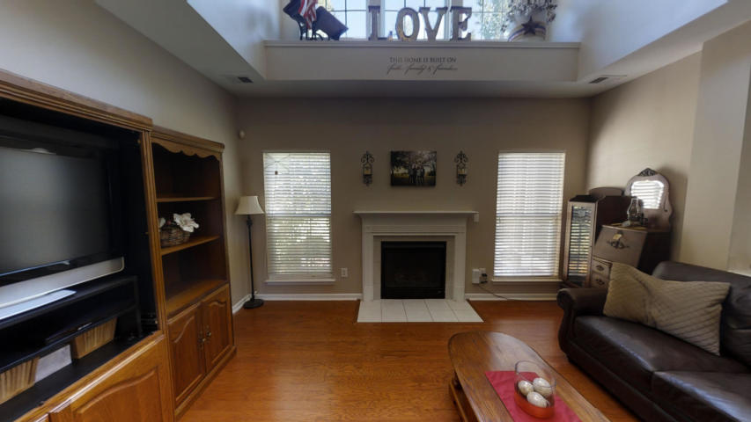
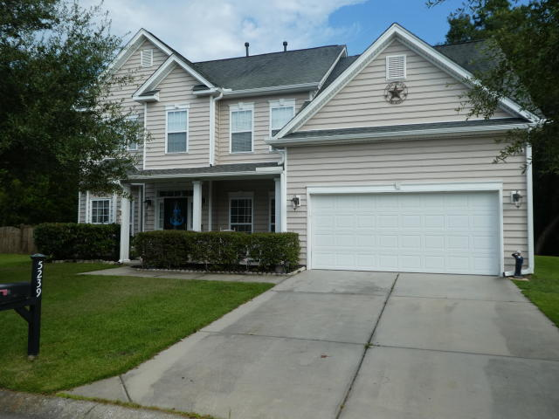
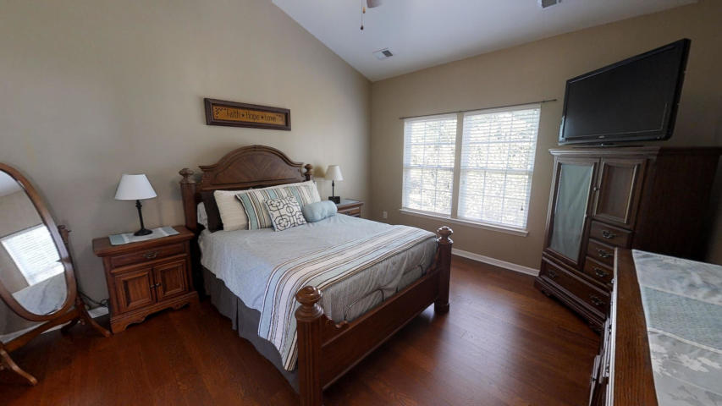
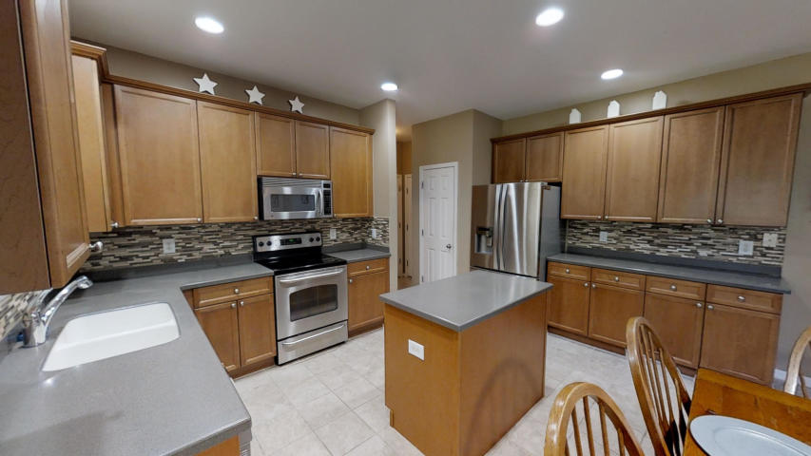
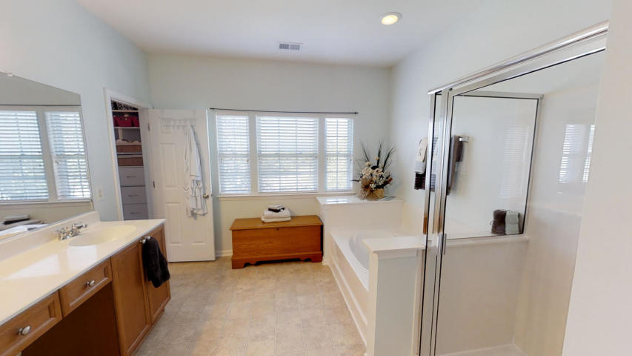
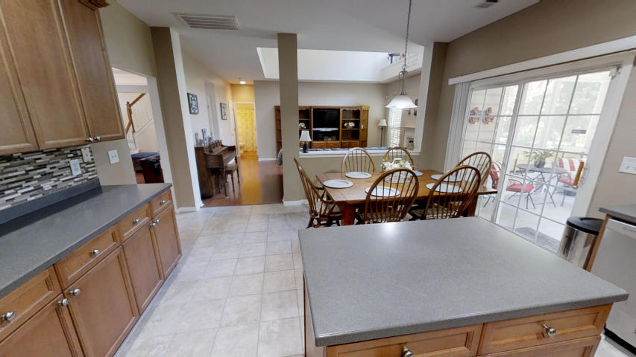
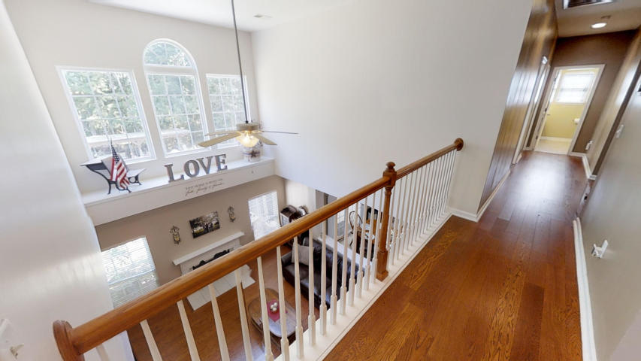
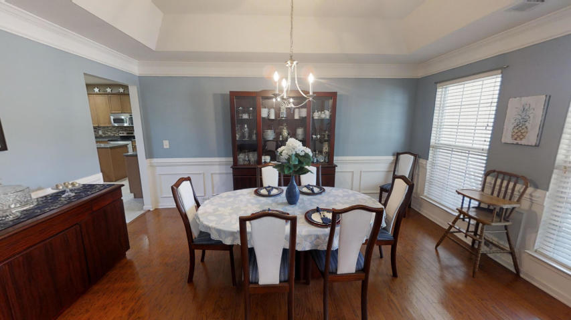
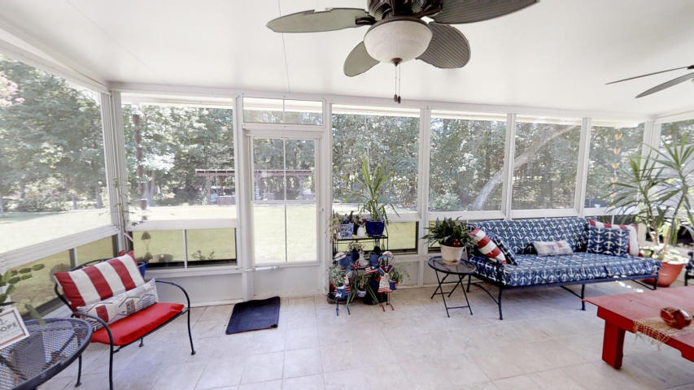
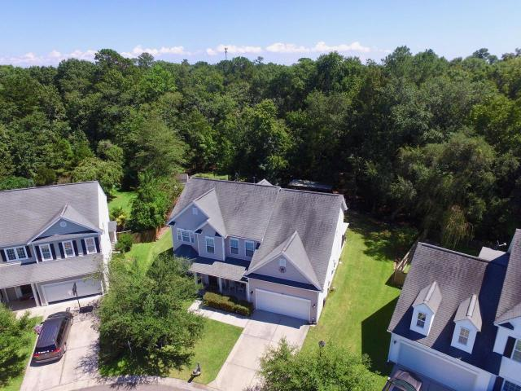
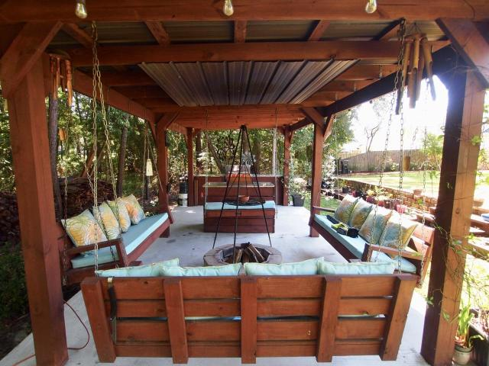
Brand New Active in Wescott Plantation
5239 Lenora Drive
Wescott Plantation
Summerville, SC 29485
MLS# 19025141
$325,000
Wonderful 2-story 5 bedroom/3 full bath home on Cul-de-Sac in Wescott with utility-saving Solar Panels! Home backs to 2nd hole on golf course, and has large (.36 acre) private, wooded backyard, with Pergola and fire pit. The Home is 3171 square feet, with beautiful hardwood floors, large formal dining room with wainscoting, and adjacent living room/office. A large two-story family room allows for lots of light, and has a gas log fireplace. The large Master bedroom is upstairs with walk-in closets, and the master bath has a garden tub and nice shower. There are three other nice-sized bedrooms upstairs and also a huge loft area now used as an NFL ''man cave.'' There is also a nice sized guest bedroom on the first floor with adjacent full bath - which is perfect for a Mother-In-Law Suite. The kitchen features solid surface counters and stainless appliances and leads to a large Sunroon/Screened Porch area for enjoying quiet evenings. Sellers have lease in place for solar panels, which have reduced Summer electric bills from $300 to about $35/month. Wescott Plantation is a wonderful subdivision with a golf course, neighborhood pools, walking trails, and close to good restaurants and shopping.
Randy Espeseth
843-743-1025 | Randy@RandyEHomes.com | Carolina Elite Real Estate

