Slide 1
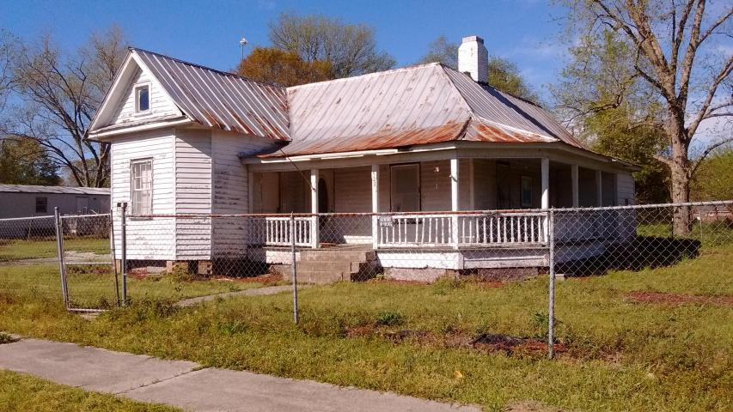
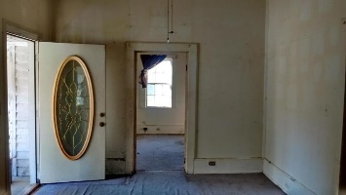
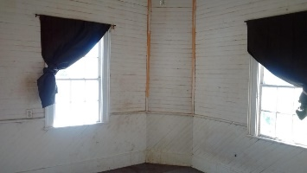
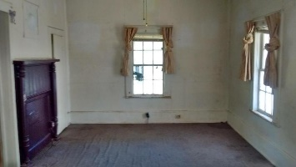
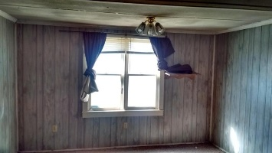
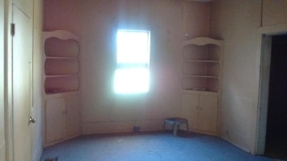
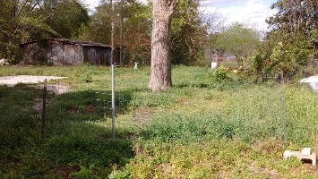
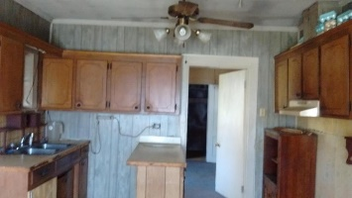
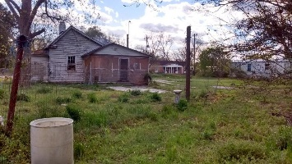
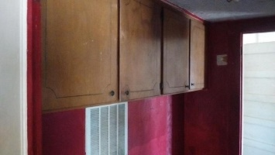
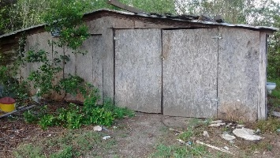



Open House TODAY from 12-2 ~ Food And Drink Provided ~
Bring Business Card To Enter Drawing For Several Gift Cards.
523 Dibble Street
Bowman, SC 29018 | MLS# 17010138 | $19,000
Experienced investor or HGTV enthusiast with handyperson skills, this might be a good project for you. According to the tax record, this is a 3 bedroom/1 bath, approximately 1228 sq ft, frame house built in 1945 on large .8 acre lot. Boarded-up fireplace (not functional) opens in living room and adjacent room sharing wall. Currently the house does not have a stove or heating/cooling system (there are vents in the floor and may have ductwork under house). Being sold as is-seller will make no repairs. Tax record states public water and sewer. Bowman is a rural community (has grocery store, gas station, few other small businesses). Orangeburg, the closest large town, is approximately 15 miles and St. George, a small town, is approx. 20 miles, I-26 and I-95 within 6 miles. With creativity and work this could be a very attractive, unique home. Buyer to verify schools, etc.
Linda Spell Ashley
REALTOR
(843) 991-5745
linda.ashley@agentownedrealty.com
AgentOwned Realty Co. Premier Group, Inc. | 141 A N. Main Street | Summerville, SC 29483

