Slide 1
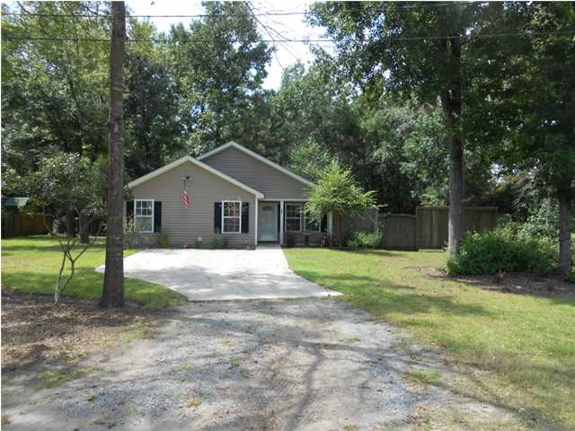
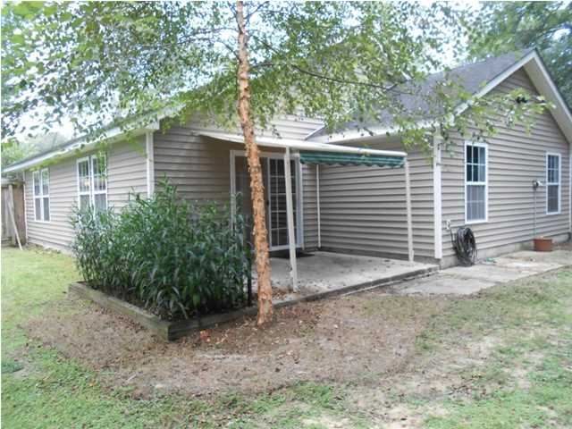
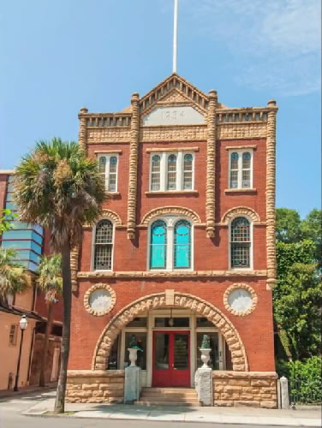
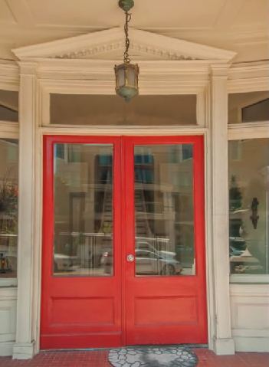
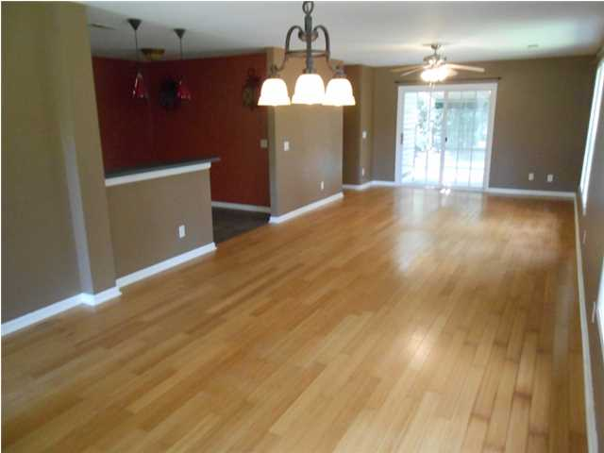
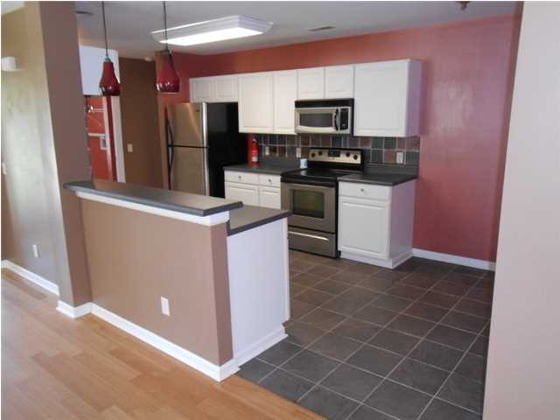
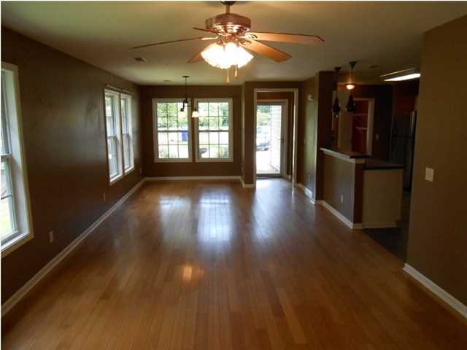
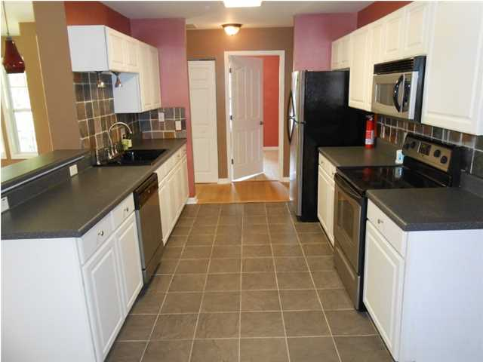
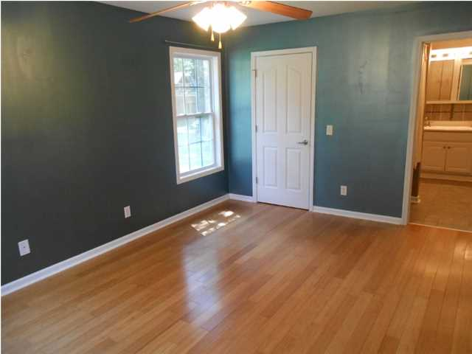
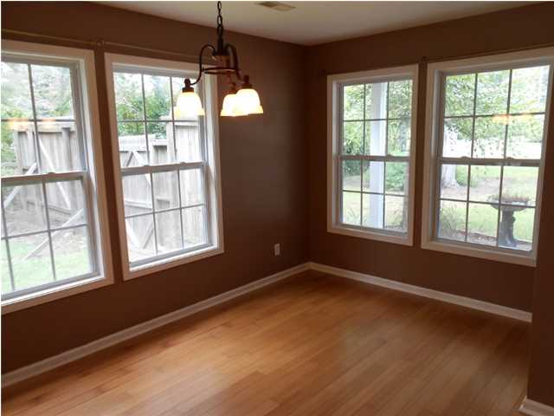
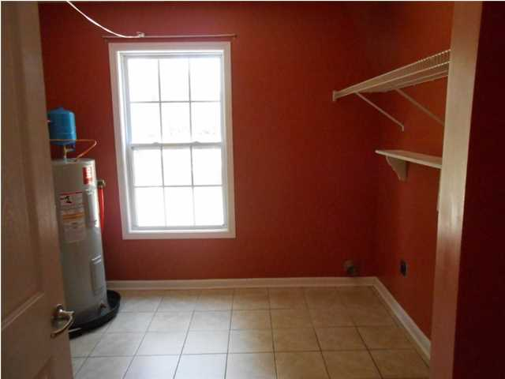
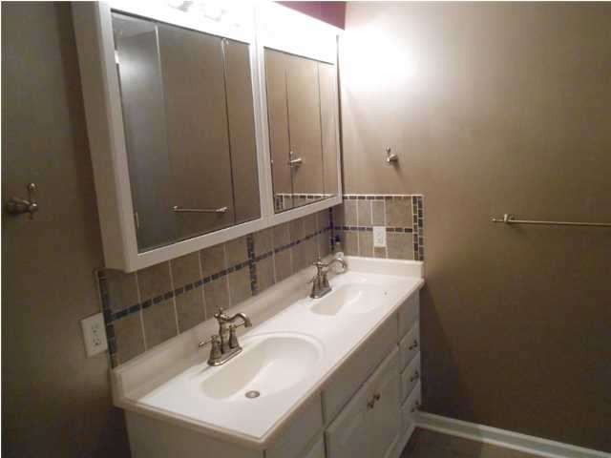
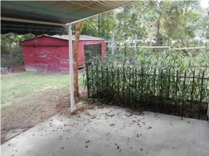
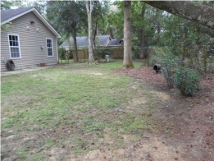
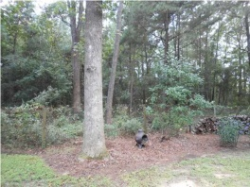
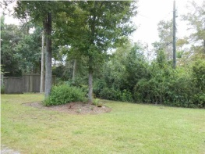
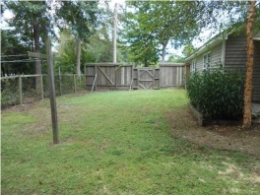

Waterfront with Dock on Tidal Creek
Reduced by $52,000!
5247 Ravencrest Dr
Hollywood, SC
MLS# 1424917
$169,000
One level house on private .37 acre lot that backs up to private horse farm. Only half hour drive to downtown Charleston and the beaches. This house has beautiful hard wood floors through out with the exception of the laundry room, kitchen and bathrooms which all have ceramic tile. This is a nice open floor plan with a bar top where you can sit and converse with the chef while cooking dinner. The large kitchen has stainless steel appliances, wood cabinets and a tile back splash. The master bedroom is a good size with plenty of windows to let the light shine through. The master bath has dual vanities and custom tile back splash in the shower and behind the sink. The other 3 bedrooms are set at the back of the house away from the master. A well appointed full bath is accessible through hallway leading to the bedrooms. This home is tastefully painted and low maintenance. There is a huge back and side yard which are fenced in. There is a fire pit in the back yard as well. There is also a storage shed in the back yard. Don't miss awesome house in a quiet private setting. This house is only a stones throw from the new charter school in Hollywood.
Rob Sturm
M 843-478-2404
rsturm@century21properties.com
Bud Poston
M 843-697-3786
bposton@century21properties.com
Century 21 Properties Plus | 3301 Salterbeck St Suite 100 | Mt. Pleasant, SC 29466

