Slide 1
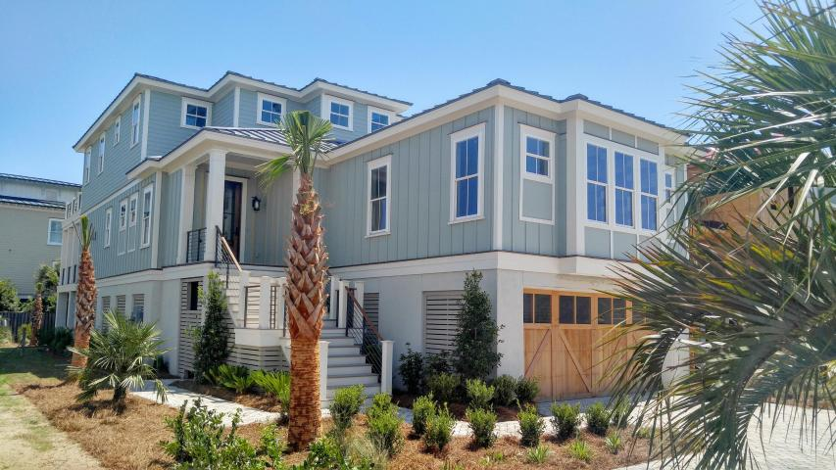
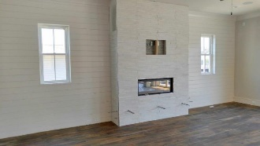
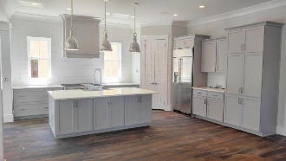
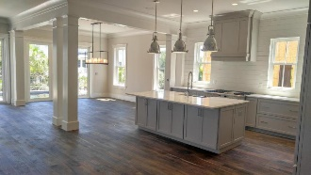
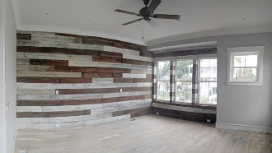
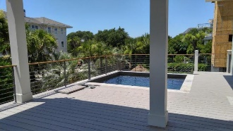


524 Carolina Boulevard Isle of Palms :: MLS# 16015382 :: $2,155,000
New Construction on the Isle of Palms
Welcome to the Surf Shack, a newly constructed home located just steps from the beach! Home features gourmet kitchen with 48'' gas range, custom cabinetry & large center island. Master Suite on main level has 3 walk in closets and modern, spa bath.
Main living features a wall of windows which leads to cabana and elevated pool. 3 Stop Elevator. Oak floors throughout. Home Audio in Kitchen, Dining, Cabana and Master, perfect for the entertainer. Maintenance free AZEK decking. Radiant Barrier Roof Sheathing, tankless hot water heater and Low E windows add to energy efficiency. Impact Glass rated Windows & Doors.
Putting Green on ground floor! Privacy fence & Outdoor Shower to use on the way back from the beach! Steps from beach access and convenient to nearby shopping and dining.
Clay Cunningham
O (843) 886-8110
M (843) 345-4647
clay@carolinaone.com
www.claysre.com
Carolina One Real Estate
1503 Palm Blvd Ste
Isle of Palms, SC 29451

