Slide 1
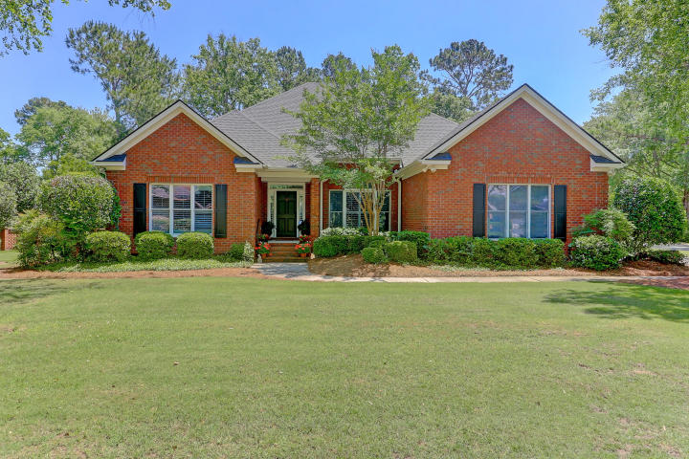
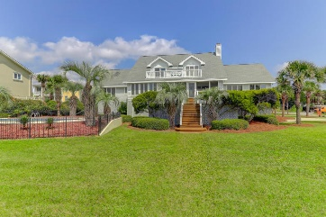
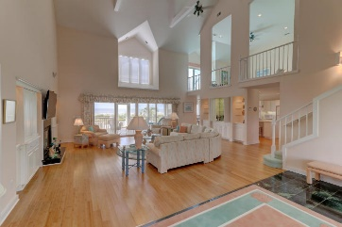
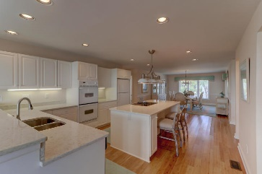
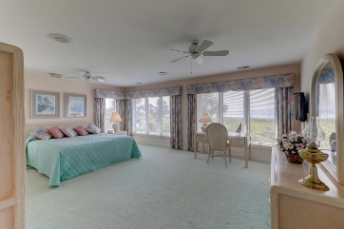
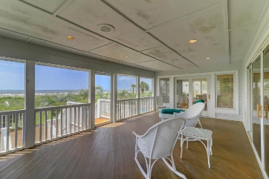
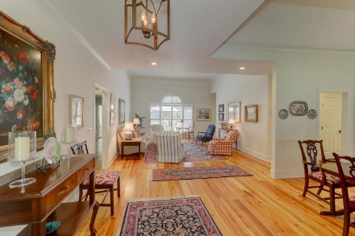
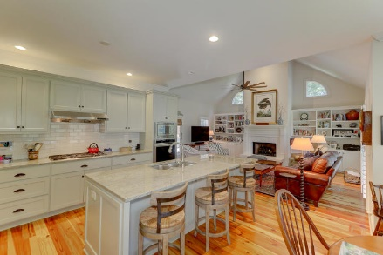
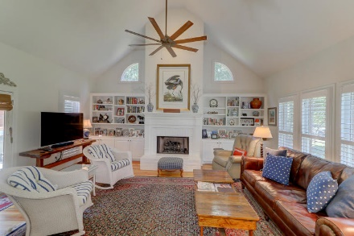
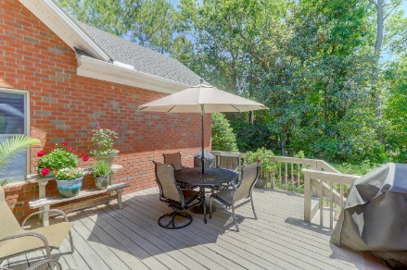


524 Rice Planters Drive
Rice Planters Pointe | Mount Pleasant, SC 29464 | MLS# 19013663 | $715,000
Just Listed...Gorgeous Brick Ranch...Tons of Upgrades
New Price
Rice Planters Pointe is tucked away off Longpoint Rd with golf cart access to Snee Farm golf and clubhouse. Bordered by Charles Pinckney home, Boone Hall. This stunning completely renovated Brick Ranch situated on a corner lot offers spectacular upgrades and gorgeous additions such as beautiful heart pine floors, crown molding, plantation shutters, a completely renovated kitchen with new cabinets, granite counters and appliances and new lighting throughout. The Open plan of this home is perfect for entertaining. The extensive landscaping that surrounds this home shows off the gorgeous green space and is filled with privacy. This meticulously cared for home will please even the most particular home buyer.
Darlene Smith
Office - (843) 886-8110
Mobile - (843) 696-7824
darlenesmith@carolinaone.com
DarleneSmithTeam.com
Carolina One Real Estate
1503 Palm Blvd Ste
Isle of Palms, SC 29451

