Slide 1
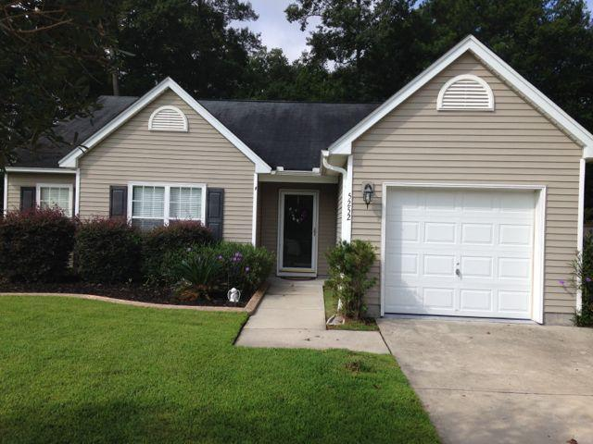
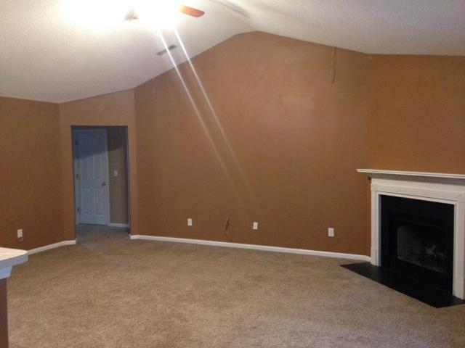
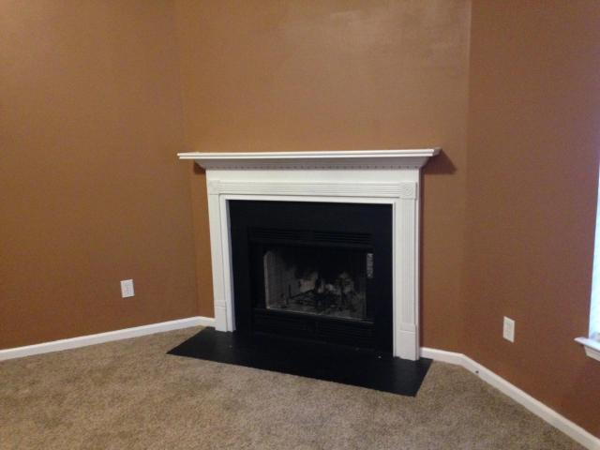
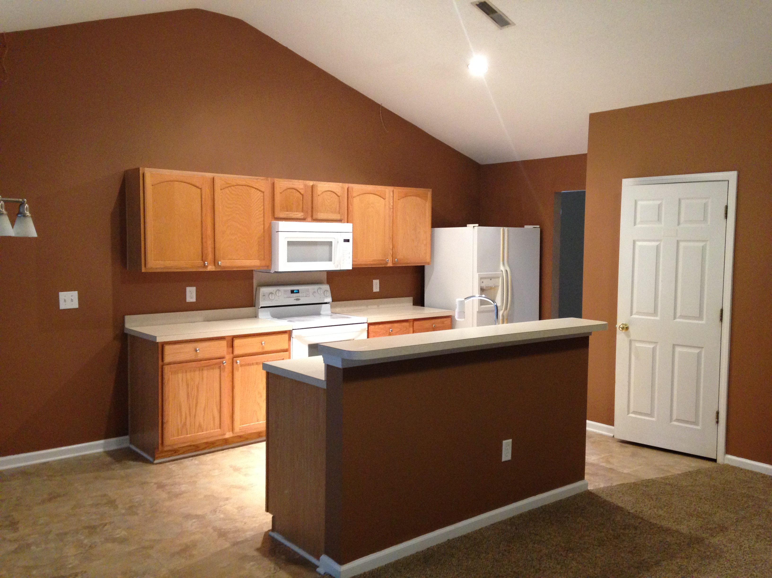
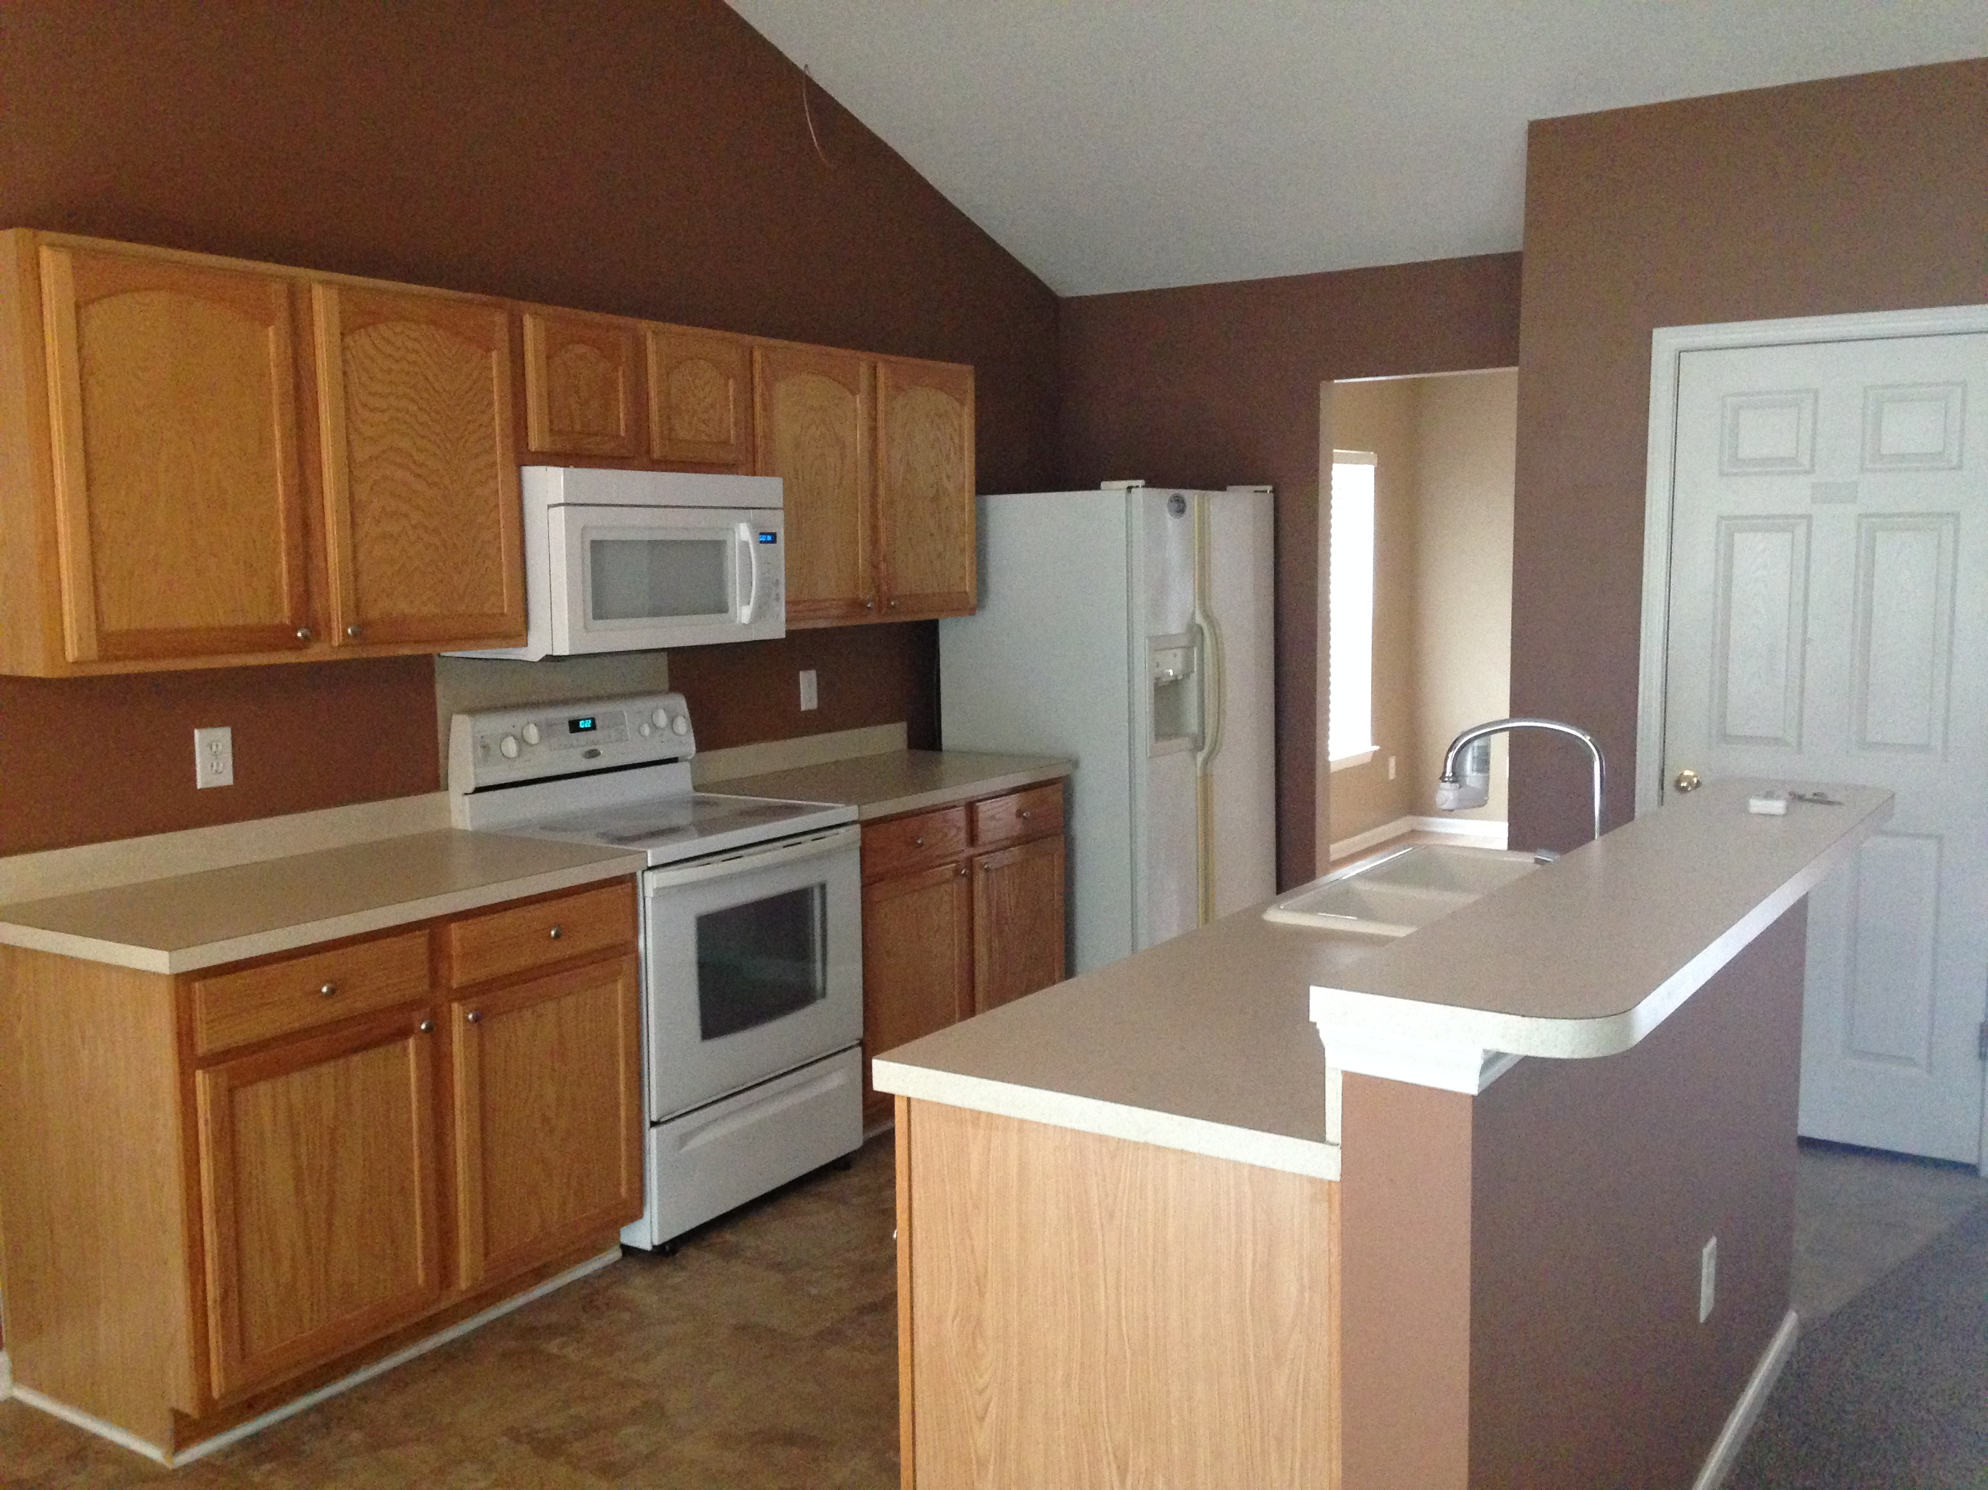
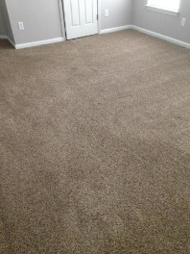
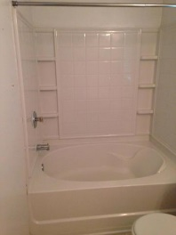
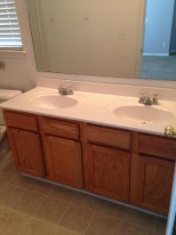
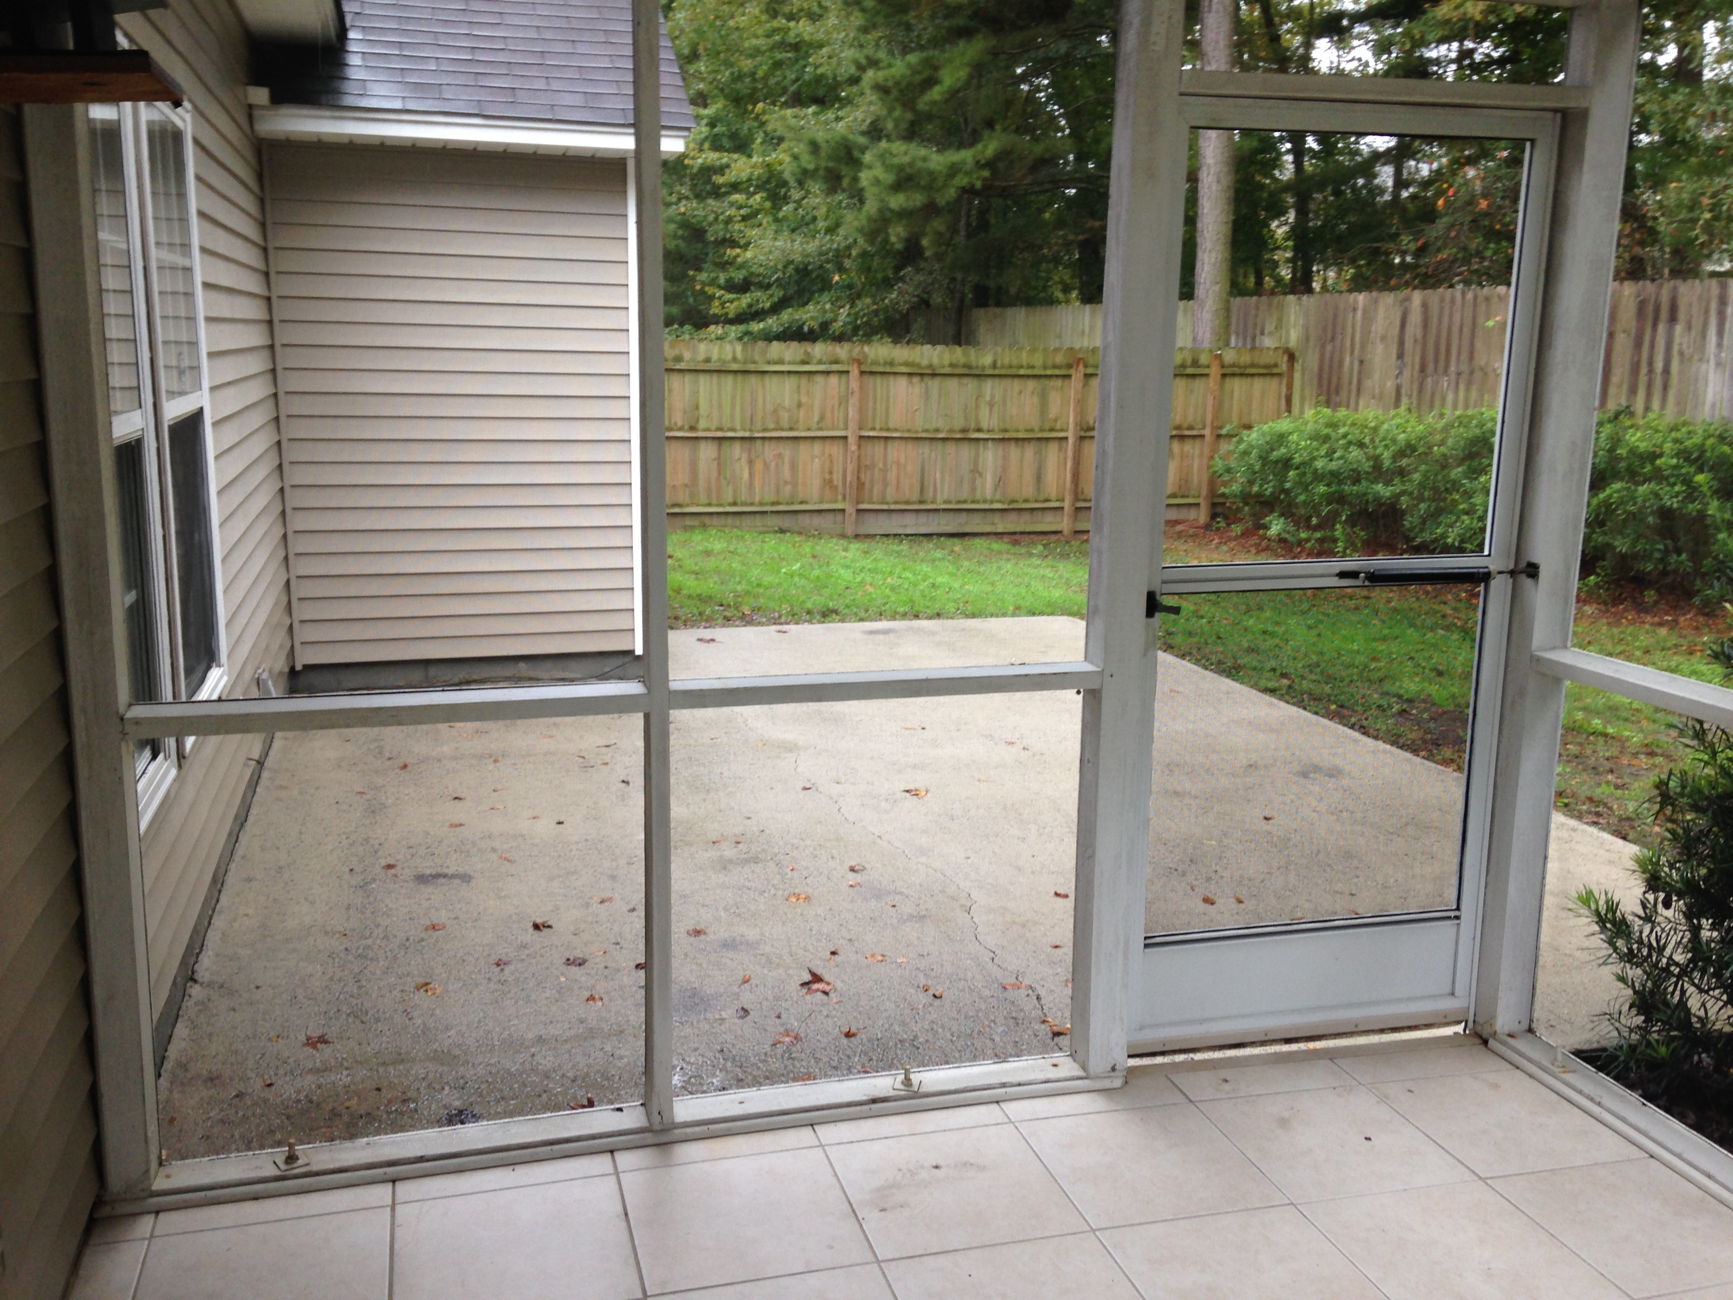
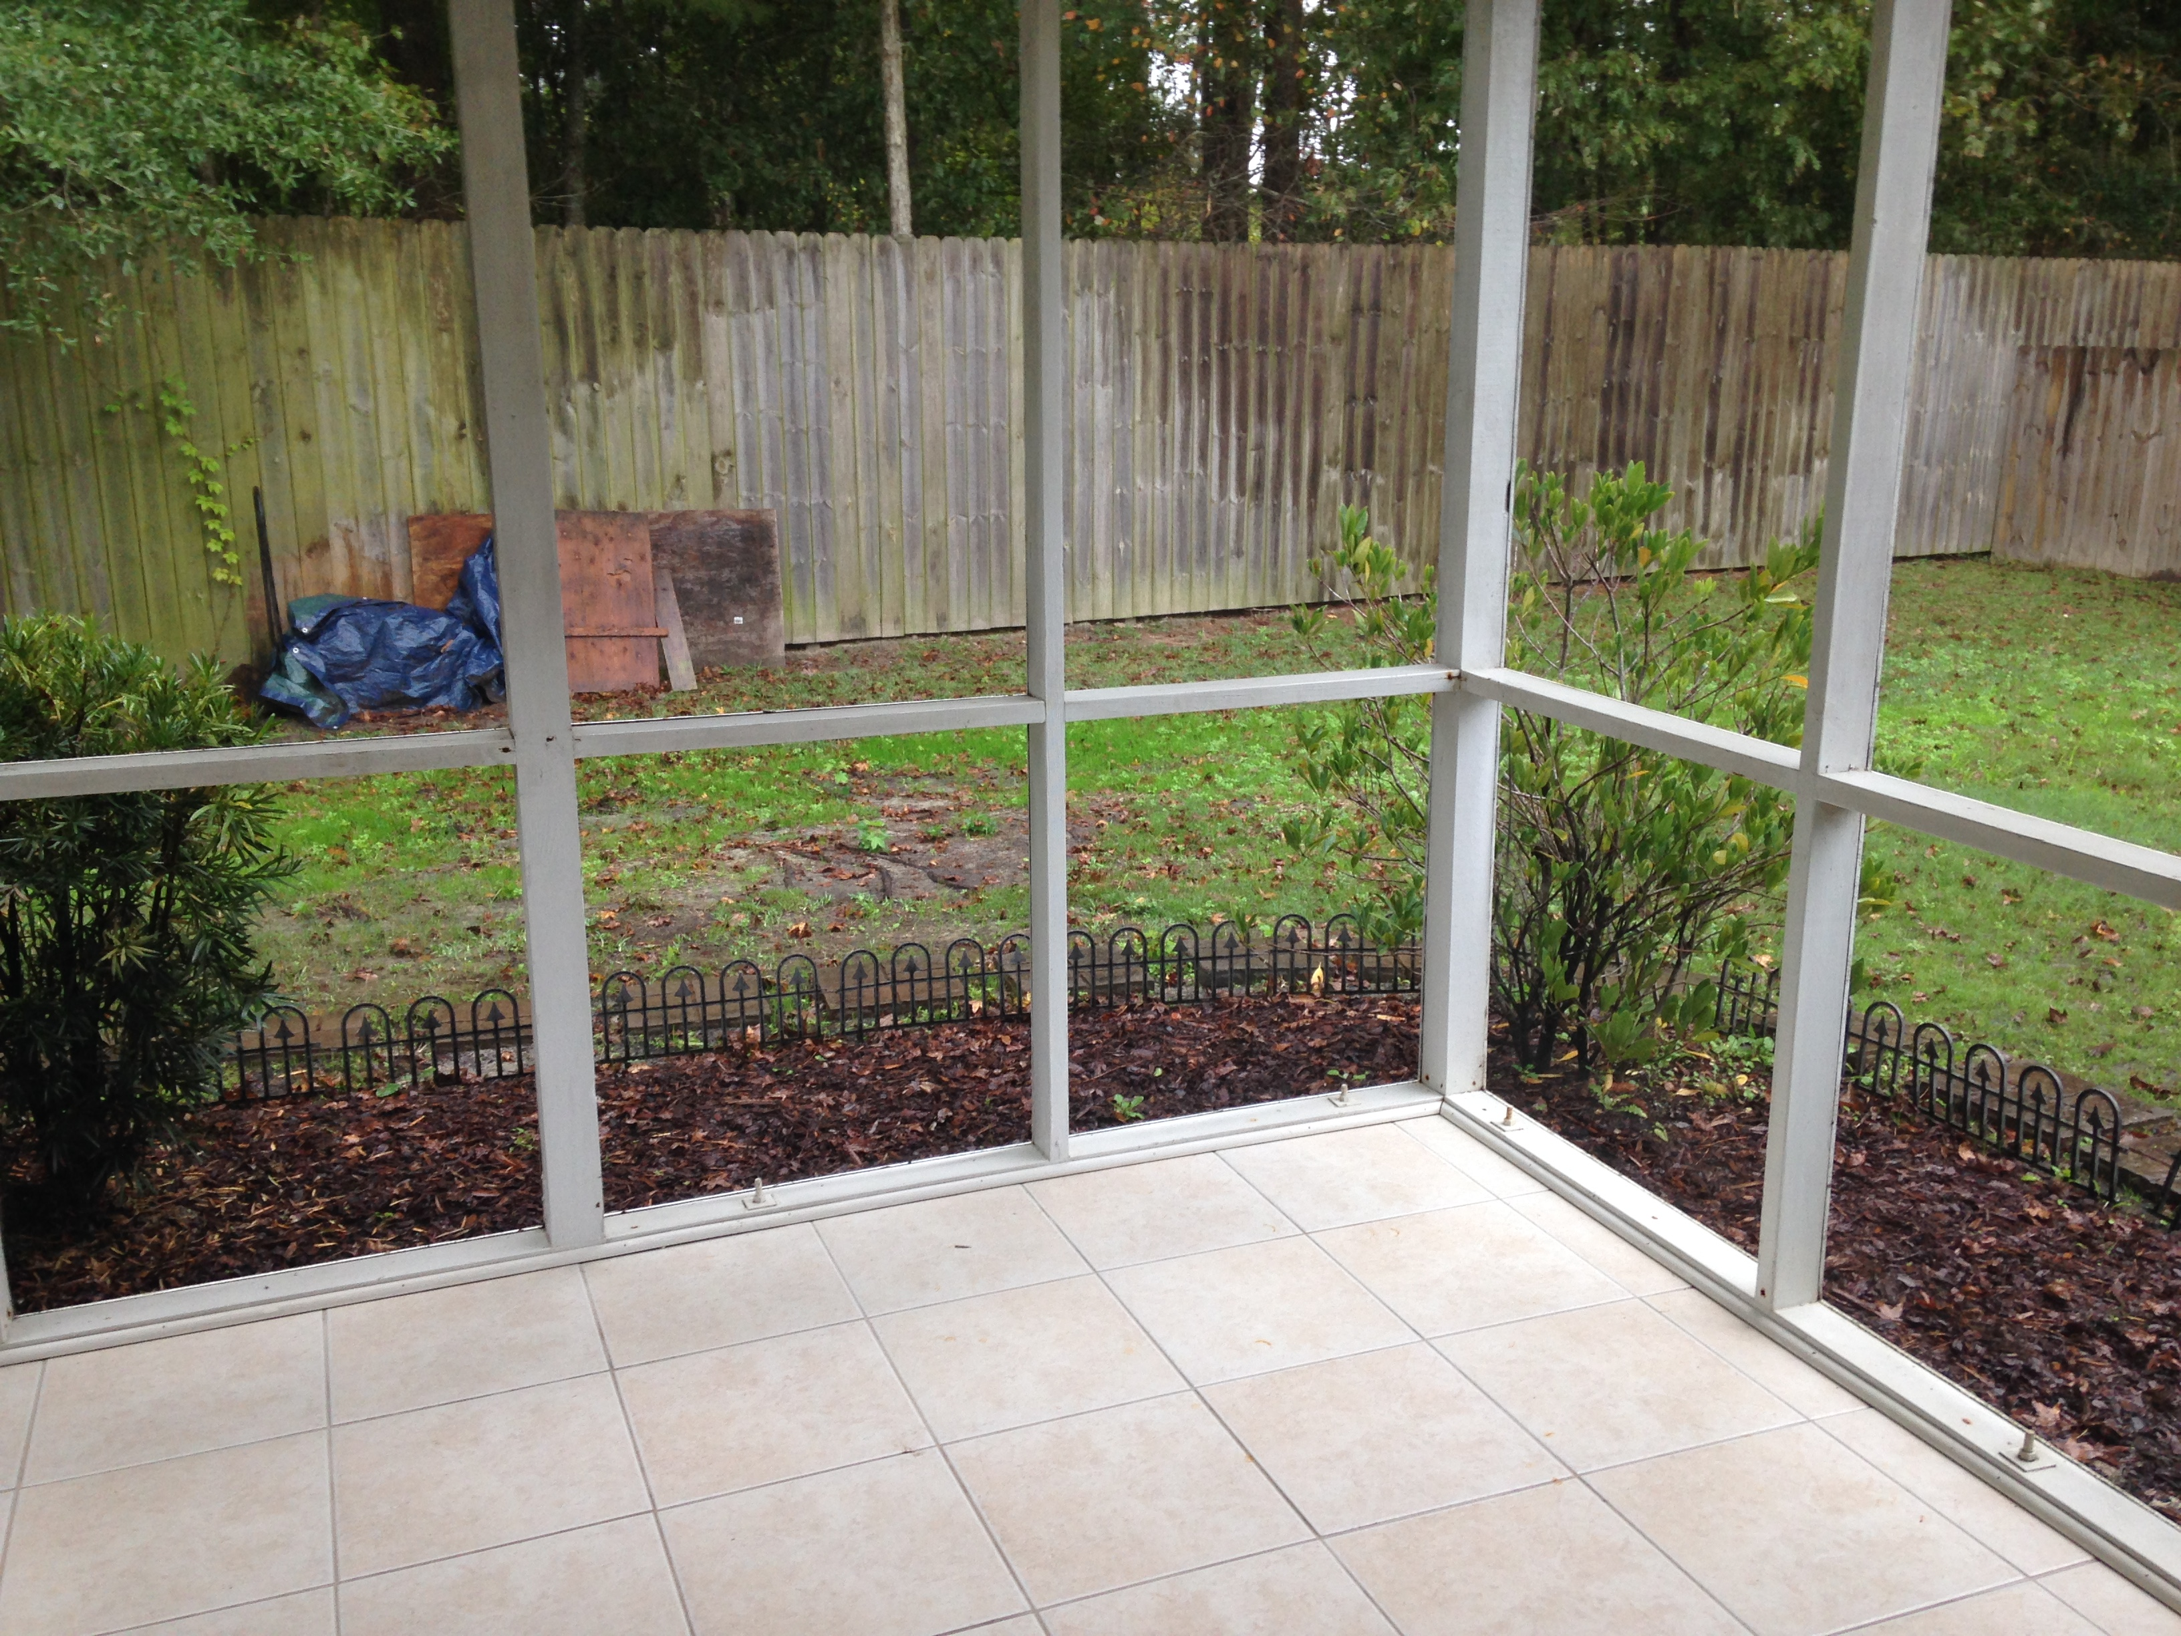


Price Reduced & Ready to Go!
5252 Copley Circle
Woodlands at Wescott | Summerville | MLS# 15024900 | $169,000
Fantastic single story home priced to sell! Open floor plan with kitchen open to family room. There is a breakfast area in the kitchen as well as a separate formal dining room. High vaulted ceilings in family room and master bedroom. Entire interior was painted and new carpet installed last year! Back yard is completely fenced in with high wooden fence that was installed a little over a year ago. Back yard also features a screened in porch and patio that is perfect for cooking out and entertaining. Wescott Plantation features a public golf course. Conveniently located near shopping and restaurants.
Erik Fender
C 843-830-7346
O 843-875-5525
Erik.Fender@cbunited.com
Coldwell Banker United, REALTORS
4969 Centre Pointe Dr., Ste 203
Charleston, SC 29418

