Slide 1
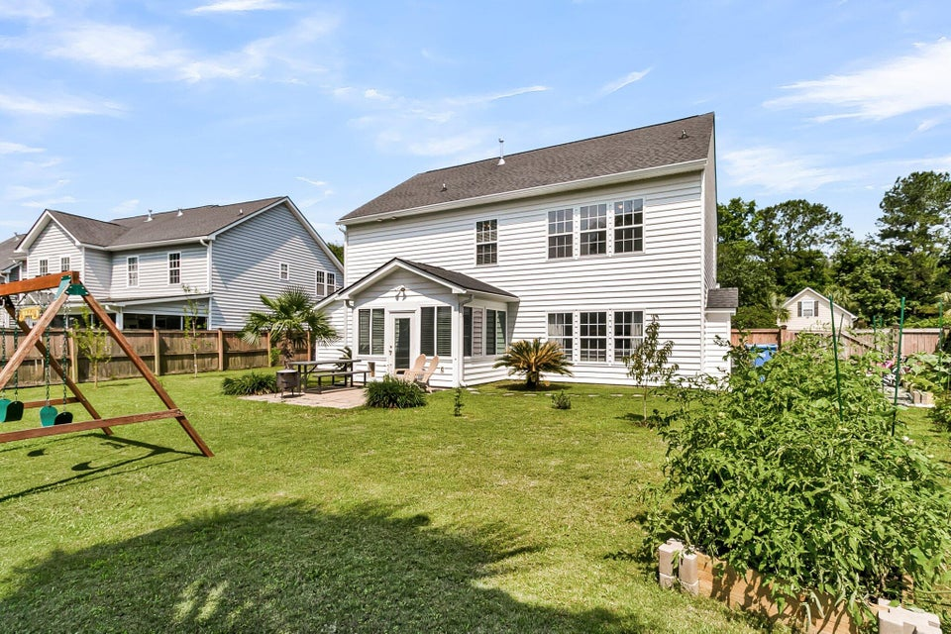
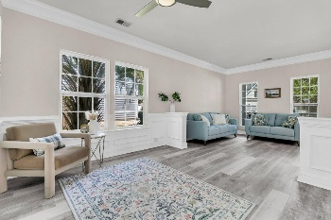
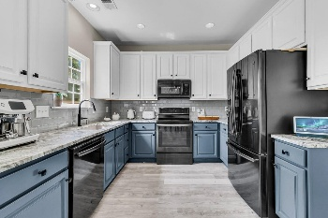
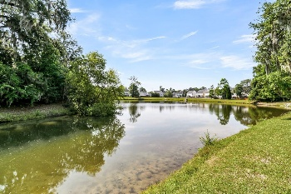
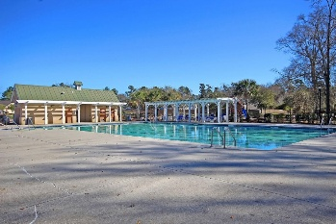
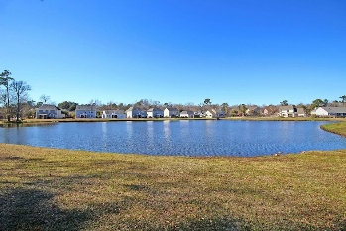

5257 Mulholland Drive Wescott Plantation · Summerville, SC 29485 · MLS# 25013910 · $465,000
Wescott – Updated - Loads of Parking - 3% Co-op
Welcome to this meticulously maintained 4-bedroom home in the highly desirable Oak Forest neighborhood of Wescott Plantation. Offering outstanding curb appeal with a charming full front porch, this home is perfectly positioned to enjoy stunning pond views and serene outdoor living. Step inside to an elegant, open-concept layout where the kitchen, dining area, and great room seamlessly flow together—perfect for entertaining. The interior features luxury vinyl plank flooring, stylish gold accent finishes, and an abundance of natural light. The chef-inspired kitchen is a showstopper with 36'' cabinets, gorgeous stone countertops, black stainless-steel appliances, a large single-bowl sink, and a tasteful tile backsplash. The spacious living area boasts cove crown molding and a cozy gas log fireplace, ideal for cool Charleston evenings. Upstairs, you'll find the luxurious owner's retreat with tray ceiling, a beautifully renovated en-suite bath, dual vanity, spa-like tile shower, stunning freestanding relaxing soaking tub, and a large walk-in closet. Three additional well-sized bedrooms share a full bath, providing plenty of space for family or guests. Enjoy year-round relaxation in the all-season sunroom, the perfect spot for morning coffee or unwinding with tranquil pond views. The backyard is a dream - fully fenced with raised vegetable and flower garden beds, numerous fruit trees, ample grilling space, and a bonus parking pad ideal for storing a boat or extra vehicles, in addition to the attached two-car garage. There's also a separate outdoor storage area for added convenience. Important features: Roof 2019, Tankless Water
2024, fresh paint 2024, and gold accent light fixtures and door hardware 2024. Wescott Plantation offers a vibrant community with sidewalks, a playground, and a neighborhood pool-both within walking distance of the home. Golf memberships are also available for those looking to enjoy even more of what this community has to offer. Don't miss the chance to call this exceptional property your home!
Stan Huff
843-670-2835 stan.huff@agentowned.com
Jill Marcacci
843-297-5590 jill@agentowned.com
www.agentownedrealty.com
AgentOwned Realty Co. Preferred Group, Inc. | 824 Johnnie Dodds Blvd | Mt Pleasant, SC 29464

