Slide 1
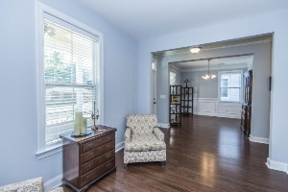
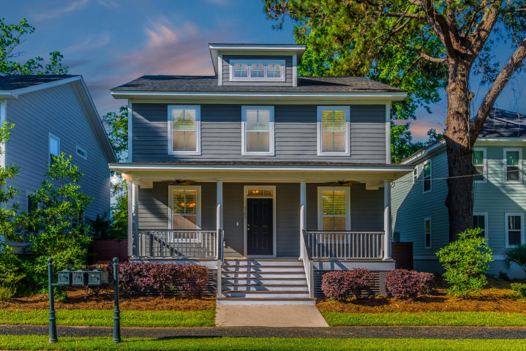
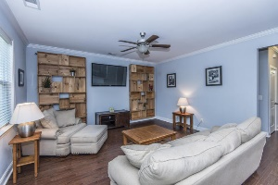
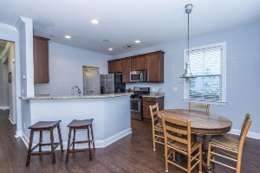
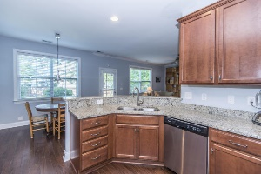
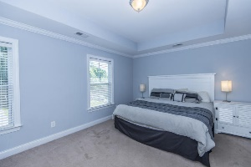
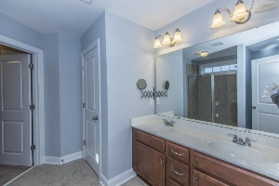
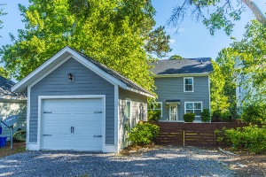

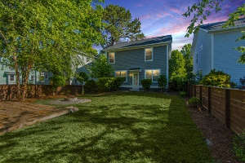

Great New Listing!!
5262 E Dolphin Street
Oak Terrace Preserve - North Charleston
MLS# 17014092 - $329,500
Your chance to buy one of the best lots in Oak Terrace Preserve. This 4 bedroom, 2.5 bath home was built by Crescent Homes in 2012.
The kitchen has the best finishes with granite countertops and a gas range. This is such a great floorplan.
The backyard is one of the biggest in the neighborhood. Also, the pocket park is only about 50 yards away.Please watch the Matterport photo tour and schedule a showing today!
Del Shaffer
843.408.6821
dshaffer@carolinaoneplus.com

