Slide 1
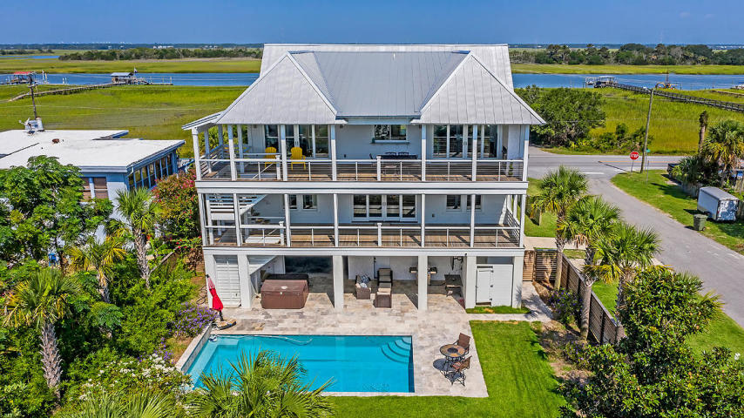
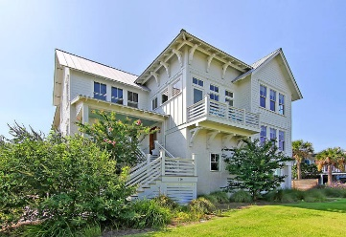
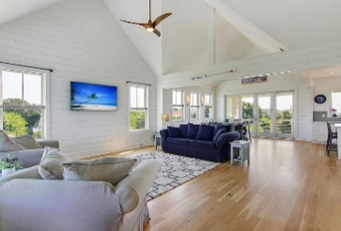
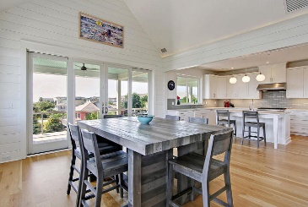
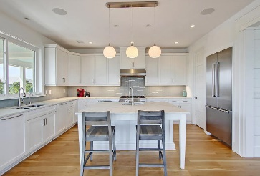
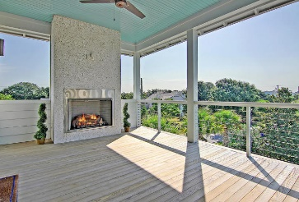
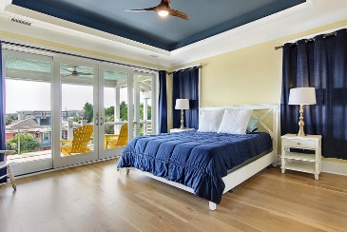
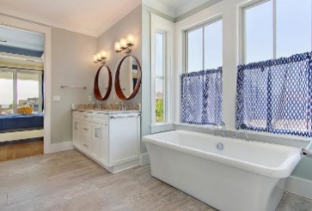
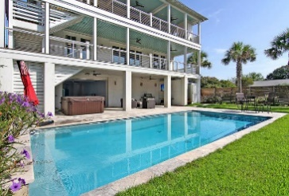
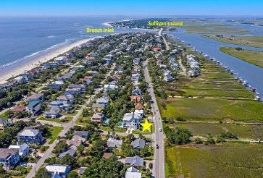
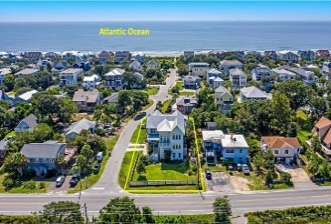



IOP Home With 360° Views
526 Palm Boulevard
Wild Dunes | Isle of Palms, SC 29451 | MLS# 20025525 | $3,300,000
Prepare to daydream while enjoying the 360 degree views from every level of this home! Whether you start your day watching a shrimp boat head out to sea on the Atlantic Ocean, or you are admiring the sun setting over the Intracoastal Waterway and Hamlin Creek as the Ravenel Bridge disappears into the night, every day creates a new scene. 526 Palm Blvd is on the south end of Isle of Palms, close to Breach Inlet and Sullivan's Island. Newly constructed in 2017, this custom home sits on a spacious corner lot, just across Palm Blvd from Hamlin Creek with an unobstructed view of the Atlantic Ocean on the other side and is just steps away from easy beach access. Uniquely designed to maximize views, this reverse floorplan is ideal for a private residence or investment property. ($150k/year in estimated rental income)
Check out the full 3D tour: https://my.matterport.com/show/?m=V83MFiY6LTB
Whitley Boyd
(843) 324-4761
WBoyd@CarolinaOne.com
www.PropertiesofCHS.com
Carolina One Real Estate | 628 Long Point Rd. | Mt Pleasant, SC 29464-3032

