Slide 1
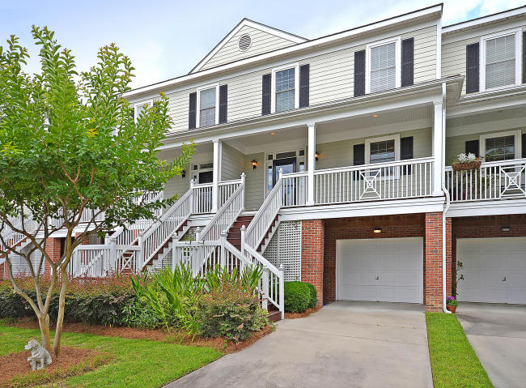
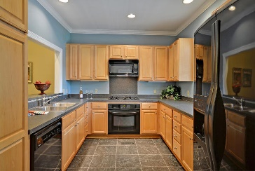
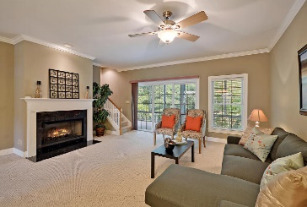
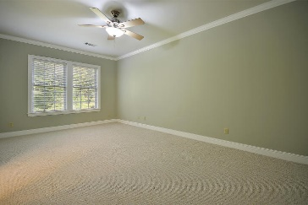
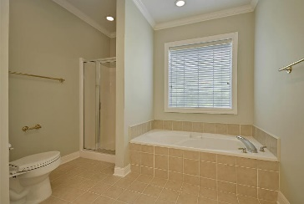
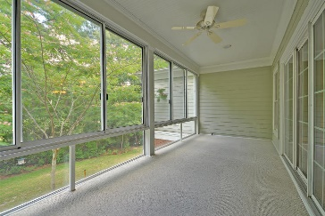


BEST KEPT LOWCOUNTRY SECRET
5276 7th Green Drive
Stono Ferry
Hollywood, SC 29449
MLS# 15012953
$234,900
Come and discover what many consider the ''Best Kept Secret in the Charleston Real Estate'' market. This Remarkable 2 story townhome condo with a full rocking chair front porch is situated on a quiet tree-lined street and is surrounded by a magnificent golf course and the Stono Ferry Country Club.
This Amazing home has 3 large bedrooms upstairs including the spacious master bedroom with crafted crown molding, an awesome walk-in closet, and a private master bathroom that offers a relaxing soaking tub and a stand alone walk-in shower. All bedrooms are appointed with private bathrooms.
The main floor with beautiful crown molding and wall-wall carpet offers a Stunning open living room and dining room, a valuable breakfast bar and a modern kitchen with crafted wood cabinets & built-in upgraded appliances. There is a private walk-out to the incredible glassed-in porch that provides exclusive views of the the Stono Ferry golf course. Parking is a dream, covered parking under this elevated beauty will store 3 large vehicles. What else are you looking for? Check the price and take a ticket!
In reference to HOA Fees: Monthly Fee includes cable, grounds, pest control, and termite service. Biannual fees for Stono Ferry pay for swimming pool, main roads, and amenity field to include new Pavilion.
Age, sqft, taxes, HOA fees, and schools are approx. Buyer to verify.
Bill Everett, Jr
Broker
843-693-8539
Bill@TheEverettGroup.net
RE/MAX Pro Realty, 9209 University Blvd, Charleston, SC 29406

