Slide 1
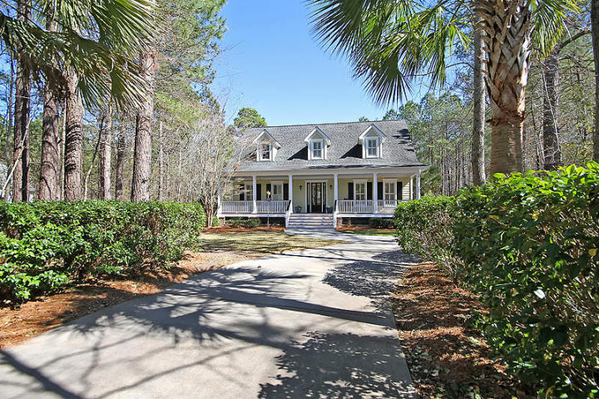
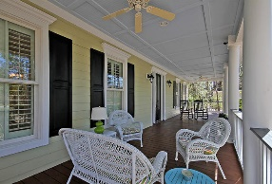
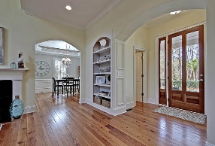
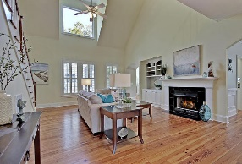
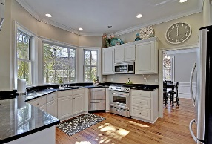
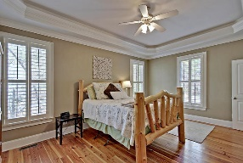
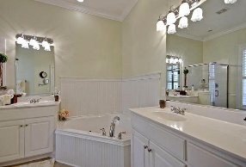
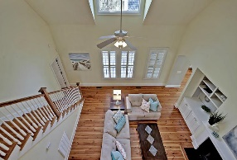
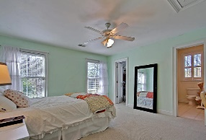
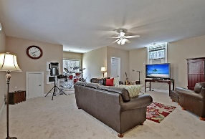
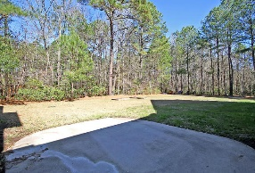
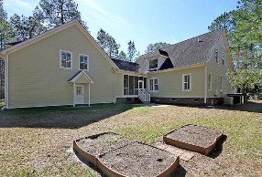
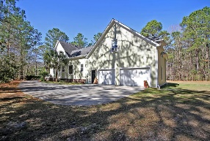


Private Summerville Beauty!!
5288 Alpine Drive
The Summit
Summerville, SC 29483
MLS# 17004432
$449,900
4 Bedrooms | 4½ Baths | 3,200 sf
Get ready to be wowed as you pull up to your own private oasis at the end of a cul-de-sac in the established neighborhood of The Summit! Curb appeal galore greets you as you drive down your palmetto tree lined driveway. You'll immediately notice the large welcoming front porch with gorgeous front door. Upon entering, your eyes will be drawn to the hearty pine floors. The large family room, with tons of natural light, has built in book cases and gas fireplace. The dining room is the perfect size for entertaining and has a tray ceiling and great crown molding. The kitchen is a cook's delight! Gas stove, huge windows offering tons of natural light and great views while doing the dishes! There is also a large eat in kitchen area. The first floor master is a great size with a tray ceiling, large master bath with dual vanities, separate shower, garden tub and walk in closet. Don't forget to check out all the plantation shutters on the first floor! Upstairs you'll find two very large bedrooms, each with walk in closets and their own full baths!! It doesn't end there! Head back downstairs and there's a large laundry room, then over the garage, another bedroom/bonus room with a full bath! Storage is not an issue in this home! Plenty of closets and attic space. The two car garage is oversized for extra storage as well! The screened in porch overlooks the private backyard. This home is on over an acre lot! Just three miles from downtown Summerville, this is the place to be!
Larry & Kathy Mazalatis
Larry Cell 843-693-0529
Kathy Cell 843-693-0159
Office 843-871-9133
AGENTOWNED PREMIERE GROUP | 1800 TROLLEY RD | SUMMERVILLE, SC 29485

