Slide 1

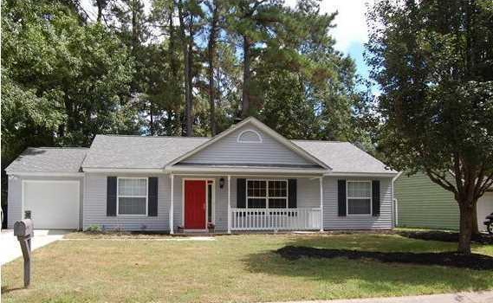
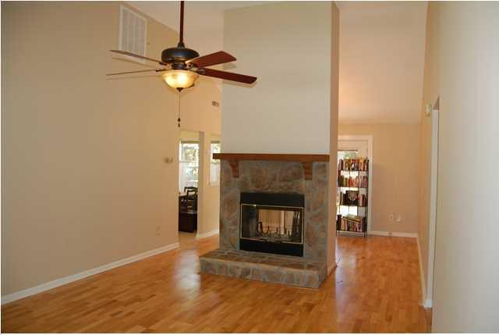
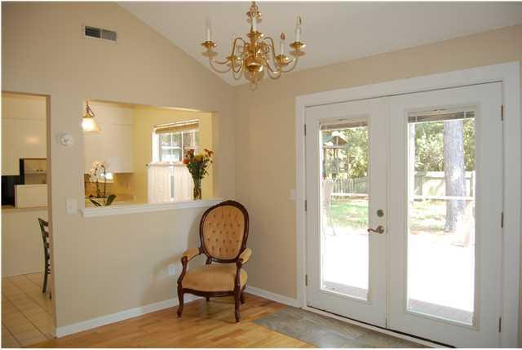
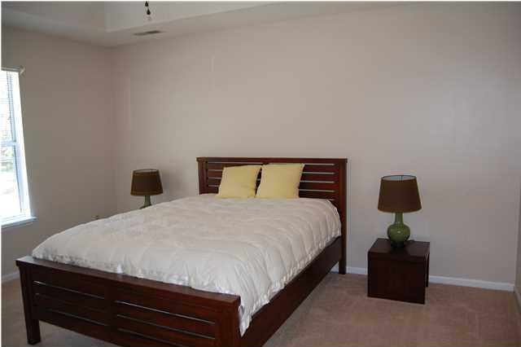
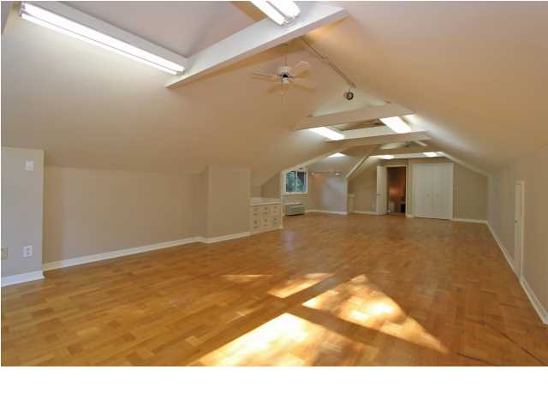
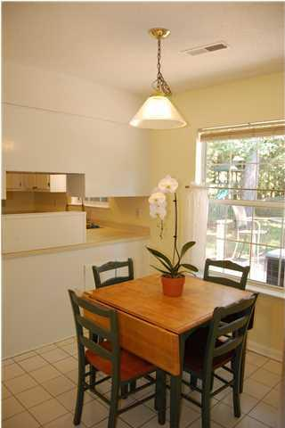
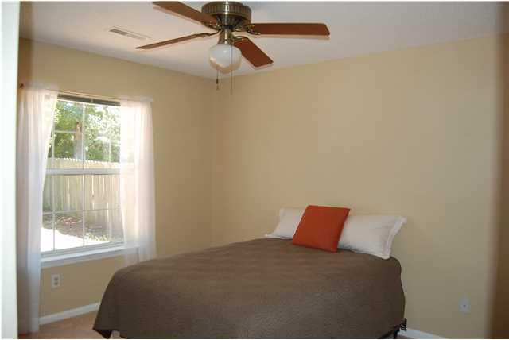
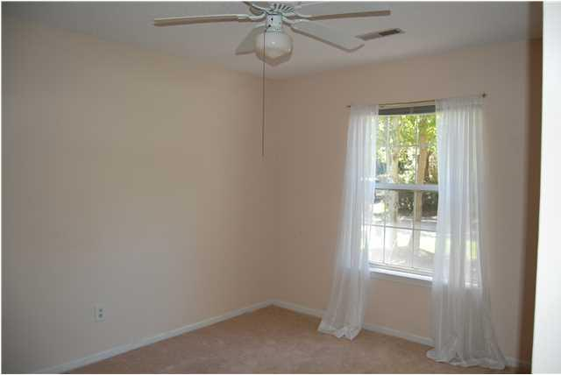
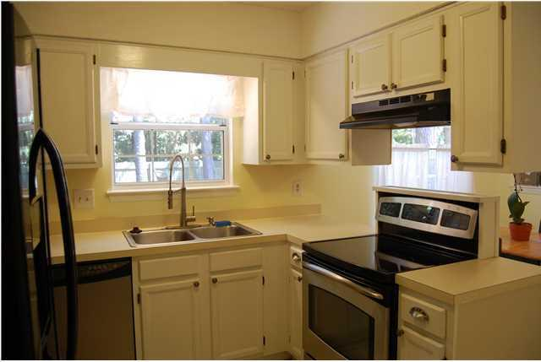
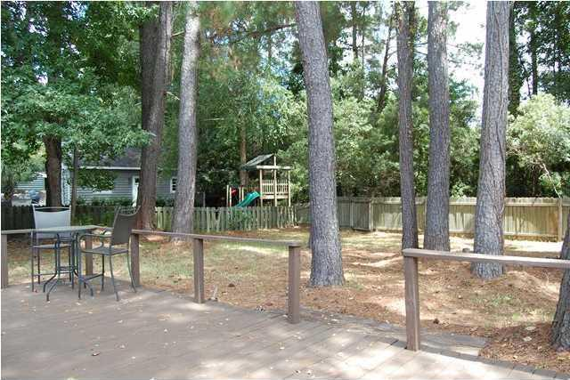


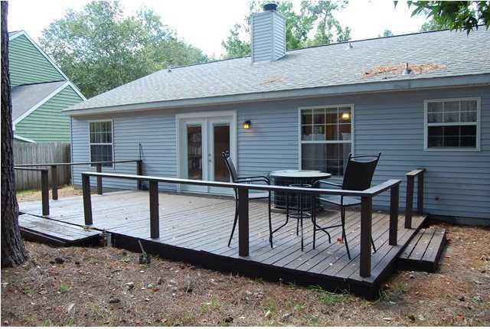

528 Castle Hall Road Longpoint Mount Pleasant, SC 29464 MLS# 1423891 ~ $275,000
$1,000 Bonus to Selling Agent at Closing
With BIC Approval
See more at www.2011shellring.com
This lovely 3Br and 2BA home is located in the very desirable subdivision of Longpoint. Its location is convenient to Charleston's beautiful beaches, downtown, shopping, restaurants and the County Park at the end of the subdivision. This home has a 2-year-old roof, new Dish Washer, new Bathroom Vanities, newly refinished floors and paint making it totally turn key. The den has wood floors, vaulted ceiling and a two-way fireplace that opens up into the formal dining room. The master suite with a walk in closet and master bathroom is on the opposite end of the home from the other two bedrooms and bath giving the buyer privacy. The open kitchen and breakfast room is bright and sunny having lots of cabinets and counter space. There are French doors leading from the back of the home to a large open deck, a great place to entertain and have those fun BBQ's. The backyard is fenced making it a wonderful place for children and pets to play. Take a look at this hoe before it's gone you will not be disappointed.
Paige Pollock
Cell - (843) 412-4447
paigep@carolinaone.com
www.paigepollock.com
Carolina One Real Estate 195 W Coleman Blvd, Mt Pleasant, SC 29464

