Slide 1
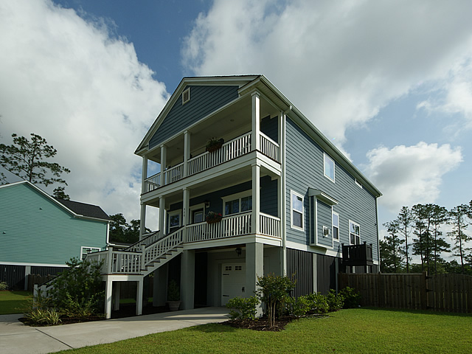
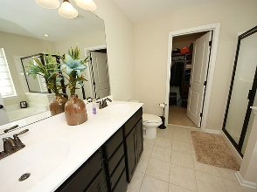
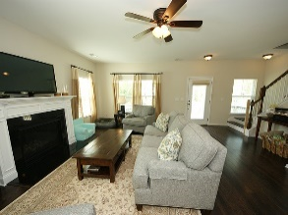
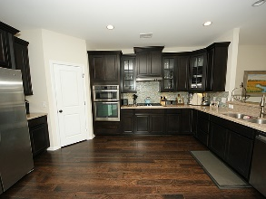
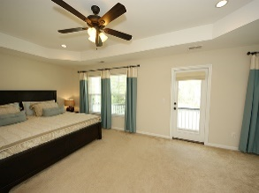
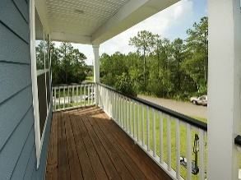
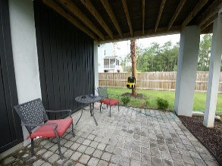
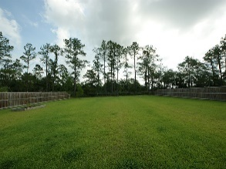
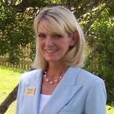

528 Sanders Farm Lane
Retreat at Beresford ~ Charleston ~ MLS# 16016248 ~ $438,000
Just Listed
~ Join Me For An Open House ~
Wednesday, August 17th ~ 11:00-2:00
VIEWS, VIEWS VIEWS, water and marsh front on a natural pond fed by beautiful Beresford Creek, enjoy watching Osprey and Egrets, and the Fishing is Great! HUGE yard, almost half acre surrounded by a 6 foot privacy fence. HUGE garage with tons of storage for small boat, bikes, kayaks and up to 3 cars! Location is fantastic, only 2 miles to Hwy 526, 20 minutes to the beach, airport, and downtown Charleston. Beautiful 2 story home has pride of ownership, ready to move in! Some features are: Double Front Porch, Screen Porch, Covered Patio made from stone “pavers”, a concrete Grilling Patio, Wide Plank Wood Floors through-out 1st floor, stairs to 2nd floor, loft and 2nd floor hallway. Corian Counters, upgraded 42 inch Maple cabinets with glass inserts, Walk-in Pantry, Gas Fireplace, Open Floor Plan, Formal Dining, Breakfast Nook/Sitting Room, Breakfast Bar, Stainless Steel Appliances, Gas Cooktop, Wall Oven, Built in Microwave, Side by Side Refrigerator, Tiled Back Splash, Laundry Room, Â½ bath on 1st Floor, Coat Closet, Loft/office/media room, Linen Closet, Master Suite with sitting area and outside access to Private Covered Porch, Luxury Master Bath with double sink vanity w/drawers, soaker tub, separate shower, walk in closet with built-ins, 2nd and 3rd Bedroom have great view of Marsh and Pond. Green Features are Rinnai Tankless Water Heater and Radiant Barrier Roof. New Elementary and Middle School open August 2016 and the new High School opens August 2017; both are only approximately 5 miles down Clements Ferry Road. Don't wait this home won't last long!
Debbie Wall-Smith, BIC, CRS, SRS, ABR
Realtor/Owner
(843) 345-1095
debbie@charlestonmetrohomes.com
www.charlestonmetrohomes.com
Charleston Metro Homes, LLC
652 Coleman Blvd Suite 102
Mt. Pleasant, SC 29464

