Slide 1
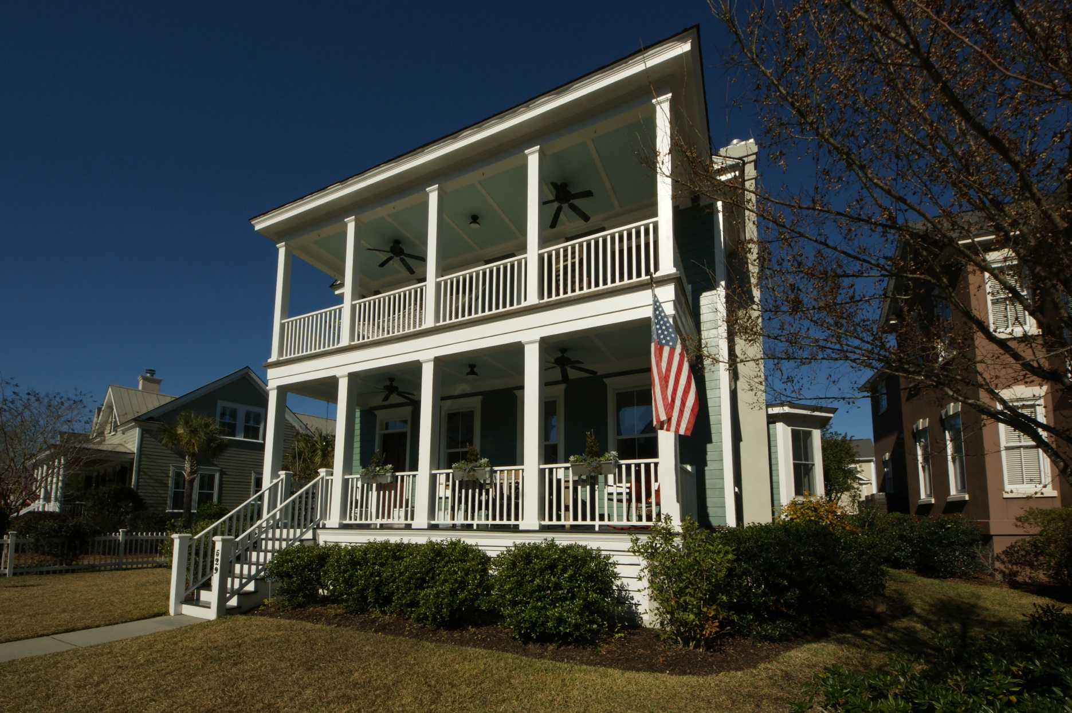
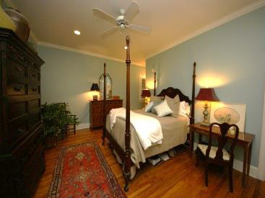
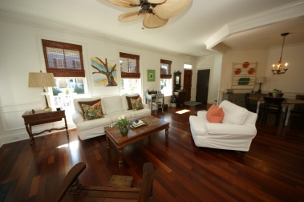
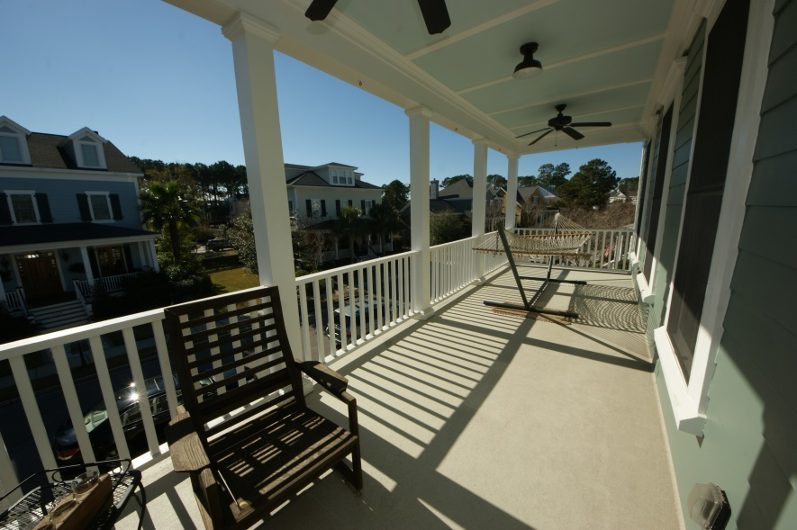
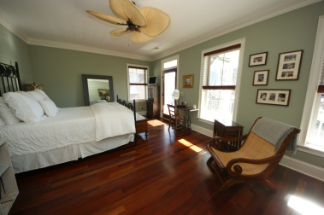
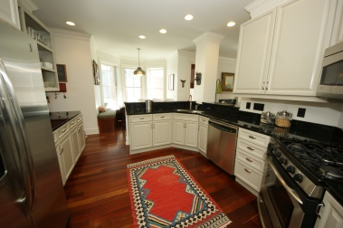
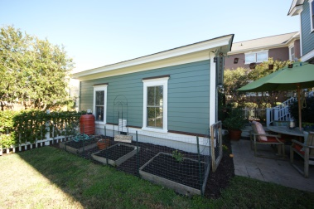


Belle Hall- Hibben Just Reduced!
529 Country Place Road
Mount Pleasant, SC ~ MLS# 15000585 ~ $659,980
4 Bedrooms :: 3 Baths :: 2,483 sf :: Detached Garage
Chuck & Edy Mimms
Cell 843-224-9507
Office 843-530-8100 www.sanddollarsc.com
www.facebook.com/Sanddollarsc
Sand Dollar Real Estate Group | 2205 Middle Street | Suite 203, Mailbox 2 | Sullivans Island, SC 29482

