Slide 1

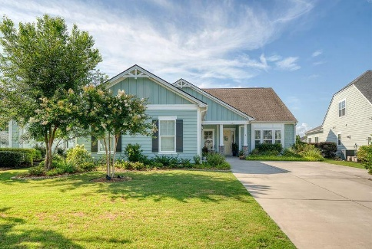
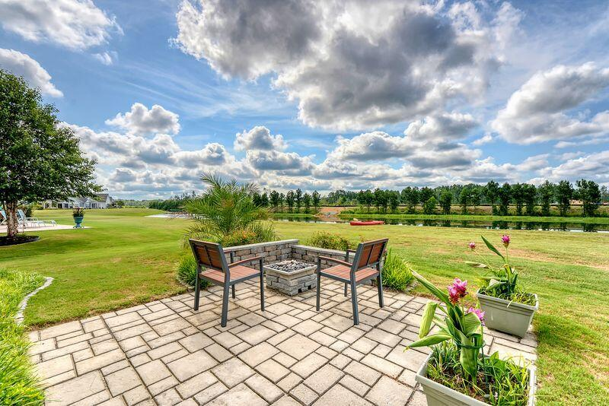
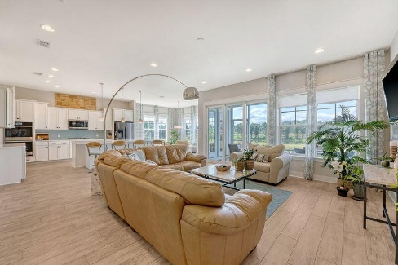
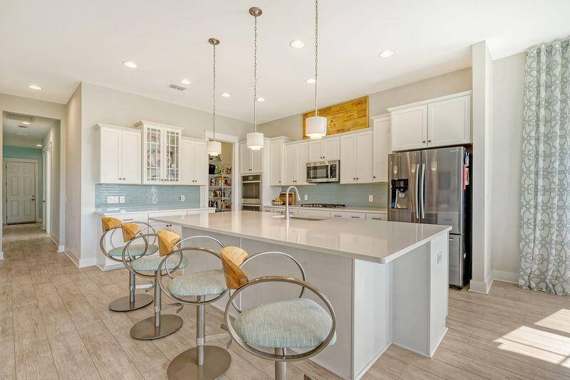
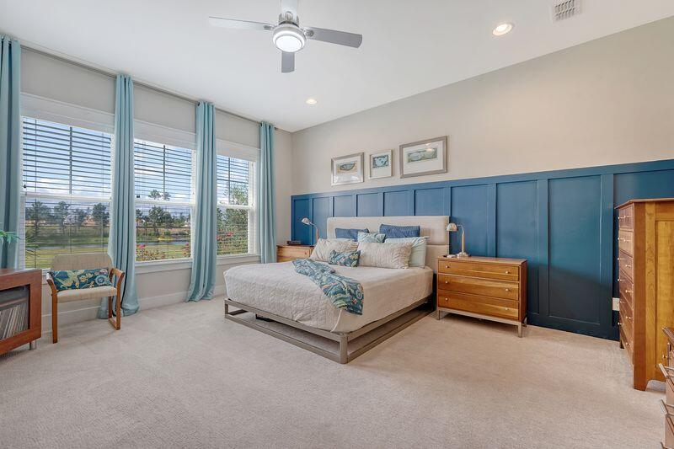
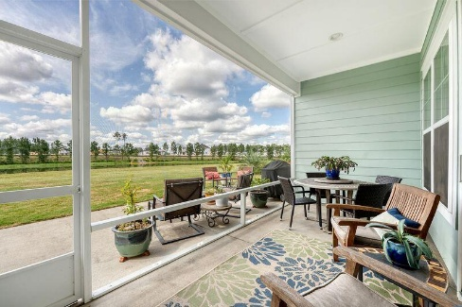
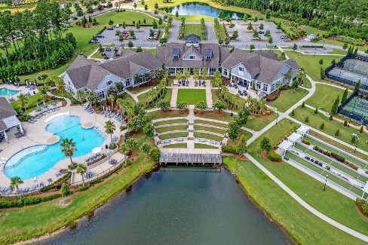

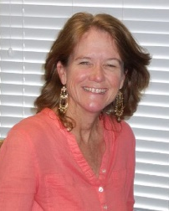
529 FOUR SEASONS BLVD Cane Bay Plantation · Summerville, SC 29486 MLS# 25018545 · Reduced to $694,000
New Price!
Welcome home to a rare lake lot. Access to large spring fed lake, embrace the storks, egrets and herons. Ravenna floor plan on the lake a few remain. Gorgeous move in ready home. Enjoy gorgeous lake views as you enter the home from the front door through the expansive glass on the back wall. A nine-foot sliding glass door that allows you to bring the outside in The southern exposure offers breath-taking sunrises from the sunroom or extended back patio while shading the back living space from the strong afternoon summer sun. Watch egrets and herons fish for their dinner as you enjoy beautiful sunset skies from the gas fire pit. Take advantage of the quick water access from your back yard to the expansive 300-acre lake system with an eight-mile waterway. Paddle only a few hundred yards up the waterway to spring-fed Cane Bay Lake stocked with fish.
Inside, relax in the spacious open living area. The home boasts multiple upgrades including 10-ft ceilings, the cottage trim package (all windows include interior trim), and statement wall treatments. The gourmet kitchen is perfect for entertaining with a large pantry, a huge 5 ft x 10 ft granite island, five-burner gas cooktop, and two convection wall ovens.
The Four Seasons community provides exceptional amenities including a large community Lakehouse with dedicated art, card, and exercise rooms; an indoor pool; and a large ballroom/stage for community gatherings and high-end shows. Outdoor amenities include two resort-like pools, a large lake-side outdoor entertainment area, multiple sports courts (including bocce, pickleball, and tennis), a large shaded dog park, and a boat landing/ramp with community access to kayaks and a canoe.
If you are looking for luxury living with serene lake views and an active lifestyle, this is your new home. This home is a must see move in ready. The window treatments are beautiful.. Owners have taken great care of this home and it's ready for the next happy homeowners. "flexible closing date"
Saturday, May 5th At 11:00a
ANN EVANS
Carolina One Real Estate
843-452-4605
aevans@carolinaone.com
www.charlestonluxuryrealestate.com
Carolina One Real Estate
195 W Coleman Blvd
Mt Pleasant, SC 29464-3495

