Slide 1
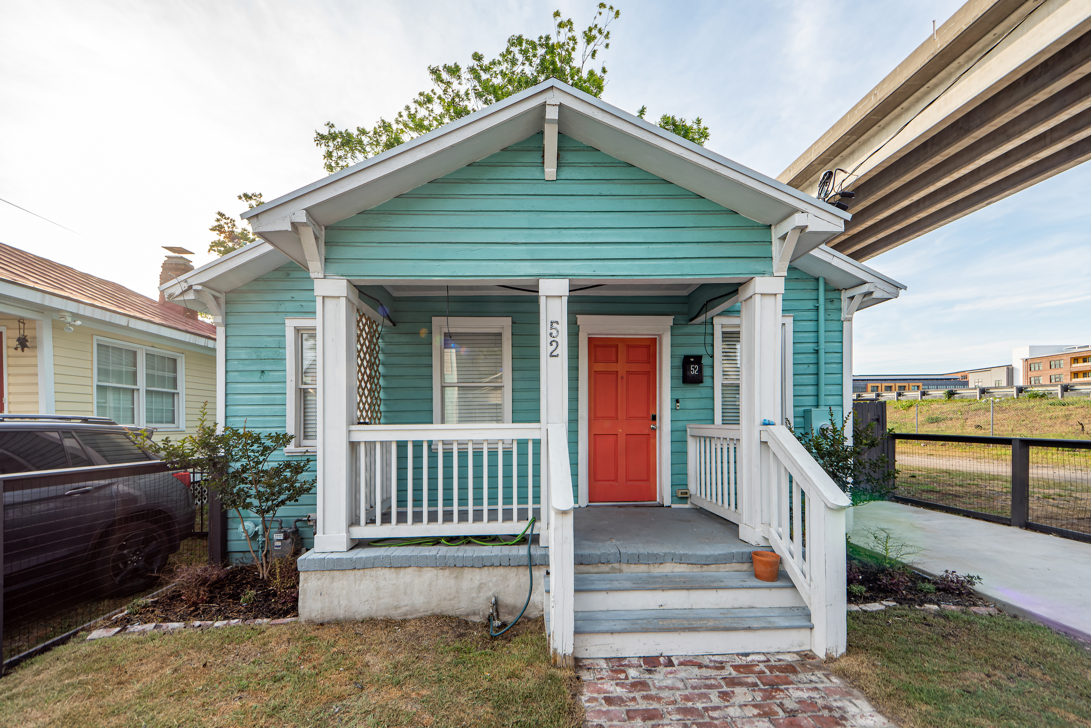
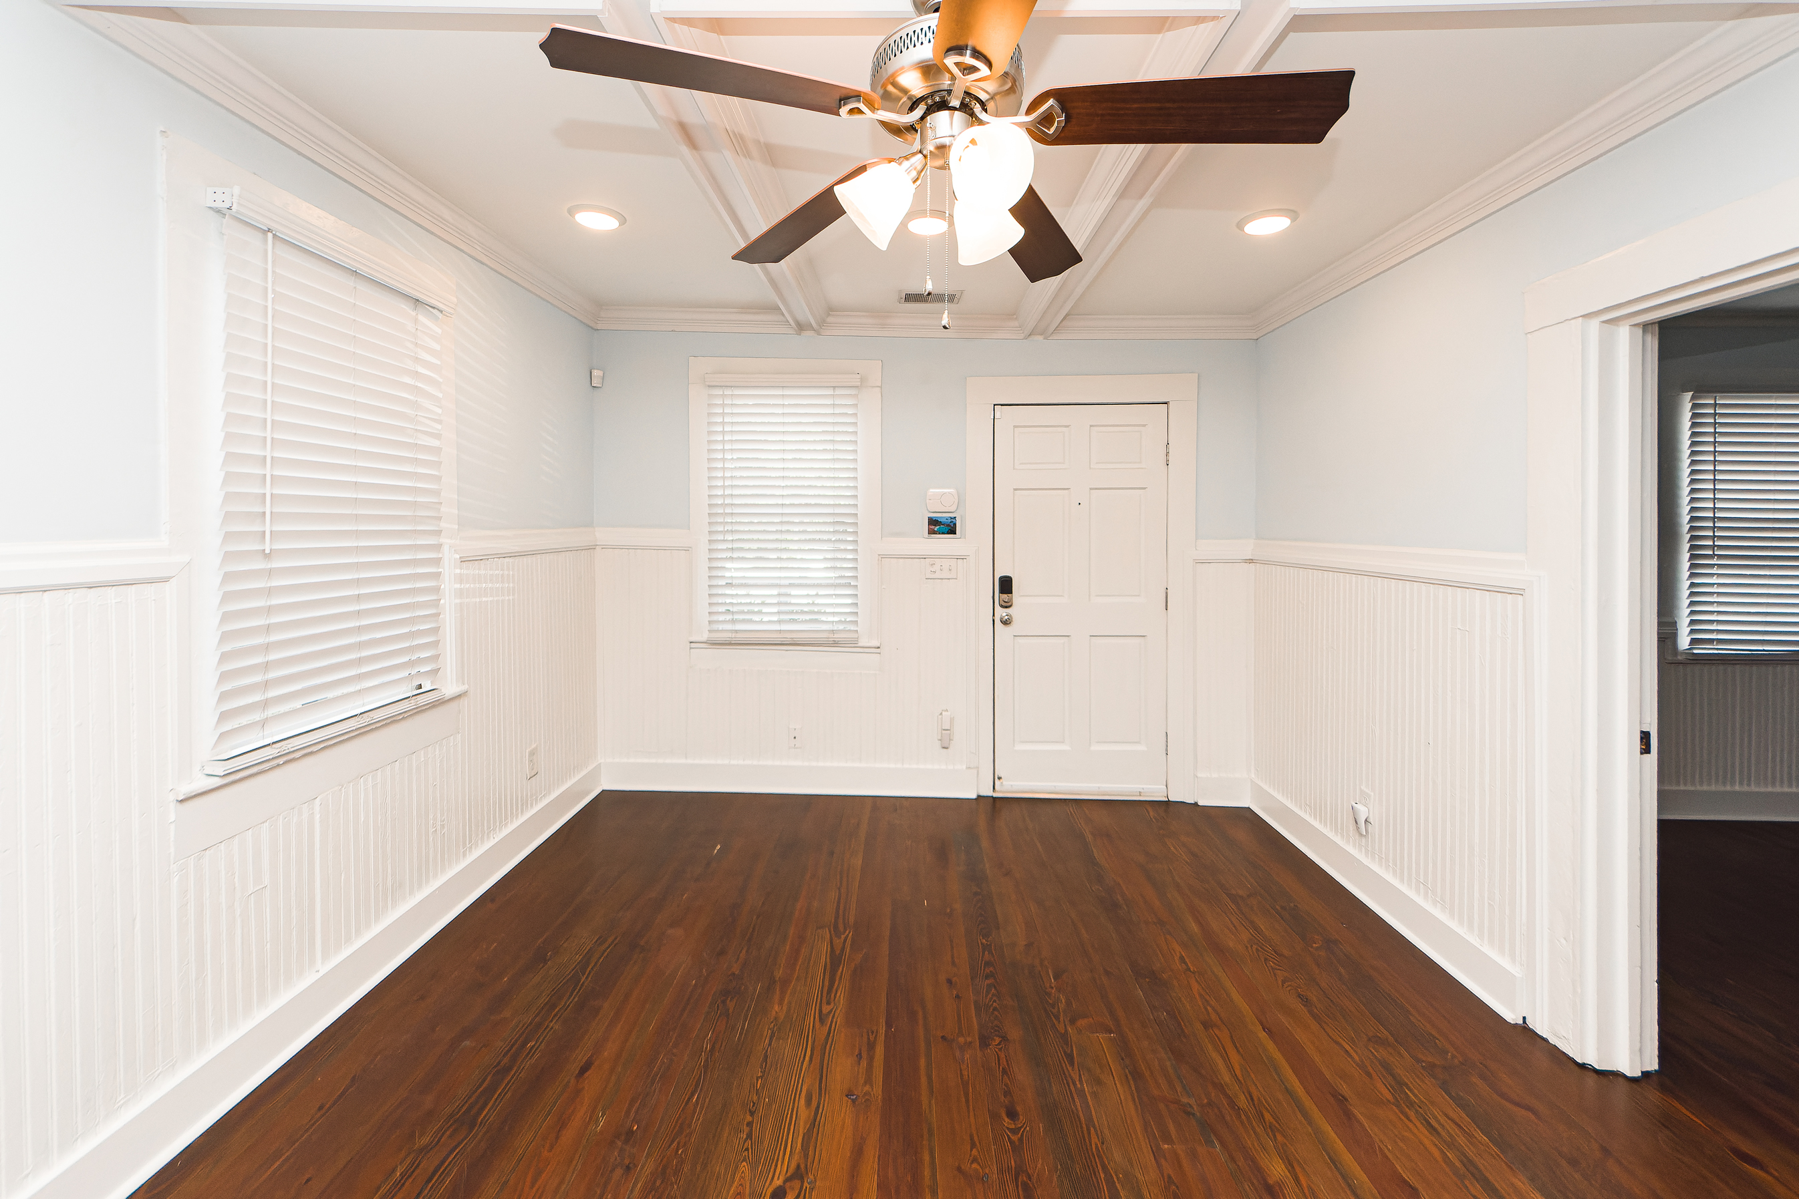
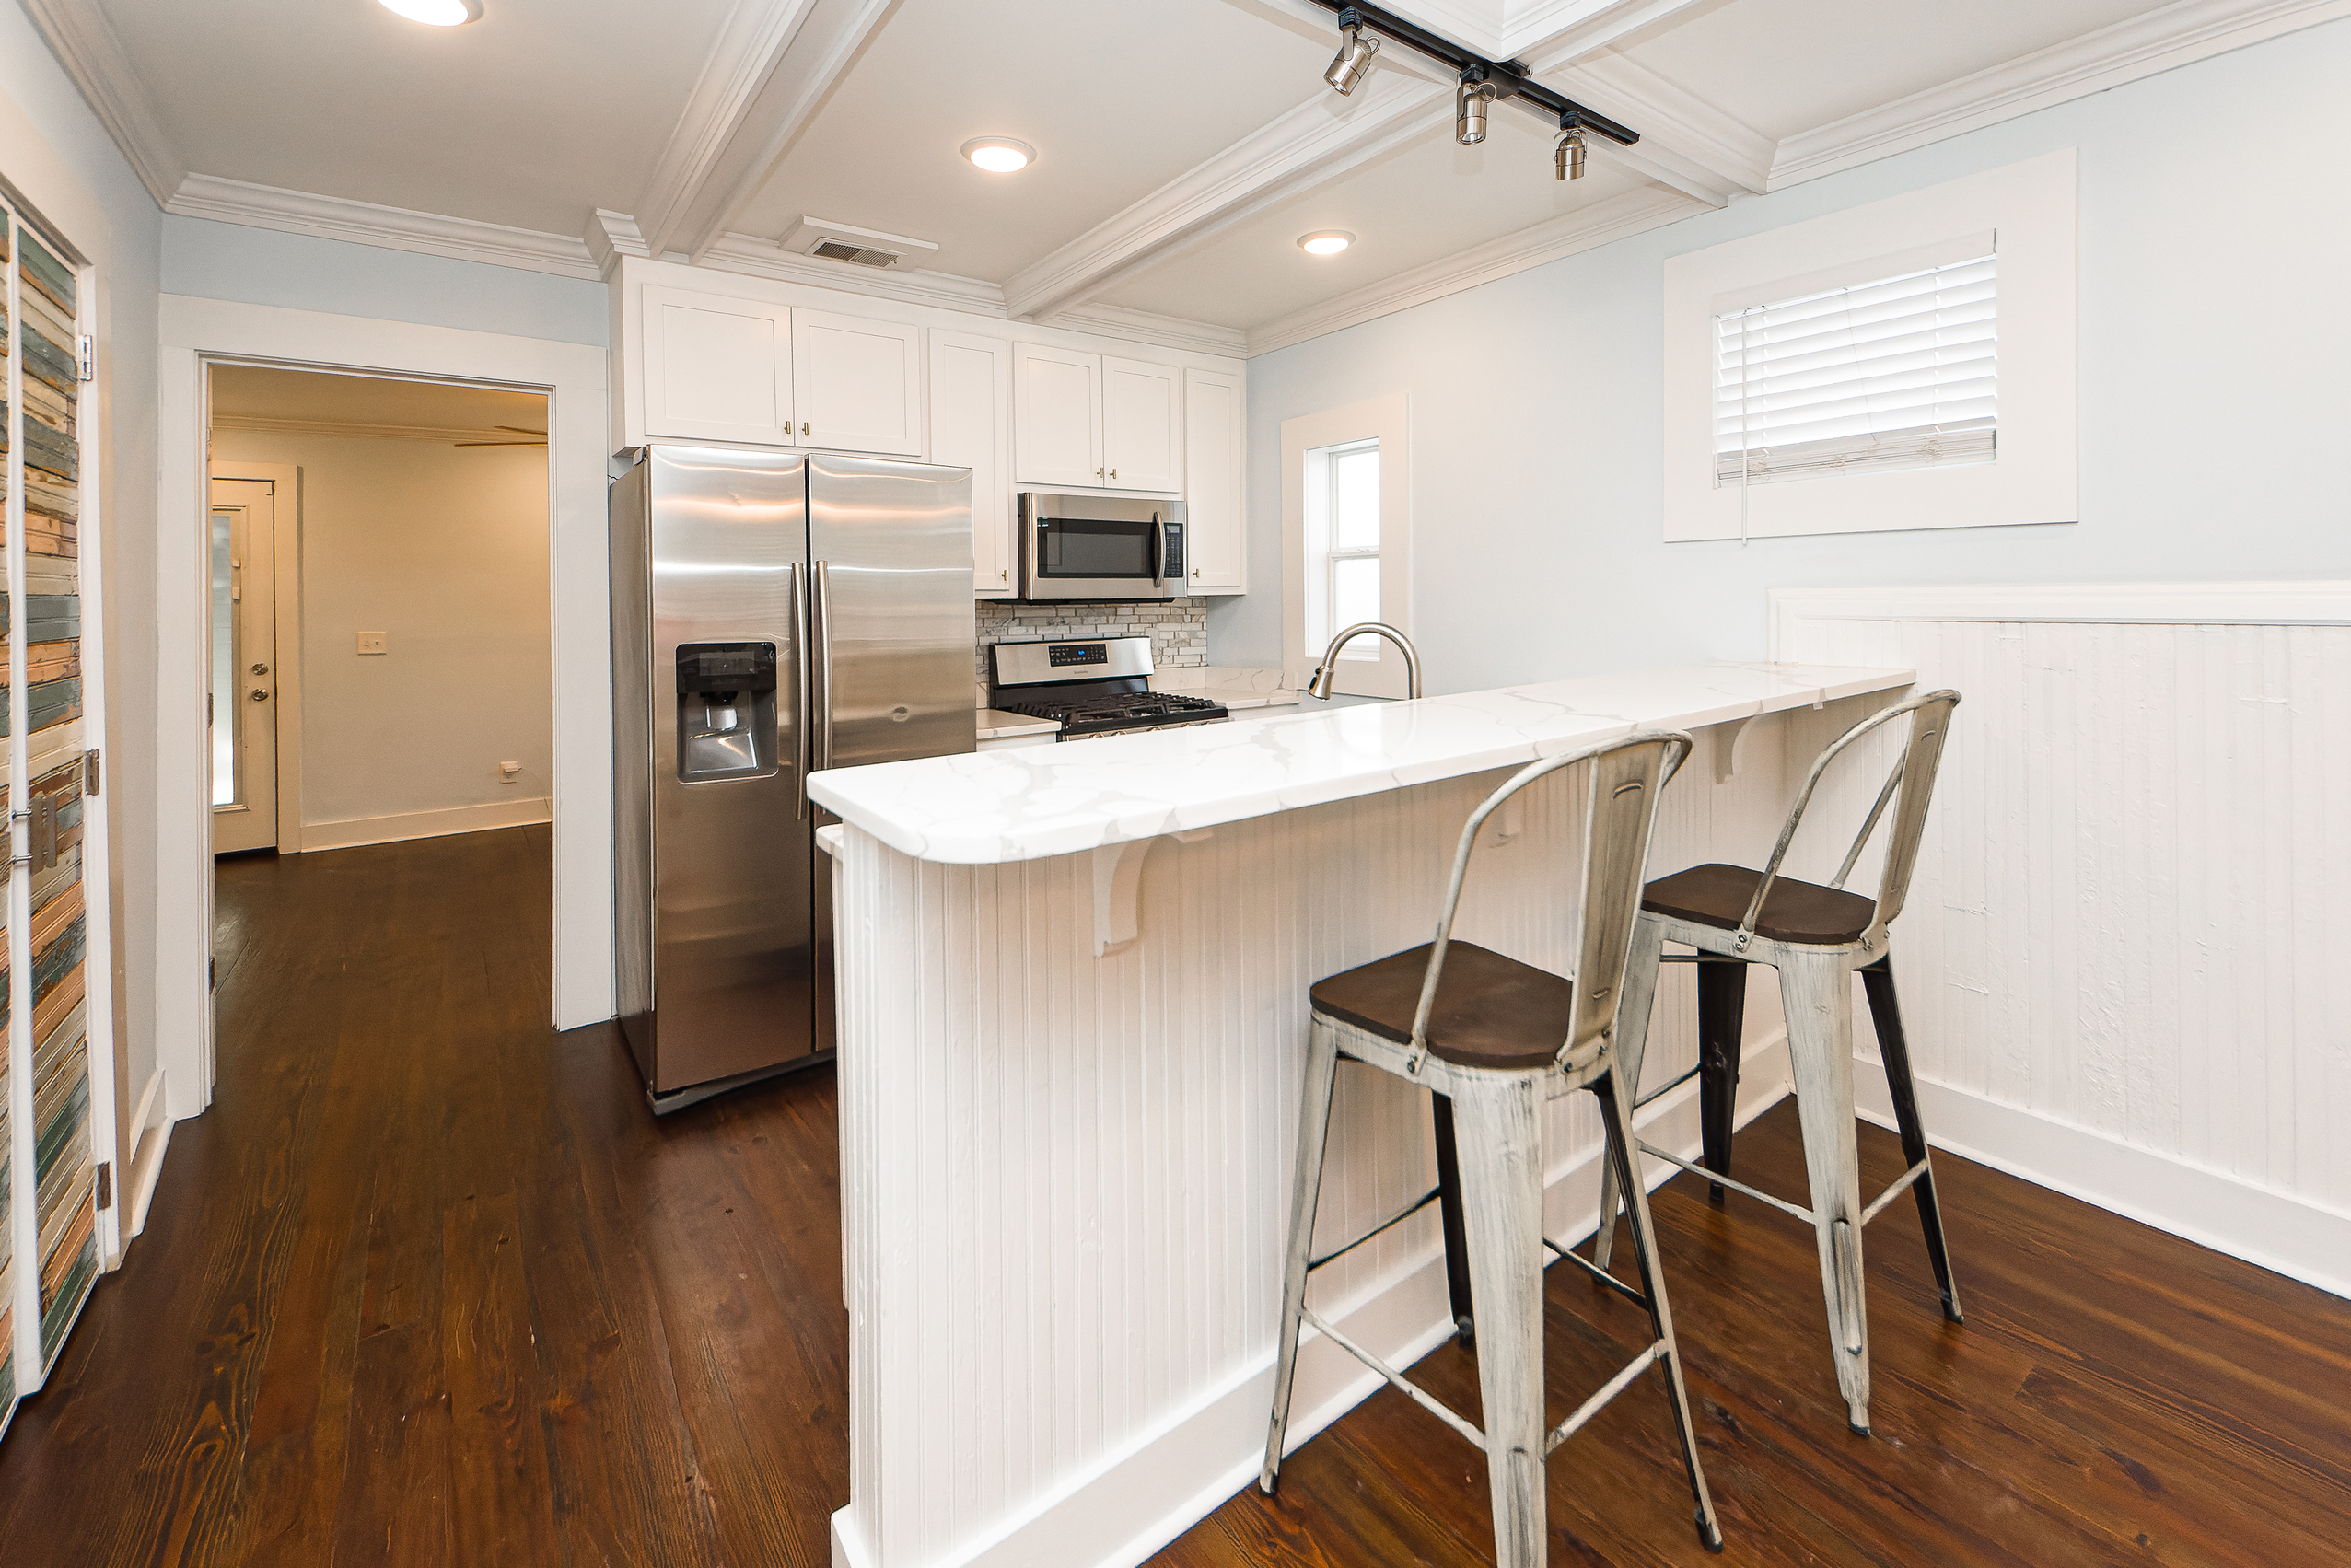
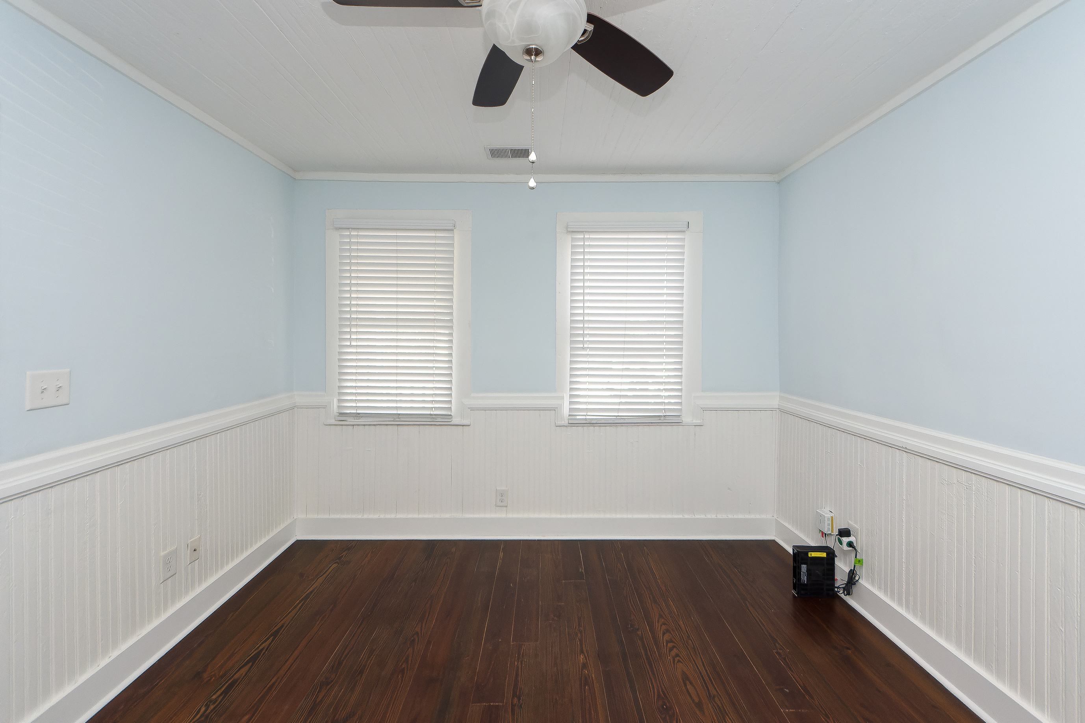
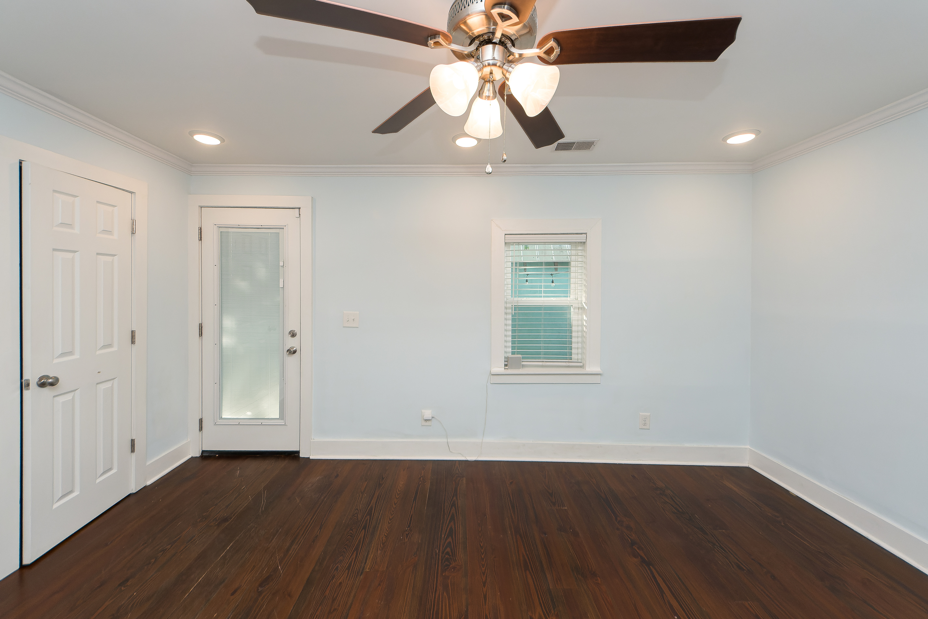
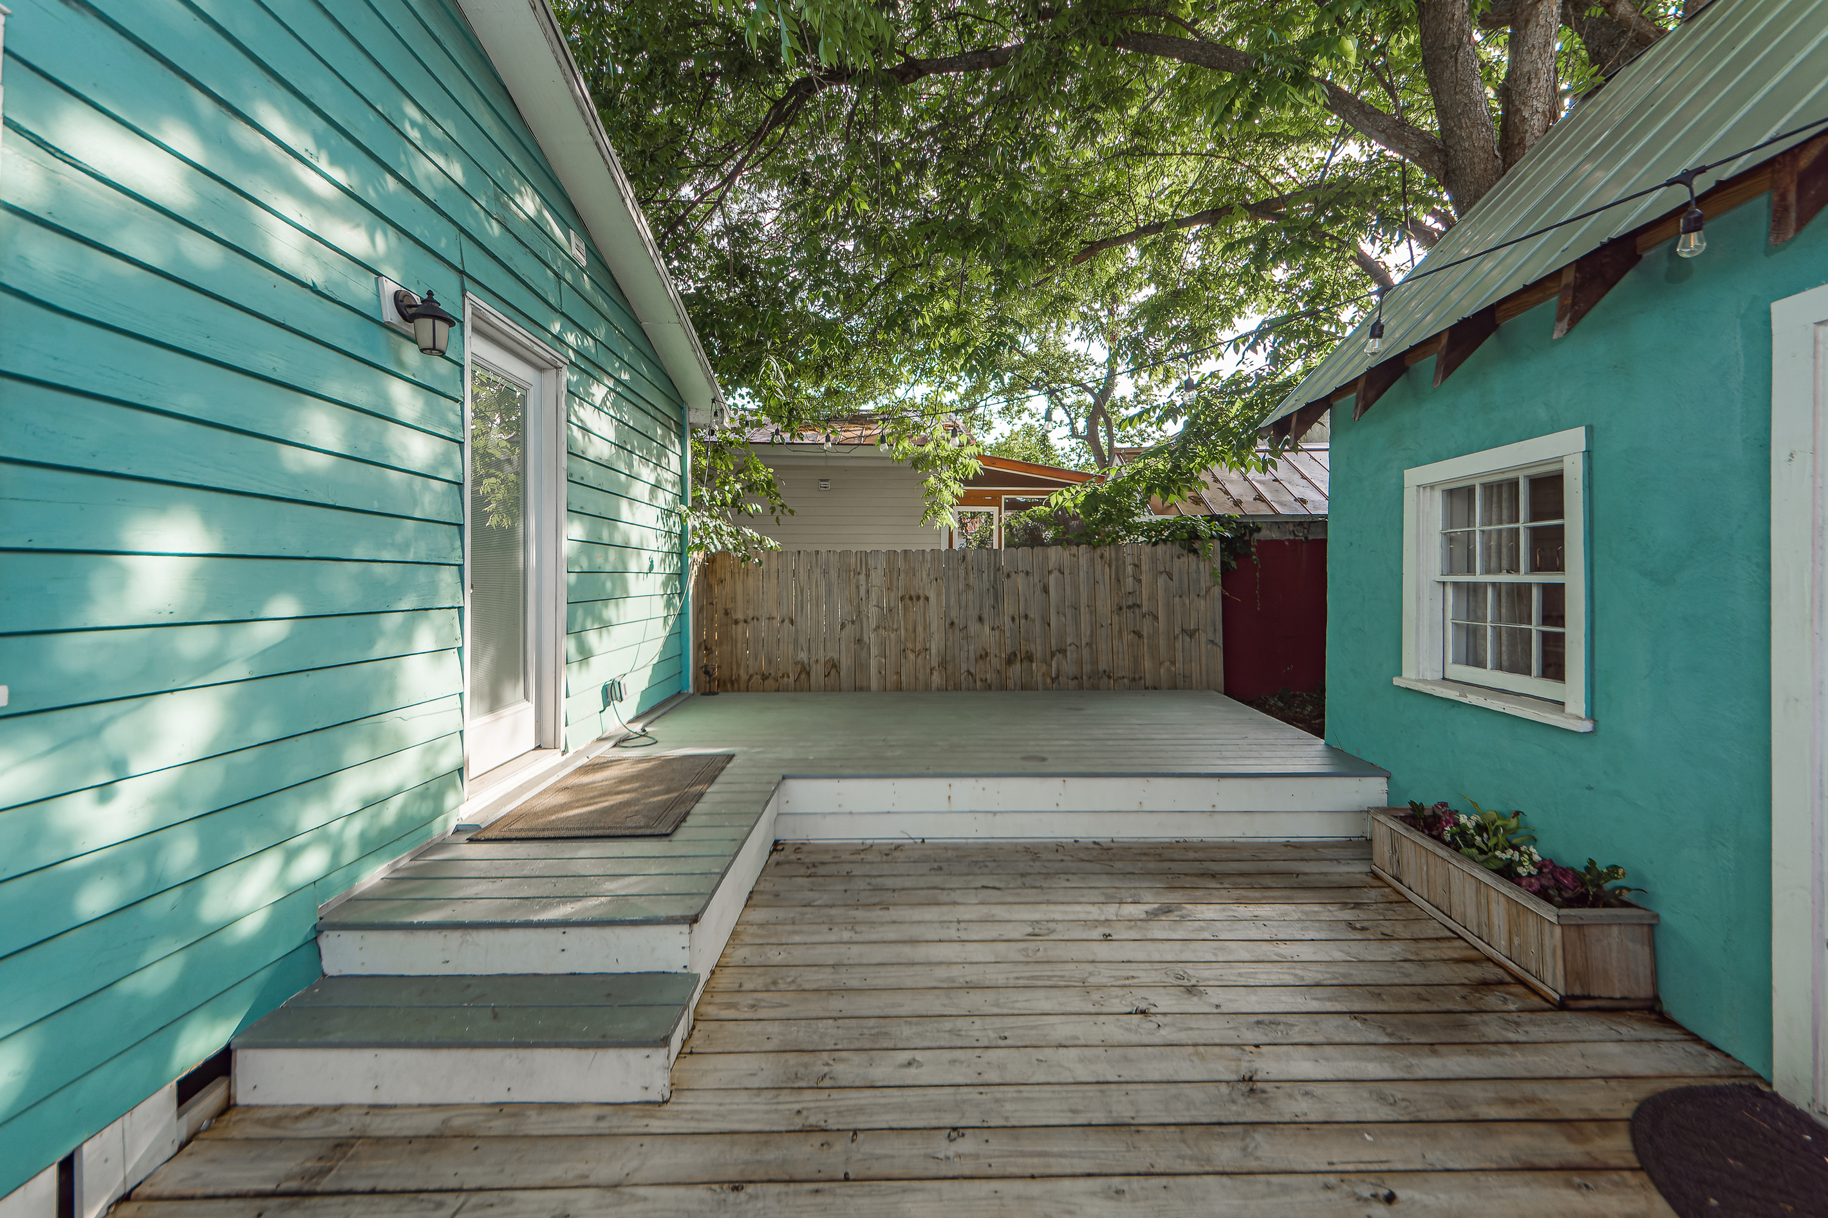
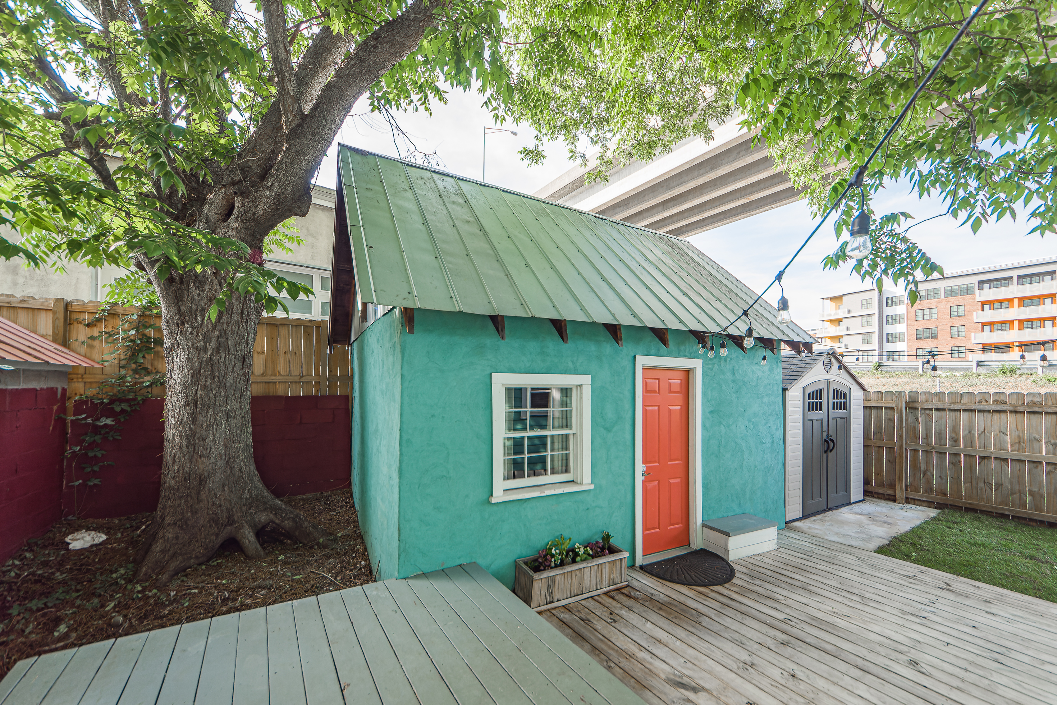
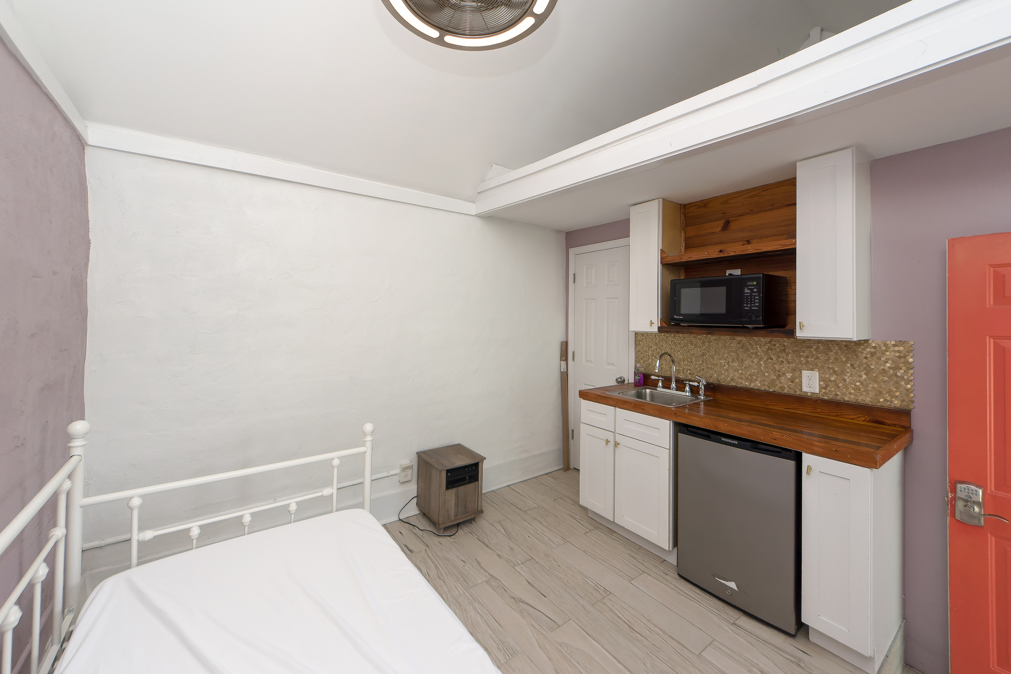
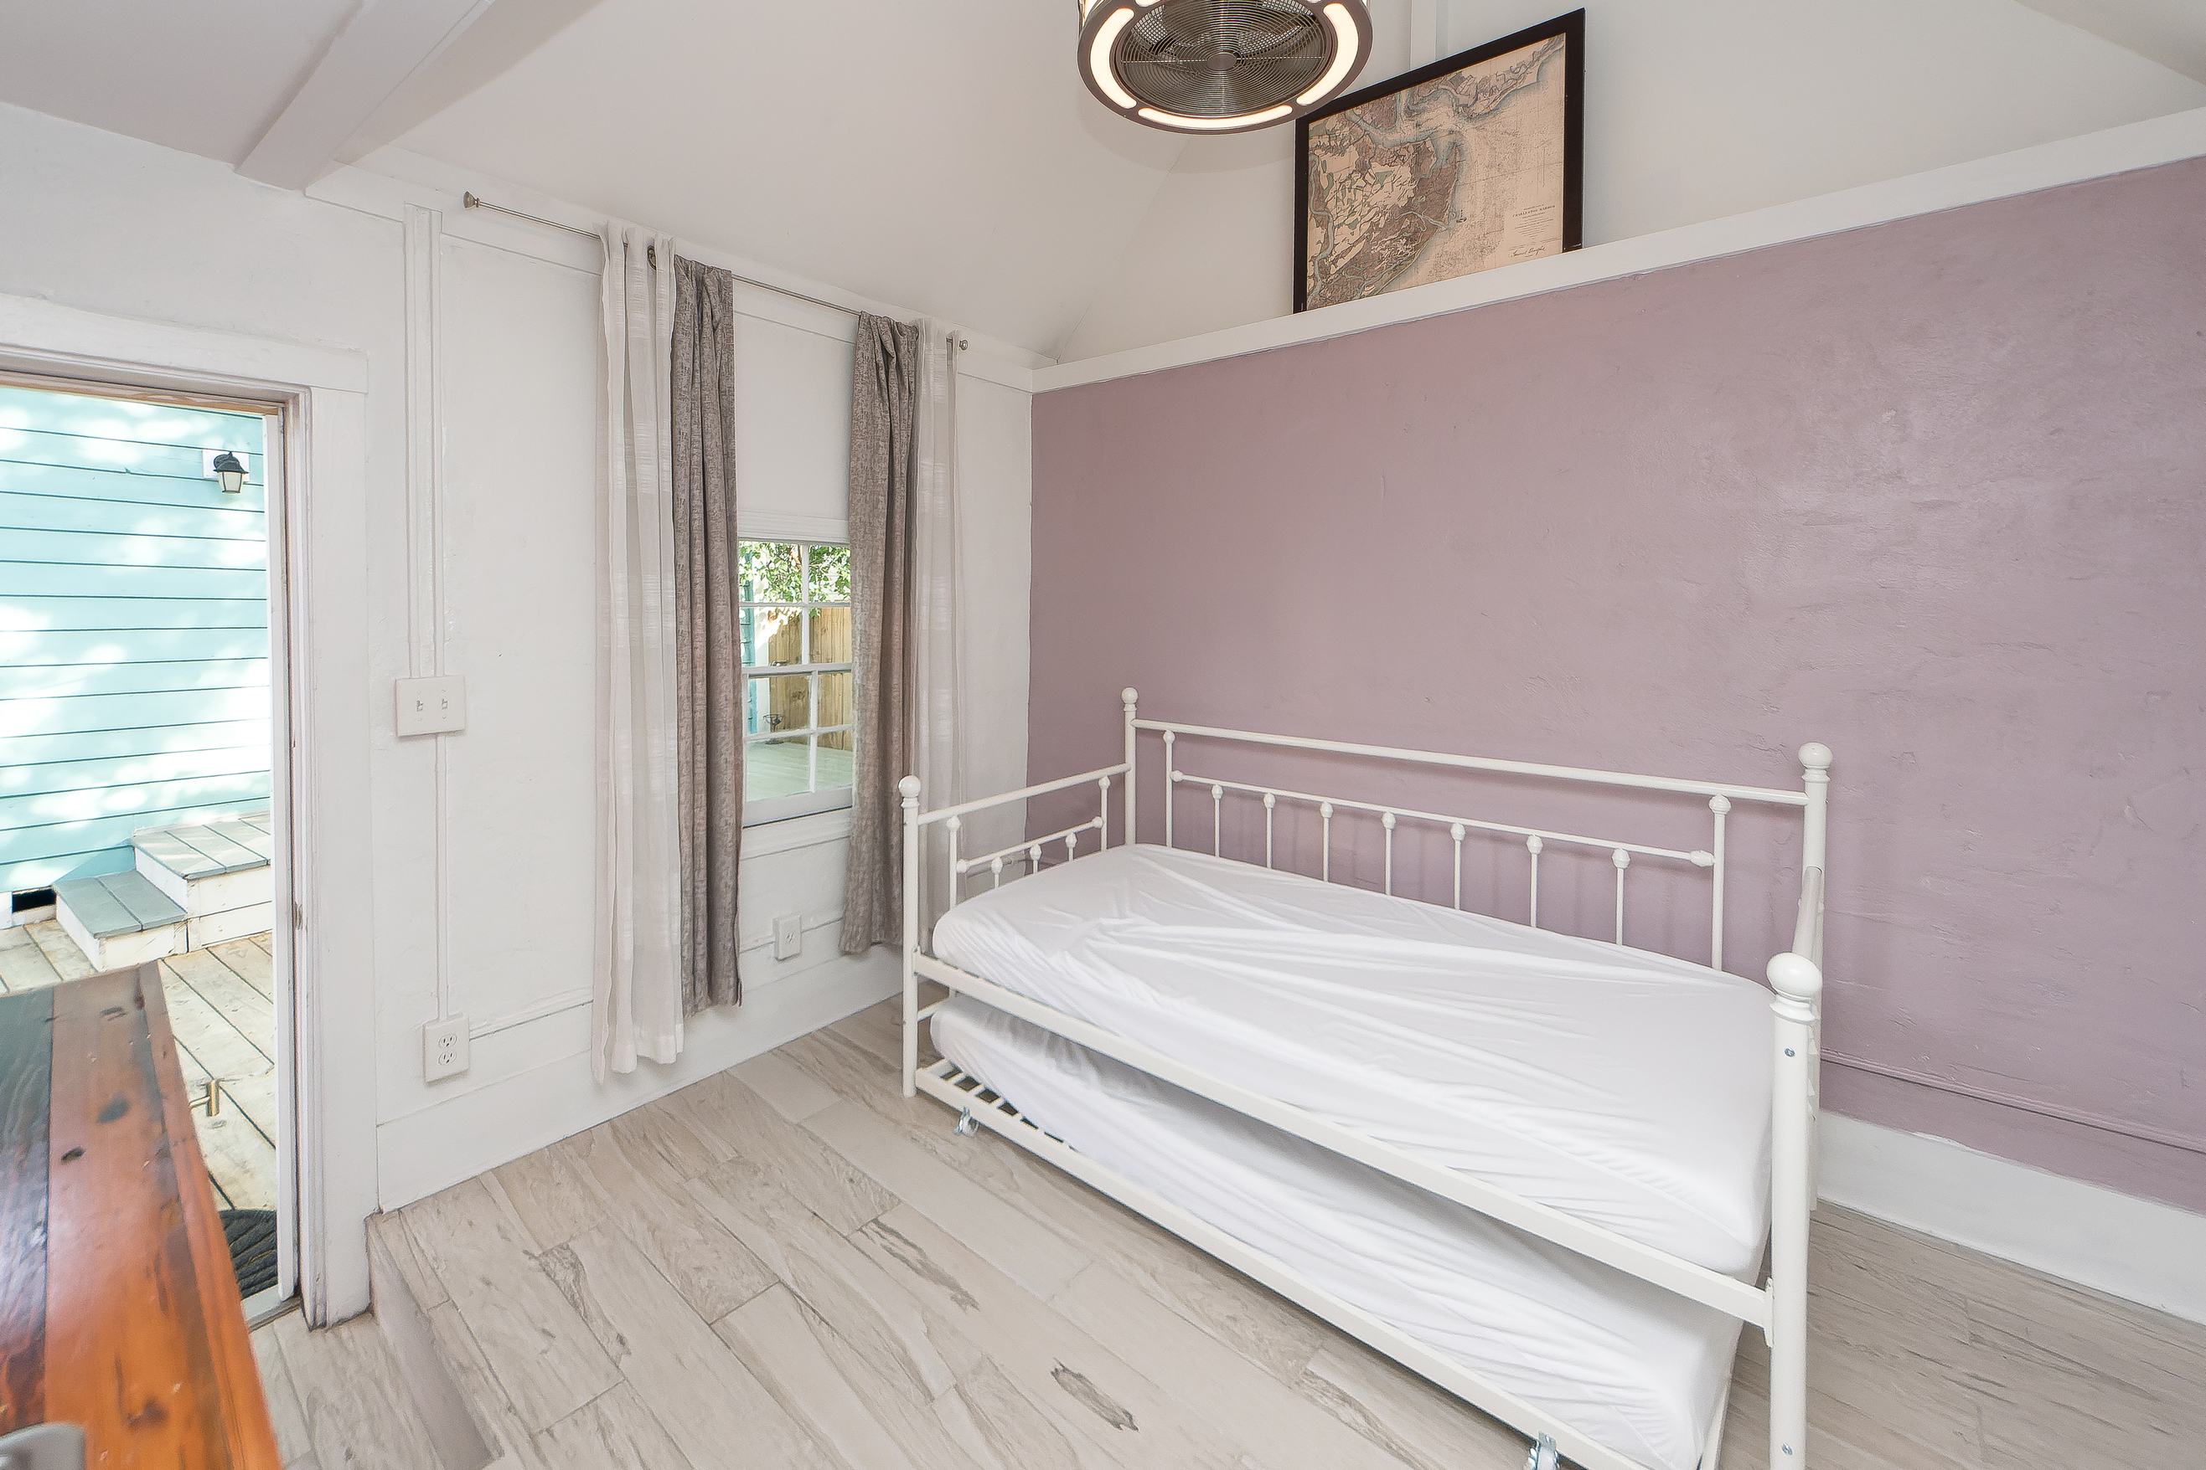
$50k Price Reduction
52 Congress Street
Charleston, SC 29403
MLS# 22014604
$639,900
Charming FULLY RENOVATED 2BD/2BA - PRIME DOWNTOWN LOCATION – Additional Dwelling Unit that is best described as an efficiency unit and can be a STR with the potential to make 35,000 a year or more! Walking in you are greeted by hardwood floors, freshly painted walls, coffered ceilings, and a cozy living room! The upgraded kitchen offers stainless appliances, gorgeous quartz countertops, and plenty of storage. The renovated master bath offers a glass standing shower, new flooring, and a new dual vanity. The back features a large backyard with privacy fence and new deck. New Storage building Tankless water heater, new front fence, off street parking no H.O.A. The home is conveniently located near the upper King Street restaurant & nightlife. This home is in a prime location sitting on the the Lowline which is scheduled to begin in 2023. Walk to Leons, little jacks, Melfi's High Wire Distillery, Palmetto Brewing company, Rodney Scotts and the list goes on. The Lowcountry Lowline is a planned linear park in Charleston, South Carolina to be located on 1.7 miles of old railroad roadbed. It will run from Mt. Pleasant Street to Courtland Street. The park is being planned by the Friends of the Lowcountry Lowline. In 2021, the City of Charleston approved $250,000 to aid the project's planning.
Virtual Tour: https://www.charlestonvirtualhomes.com/2220172/
Fudgy Brabham
(843) 568-1241
fudgy@hbrtwn.com
www.hbrtwn.com
Harbourtowne Real Estate
672 Marina Drive, Ste 110
Daniel Island, SC 29492
Harbourtowne Real Estate | 672 Marina Drive, Ste 110 | Daniel Island, SC 29492

