Slide 1
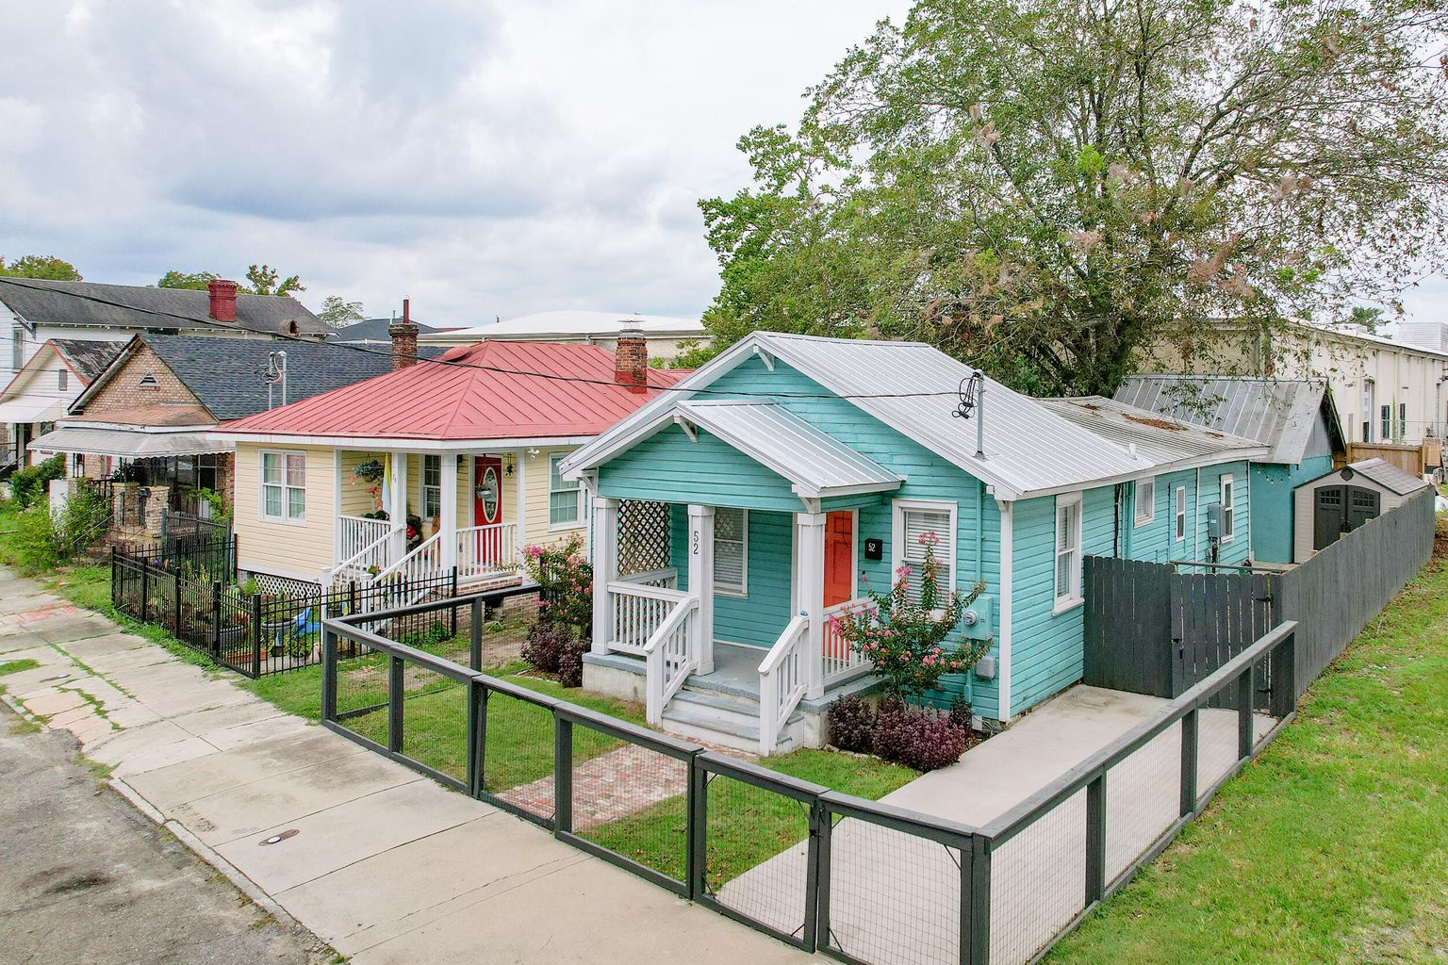

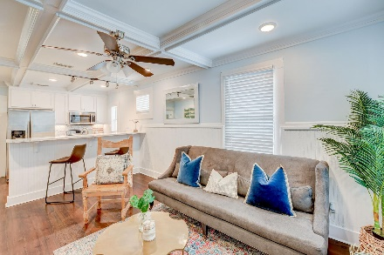
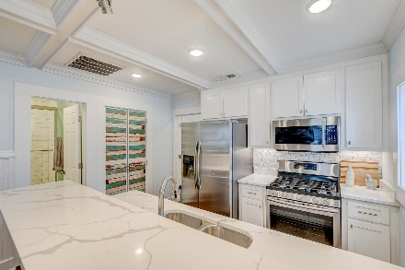
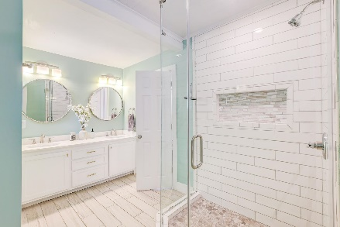
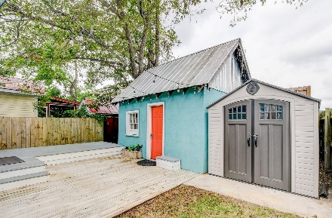
2 Bedroom Cottage
with In-Law Suite
OPEN HOUSE
SATURDAY 12-3
Open House Saturday 12-3
52 Congress Street
North Central ~ Charleston, SC 29403 ~ MLS# 22022328 ~ $639,000
With a phenomenal location in downtown Charleston, this updated cottage offers beautiful design, wonderful convenience, an in-law suite, and NO HOA! A 1.7 mile linear park, The Lowcountry Lowline, is proposed to pass by this home when construction begins. The attractive exterior, including brick from the 1920s, and a welcoming front porch greet you as you enter the home to find an open floor plan, great natural light, wood flooring, and 100 year old reclaimed wainscoting. The family room flows into the kitchen with quartz countertops, white cabinets, a decorative backsplash, stainless steel appliances including a gas range, and a breakfast bar. The owner's suite offers an en-suite bath with a dual sink vanity, updated flooring, a step-in shower, and a walk-in closet. An additional bedroom, a bathroom, and a laundry closet complete the main home. Out back, you'll find a lovely deck as well as an a detached in-law suite or office with a kitchenette and a full bathroom. This home also was renovated in 2017 and
received a new roof and HVAC. There is a tankless water heater, a vapor barrier, a new fence in 2019, and a new lower deck and shed slab in 2020. This property is located just a few blocks from I-26, 0.3 miles from the Crosstown, 0.6 miles from Hampton Park, 1.2 miles from MUSC, and 3.4 miles from Mt Pleasant. Don't miss out of this great opportunity in downtown Charleston!
*Seller is a licensed real estate agent.
Book your showing today!
Matt Johnson mjohnson@mattoneillteam.com 843-830-8901

