Slide 1
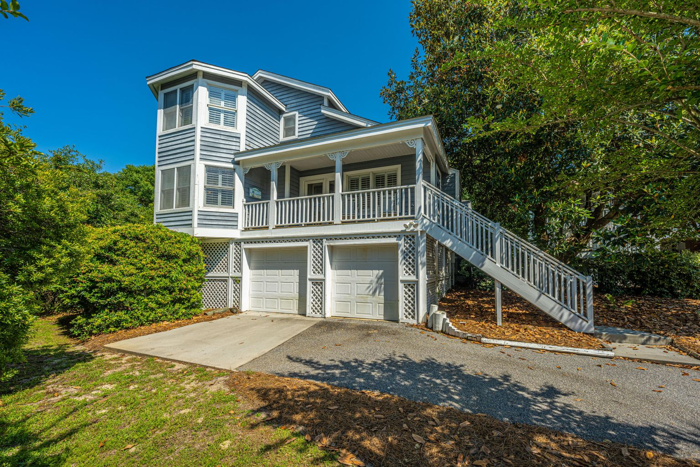
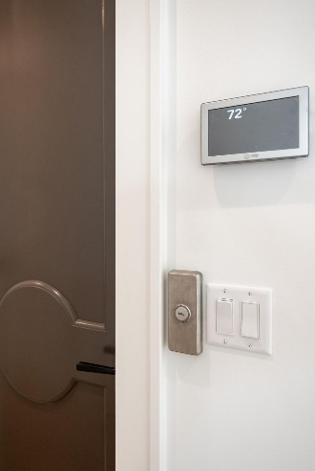
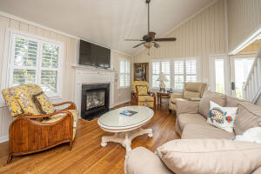
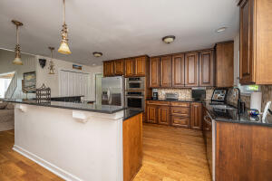
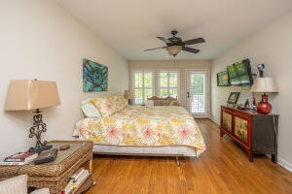
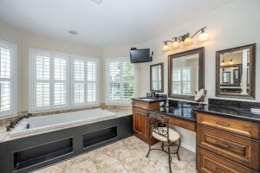
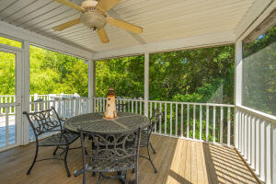
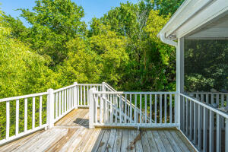
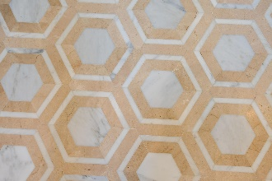


52 Pelican Reach Wild Dunes | Isle of Palms MLS# 22012762 $1,424,999
NEW PRICE!
NEW PRICE
Enjoy the fabulous ocean breezes from this adorable beach cottage hide-away just a stone's throw to the private Pelican Bay pool! This ideal location only requires a quick bike ride or walk across the street to beach access and the beautiful ocean! Too many activity opportunities to mention while enjoying the sunshine in this prestigious gated community. Whether it is golf, tennis, swimming or boating, Wild Dunes can offer it all. The WD marina sits on the Intracoastal Waterway which leads to the Charleston harbor and the barrier islands. This three-bedroom elevated home provides comfort, privacy and plenty of space to feel right at home. The property went through a large 1st-floor renovation in 2009 which added significant square footage and updates. Terrific kitchen is equipped with KitchenAid appliances show off ample counter space and cabinetry, also opening to screen porch for all your grilling needs! Elevator to the first floor level opens up to the kitchen certainly helps with unloading. Master bedroom (wing) with huge closet and bathroom provides more than convenience. Upstairs hosts two very spacious rooms with a hallway closet that is currently being used as the perfect desk niche, and an extra linen closet.
Suzi Baldrick Mobile 843-442-3149
suzi.baldrick@carolinaone.com
www.carolinacoastalproperties.net
Carolina Coastal Group Carolina One Real Estate
1503 Palm Blvd
Isle of Palms, SC 29451-2280

