Slide 1
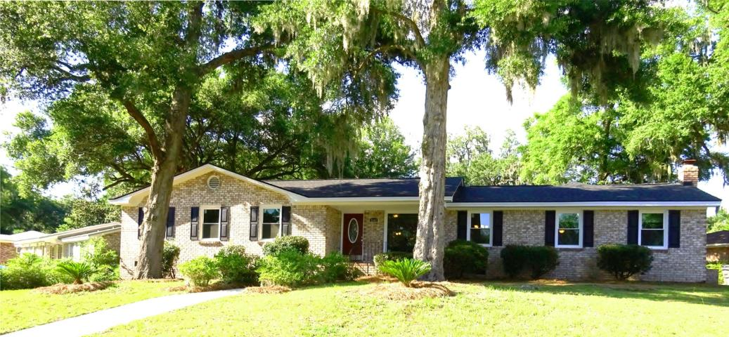
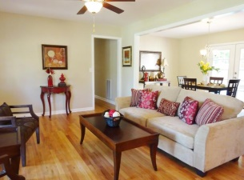
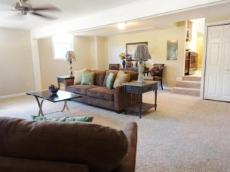
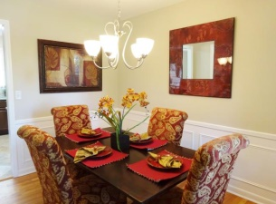
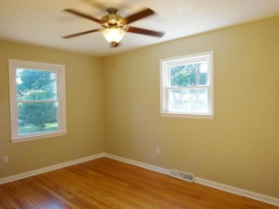
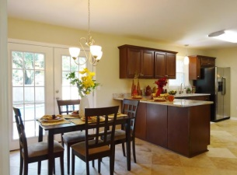
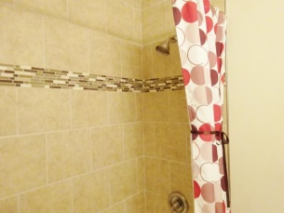
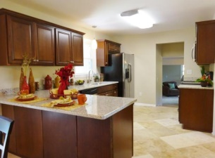
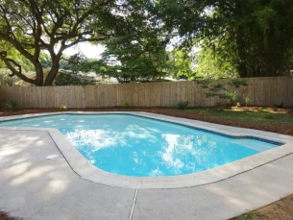

Completely Renovated
5302 Chantilly Lane
Evanston Estates ~ North Charleston ~ MLS# 15015545 ~ $249,900
Completely Renovated Home in the Heart of Everything! You have to see this fabulous renovation to believe it. New 30yr. Arch. Shingles, All New Storm Low-E Windows, All plumbing has been replaced and so much more! Finished with travertine tile, granite countertops, SS appliances and custom baths. Walk in to a new open floor plan featuring a formal living and dining rooms as well as a large eat-in kitchen Complete with breakfast bar. Enjoy your coffee while looking thru French doors to your own private outdoor oasis with newly renovated pool and privacy fence. This fabulous home also features a large den with FP, 4 spacious bedrooms, 2 full baths, and a 2 car garage on a corner lot that has been professionally landscaped! This home has everything you could ever want!
Karrie Britton
M - (843) 478-9638
design_elements@msn.com

