Slide 1
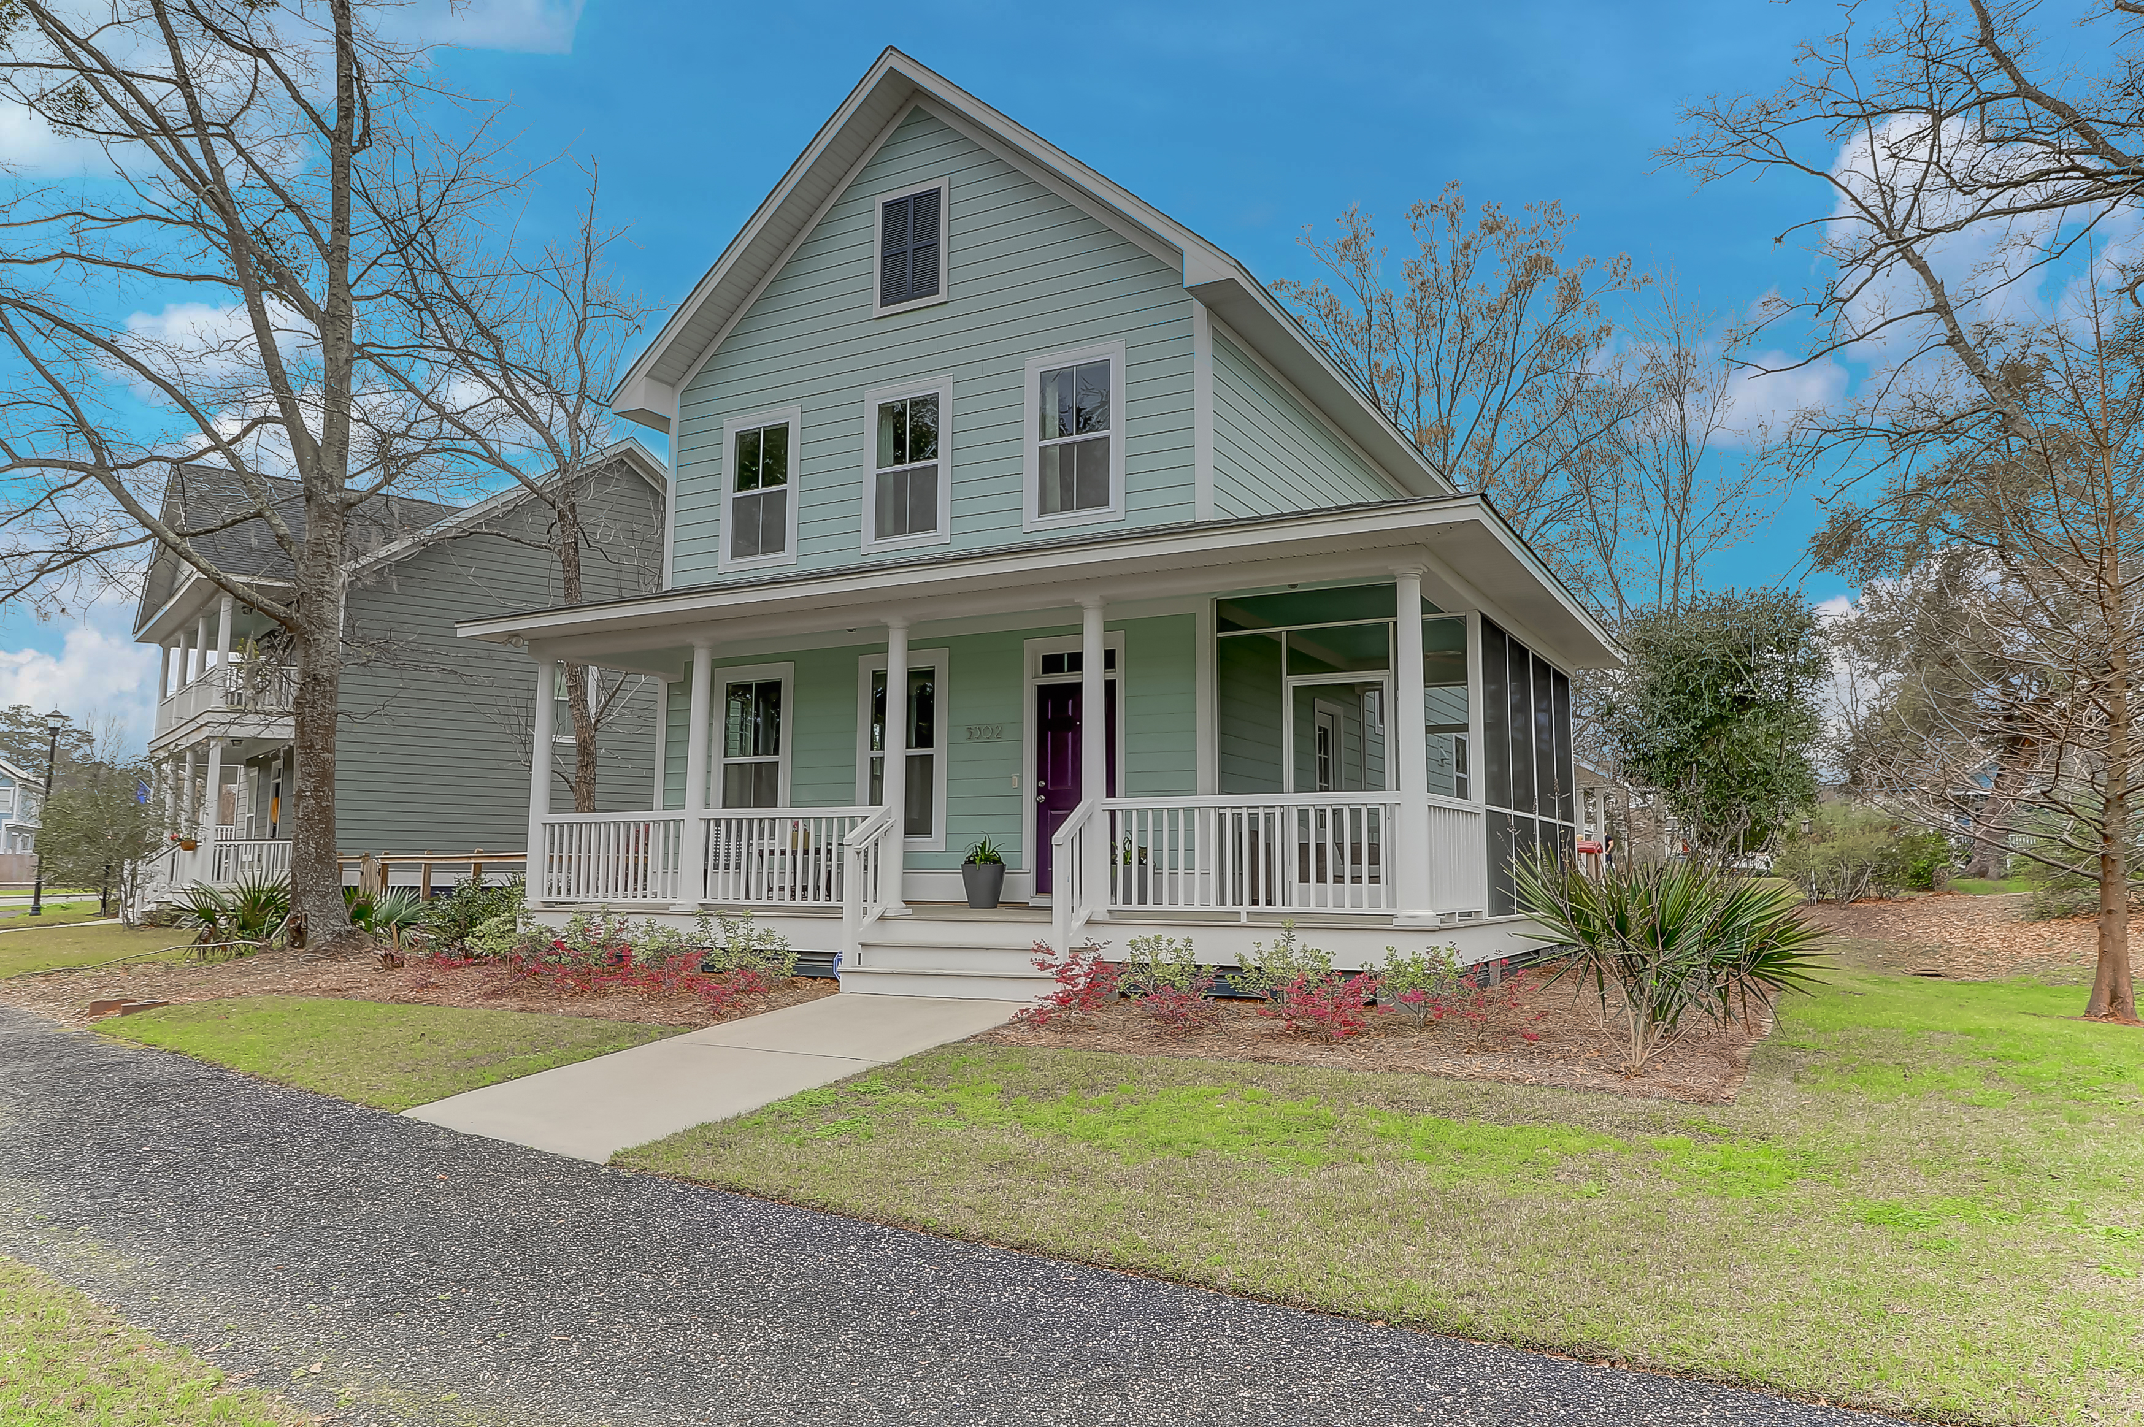
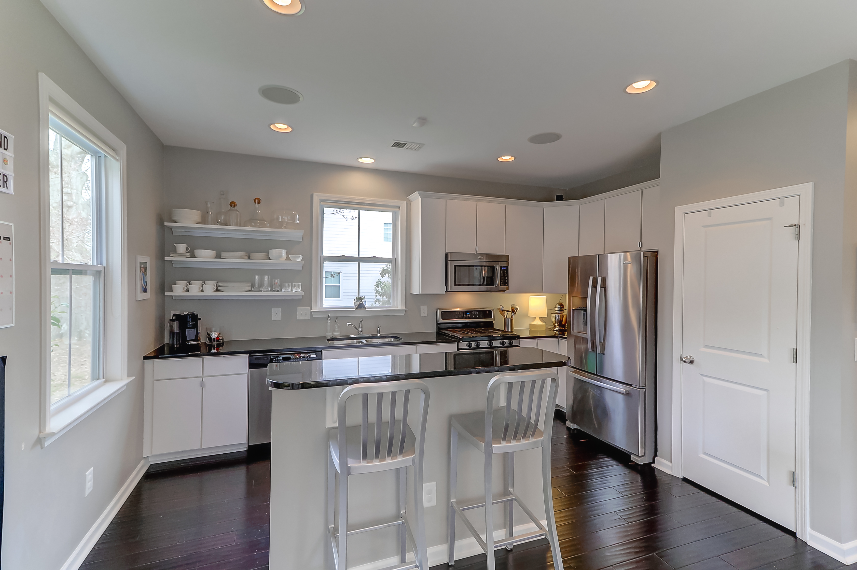
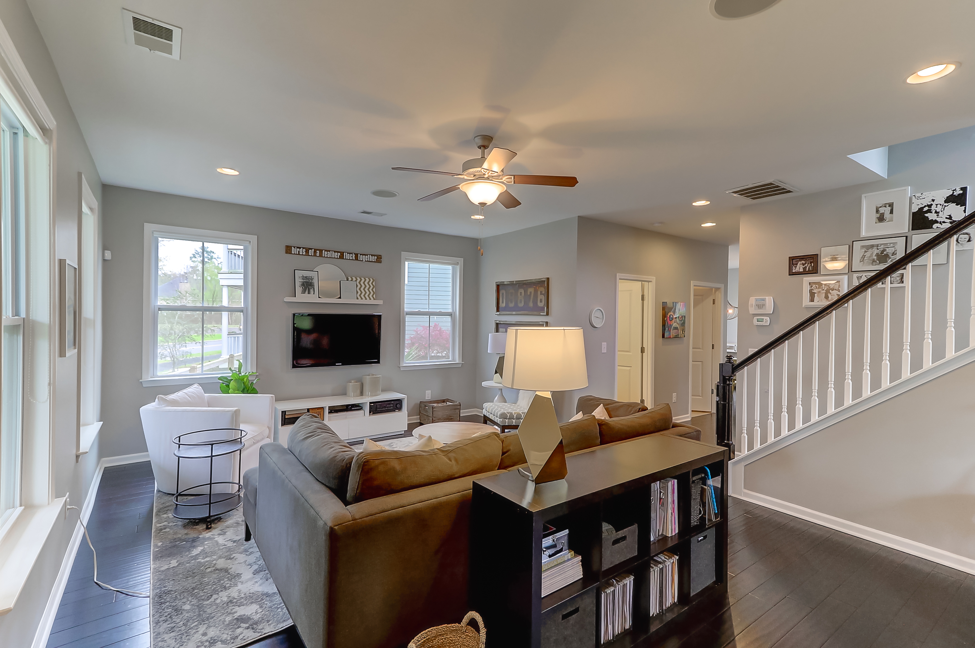
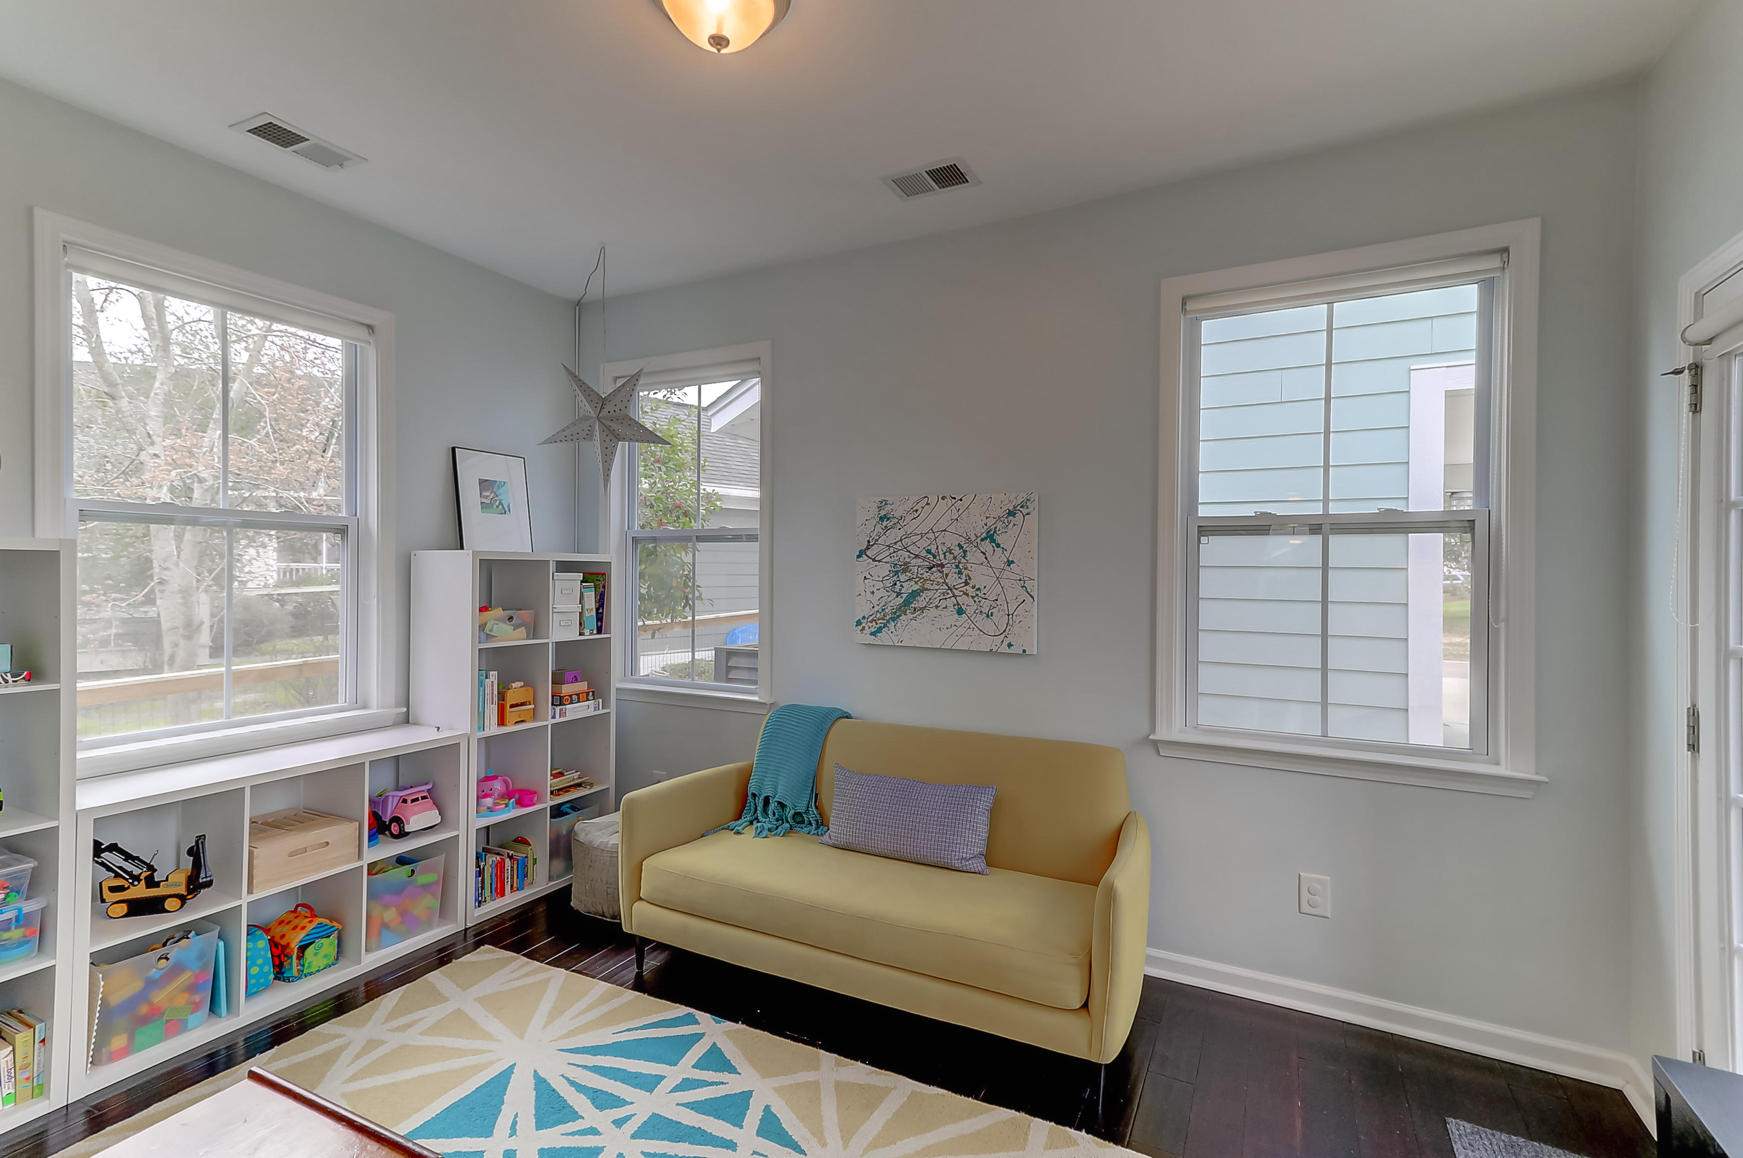
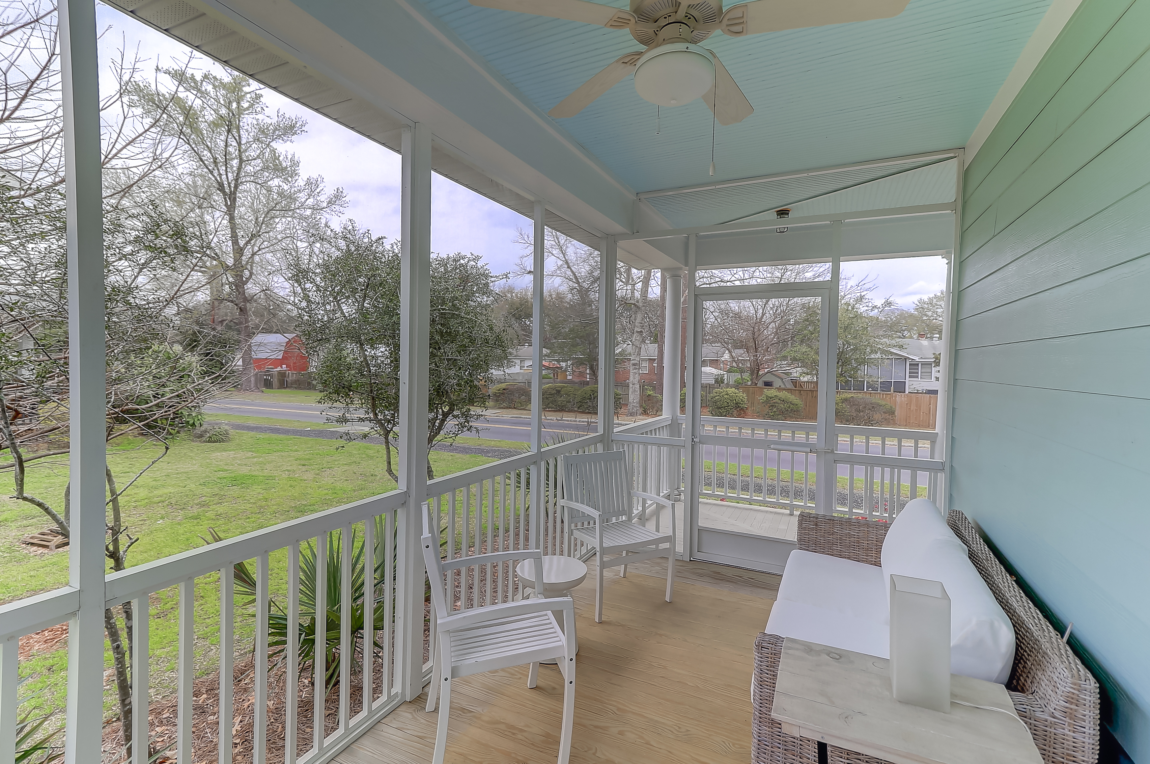

Coming On The Market Today!
Open House Saturday March 3rd
11:00-2:00
DRAFT
5203 E Dolphin Street
Oak Terrace Preserve
North Charleston, SC 29414
1,800 sf. Central to everything in the low country. About a mile from Park Circle restaurants, bars, breweries, parks, and only a couple miles from Tanger.
Move in ready. Currently the only existing home on the market in Oak Terrace Preserve. It's not going to last. Come see it Saturday!
Derrick McDuffee
(843) 371-2890
derrick.mcduffee@carolinaone.com
Carolina One Real Estate 2713 Highway 17 North
Mt. Pleasant, SC 29466

