Slide 1
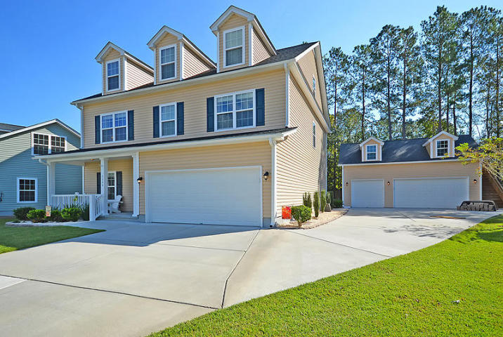
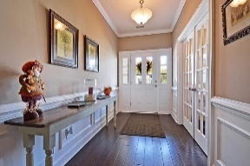
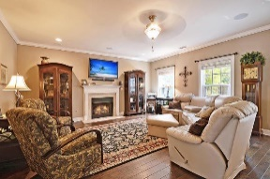
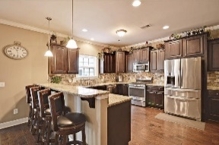
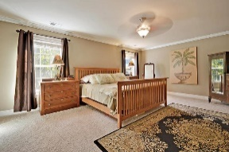
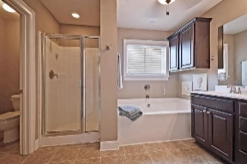
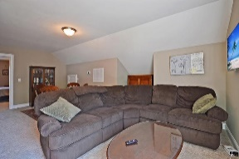
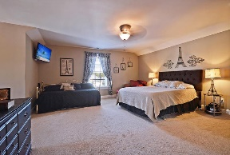
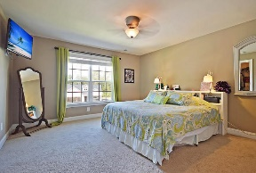
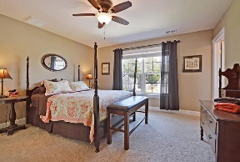
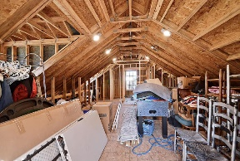
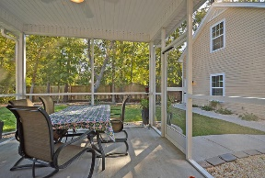
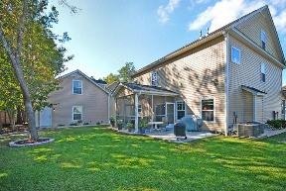


Five Car Garage! Like New Home!
5304 Natures Color Lane
Indigo Fields
North Charleston, SC 29418
MLS# 16027679
$419,900
5 Bedrooms | 4½ Baths | 3,415 sf
This beautiful 3,415 Sq. Ft., 5BR, 4.5BA home is in IMMACULATE, move-in condition and is VERY UNIQUE! What makes this home so unique? A 2 car attached garage and a 3 car detached garage for a total of 5 garages! There are no other homes in the area and price range that offer this feature! Also, on the 2nd floor above the 3 car detached garage is a large framed out area with electricity and access to plumbing to complete an apartment or guest suite if desired! The kitchen is huge and offers granite counters, gas cooktop w/ pot filler and top of the line stainless steel appliances. Downstairs buyers will also find a large family room with gas fireplace, beautiful hardwood floors, separate dining room, office (which can be 5th BR if needed) and access to the screened porch and back patio. On the second floor, buyers will find the large master bedroom as well as two additional bedrooms and ALL bedrooms have their own full bathroom! On the third floor, buyers will find a spacious bedroom with a full bathroom as well as a sitting room / upstairs family room. The 3rd floor can be a guest suite with it's own family room! This home is a MUST see and very close to Boeing and Bosch as well as many Dorchester Rd. restaurants and shopping opportunities. Less than 10 minutes to the airport!
Larry & Kathy Mazalatis
Larry Cell 843-693-0529
Kathy Cell 843-693-0159
Office 843-871-9133
AGENTOWNED PREMIERE GROUP | 1800 TROLLEY RD | SUMMERVILLE, SC 29485

