Slide 1
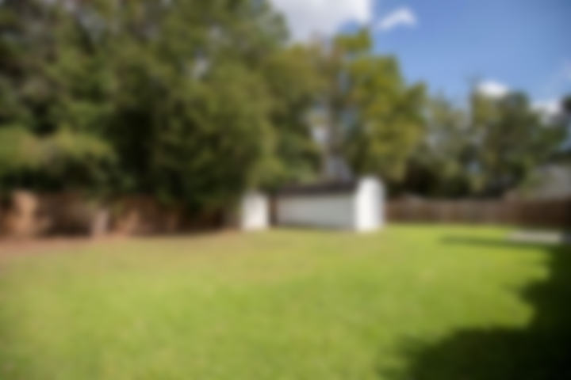
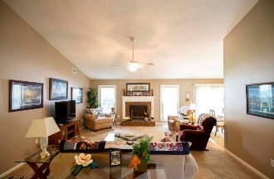
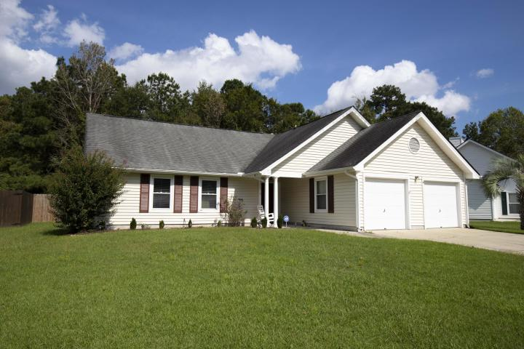
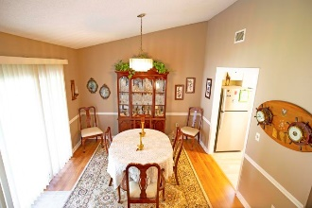
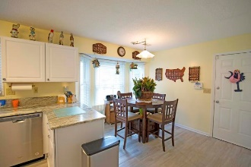
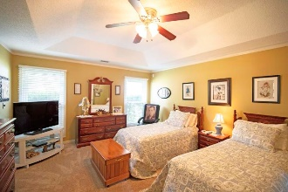
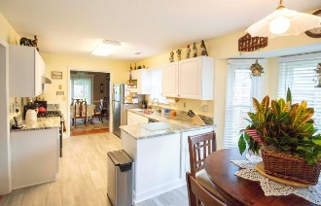
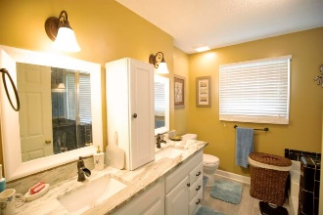
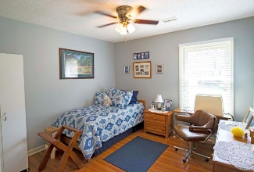
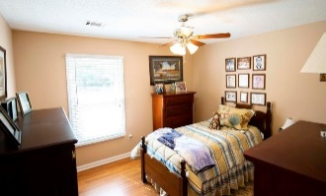
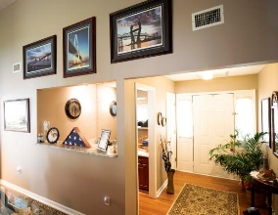
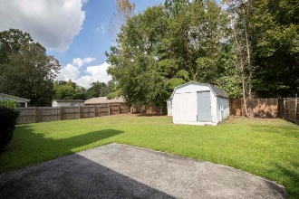
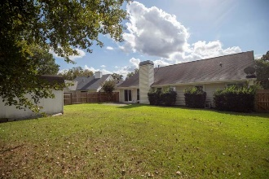

5308 Sumters Run
Riverchase ~ Charleston ~ MLS# 18027155 ~ $259,900
Custom home on beautiful lake!
Nicely Updated Ranch! Located minutes to Boeing!
Beautifully updated ranch style home in River Chase subdivision, located in Dorchester District II school district. Upon entering through the front door, you will notice a wet bar just off the entrance looking onto the large family room. Off the family room, you have a newly renovated kitchen and spacious dining room with access to the backyard. Down the hall from the family room, you will find the master bedroom toward the backside of the home and two spare bedrooms located on the frontside of the home. Recent upgrades include: Flooring, new paint, fully renovated kitchen including new appliances, updated bathrooms, and windows. Homeowner has done a fantastic job on upgrade selections and this home is move in ready! Minutes to the Charleston Air Force Base, Bosch, and Boeing.
Scott Fulton
(843) 324-8845 O | (843) 324-8445 M
scott.fulton@agentownedrealty.com
AgentOwned Preferred Group | 824 Johnnie Dodds Blvd | Mt Pleasant, SC 29464

