Slide 1

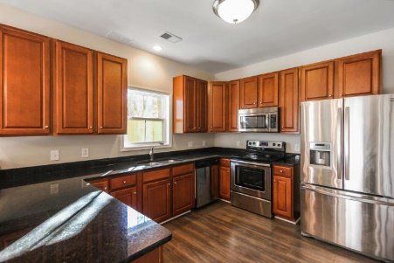
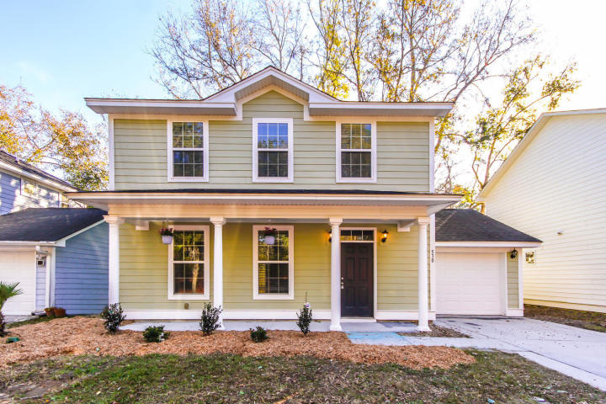
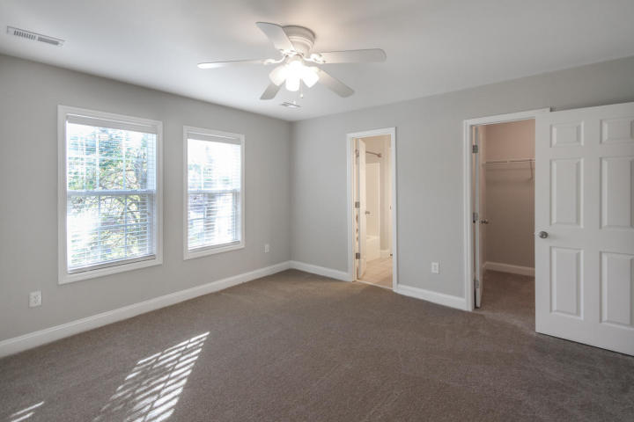
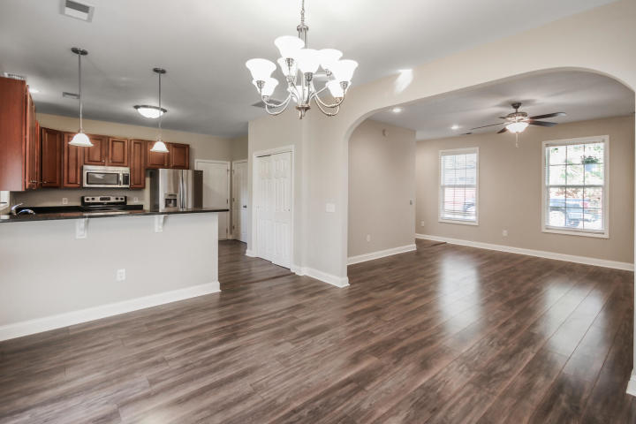
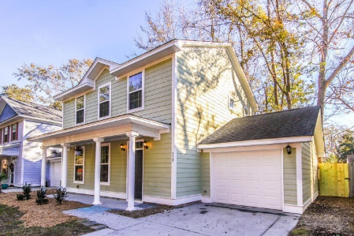


Beautifully Updated W Ashley Home - Priced to Sell!!
530 Walk Easy Lane
Pebble Estates ~ Charleston, SC 29407 ~ MLS# 19034135 ~ $299,899
Absolutely gorgeous low-maintenance home in the heart of West Ashley. This home is just steps away from the Greenway for biking/jogging/walking. 9' smooth ceilings, brushed nickel fixtures, stainless GE appliances, granite counters, newer dual Lennox HVAC units with 2 updated thermostats, Hardi-Plank siding, architectural shingles, Low E windows, freshly painted, New Laminate flooring, New carpet on the second floor and attached 1 car garage. No flood insurance or wind and hail insurance required. The home priced well below comps and is priced aggressively to move.
Peter Stanley
M 843-300-8251
petermstanleyjr@gmail.com
Brand Name Real Estate
4 Carriage Lane Suite 106
Charleston, SC 29407

