Slide 1
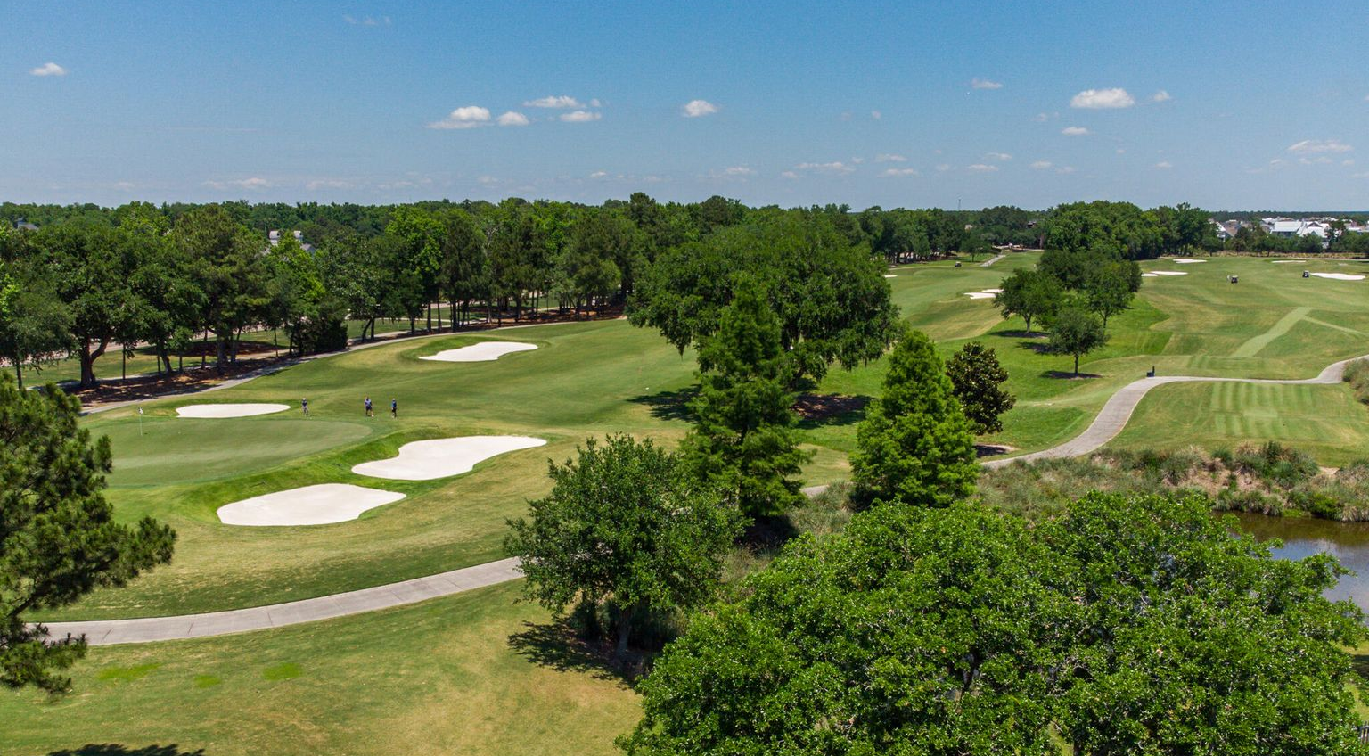

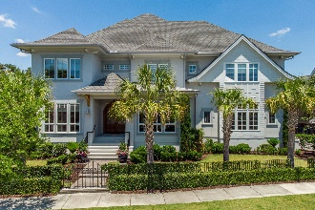
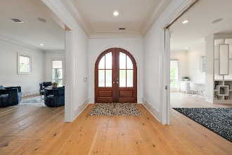
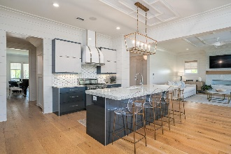
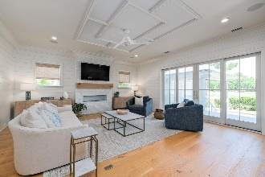
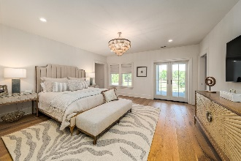
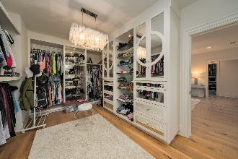
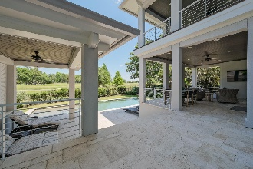
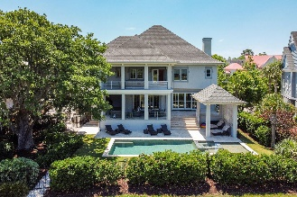
Custom Daniel Island Golf Course Home
530 Park Crossing Drive Daniel Island Park | Charleston, SC 29492 | MLS# 21013048 | $3,195,000
Don't miss this custom Daniel Island golf course view stunner with a pool. Come through the mahogany arched door and begin the journey to sheer perfection. 5 bedrooms on the second floor lend for fabulous open and vast entertaining space on the main level. This home has it all. Open floor plan, flex space, office, pantry, porch. The drop dead view from the porches and new outdoor kitchen area overlooking the Ralston course. The inside has been redone to a coastal chic with wide plank light floors, white paint throughout, gorgeous lighting and conveniences in the kitchen including a deep pantry, mud drop zone and fabulous usable spaces. This one won't last.
Take a video tour: https://vimeo.com/551541893
Clarice Cawood 865-776-2252 clarice.cawood@carolinaone.com
Jacquie Dinsmore 973-886-0357 jacqueline.dinsmore@carolinaone.com
The Cawood Dinsmore Group | Carolina One Real Estate | 1101 St. Thomas Island Dr. | Charleston, SC 29492

