Slide 1
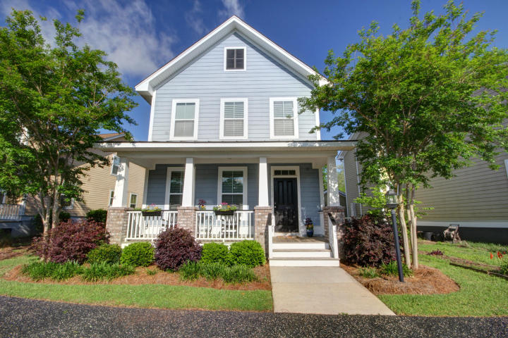
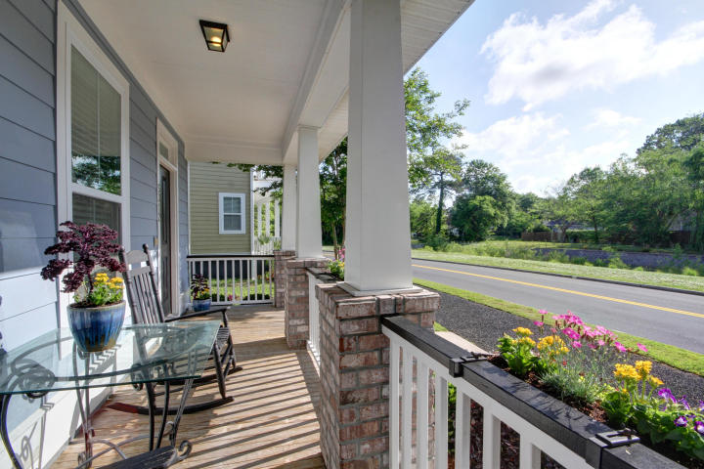
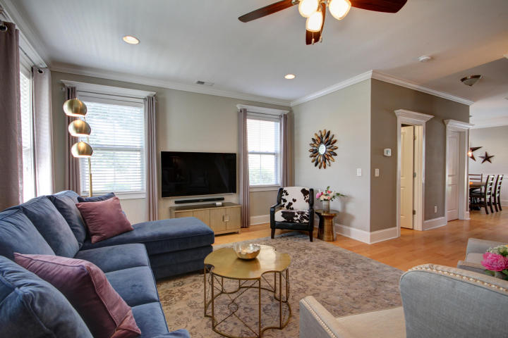
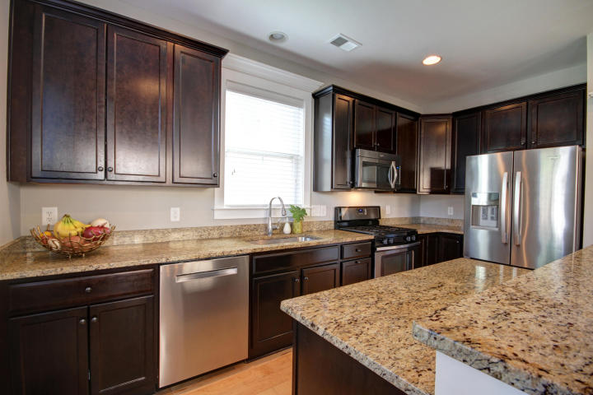
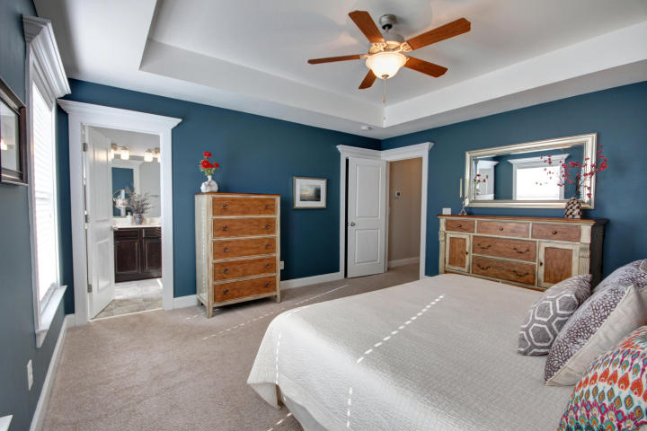
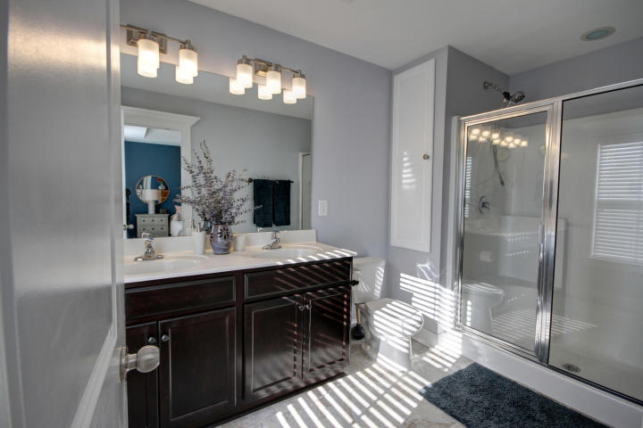
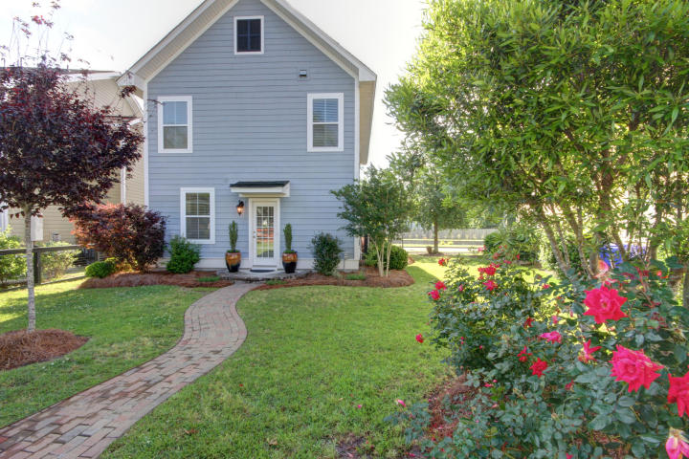

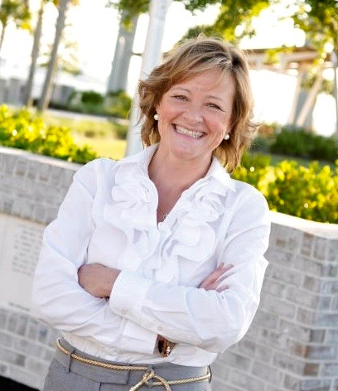
5312 E Dolphin Street
Oak Terrace Preserve ~ North Charleston SC 29405
$1,600 CREDIT AVAILABLE
toward buyer's closing costs and pre-paids with acceptable offer and use of preferred lender.
Shows Like a Model Home - but you DON'T have to wait on new construction! Fabulous Home in Oak Terrace Preserve! Southern charm front porch and beautiful landscaping welcome you. Inside - this house is loaded with upgrades when built. Extensive crown throughout the main floor and upstairs, gorgeous engineered hardwood floors in living area, half bath and kitchen, upgraded cabinets, granite,SS appliances and custom lighting in the kitchen and wood blinds throughout. Bright & Open - on a Picture Perfect lot. Large living room with upgraded trim package, a half bath and laundry complete the first floor. Upstairs huge Master Suite & 2 more bedrooms with a hall bath.
The backyard has a great storage shed for all your "toys" and "stuff". Gardens and lawn complete this darling property. Location: Park Circle is convenient to all of Charleston with easy access to 1-26 and 1-526. This neighborhood is within walking distance to highly desirable School of the Arts, Academic Magnate, and North Charleston Creative Arts Elementary.
MLS# 18012408 ~ $320,000
Geri Lipps
843.810.8398
glipps@carolinaone.com

