Slide 1
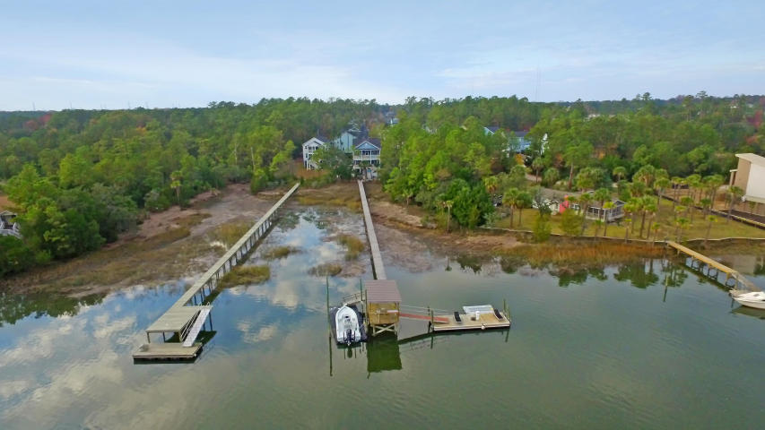
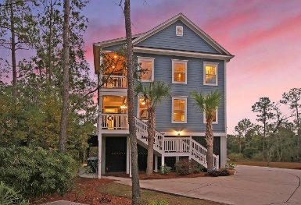
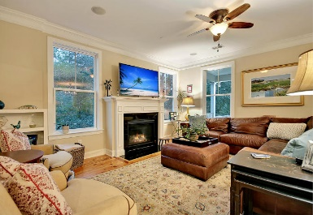
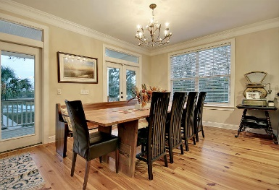
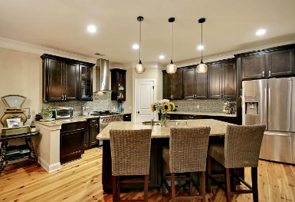
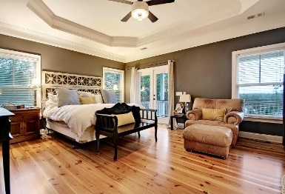
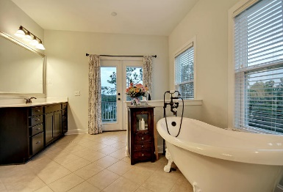
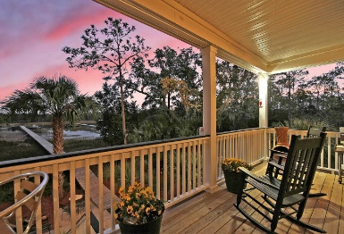


531 Sanders Farm Lane
Retreat at Beresford ~ Charleston ~ MLS# 16006026 ~ $939,990
Just Reduced $15k!
Enjoy a piece of the Lowcountry in your backyard!
Beautiful home on deep water lot. 4+ Feet at low tide! Floating dock, with a covered pier head and water/electric run. The lot is wooded on one side and sits next to a HOA lot so there is great privacy. The home has pine hardwoods throughout, granite gourmet kitchen with stainless 36'' gas range and hood, French doors, large pantry, walk in closets, surround sound in living room, porches, and master bath. There are over 600 sq ft of porches off of the living area and Master suite to take advantage of the amazing views of Nowell Creek. Master bath has 2 large vanities and a free standing claw foot soaking tub, with French doors opening out onto the porches and river.
Jonathan Vroon
(843) 514-3114
jvroon@southernlivingre.com
www.southernlivingre.com
Southern Living Real Estate 2249 Salt Wind Way, Mt. Pleasant, SC 29466

