Slide 1
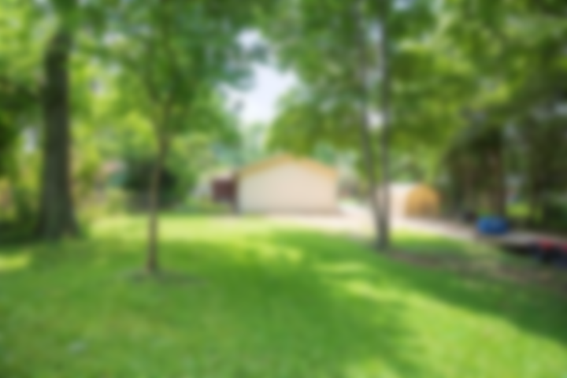
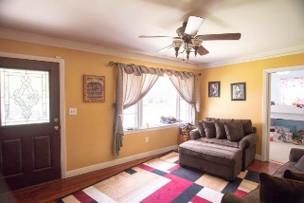
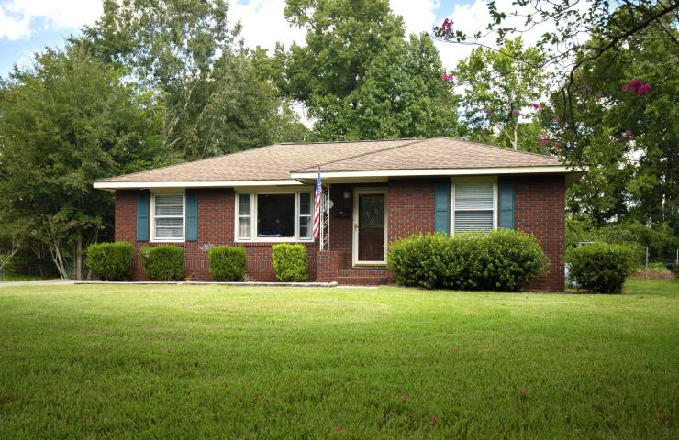
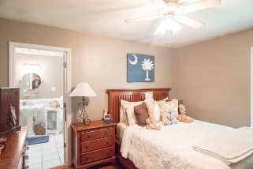
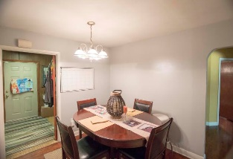
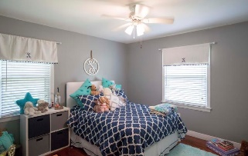
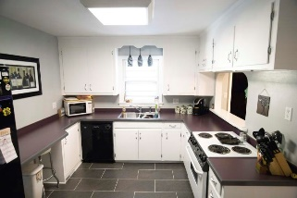
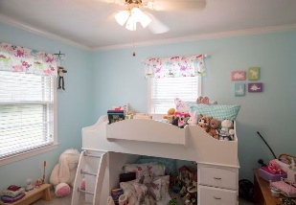
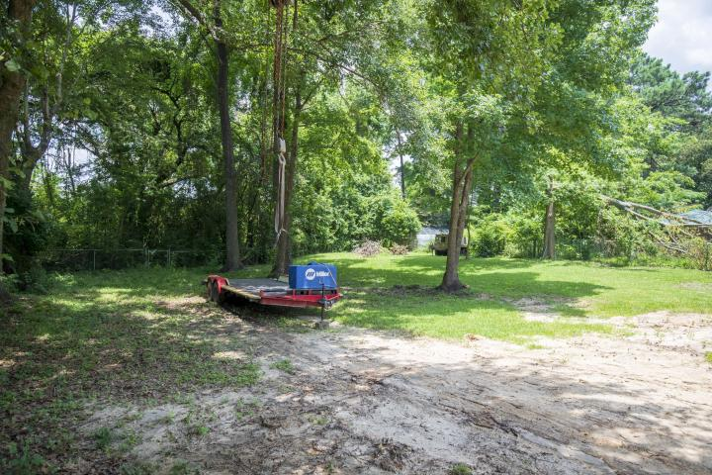
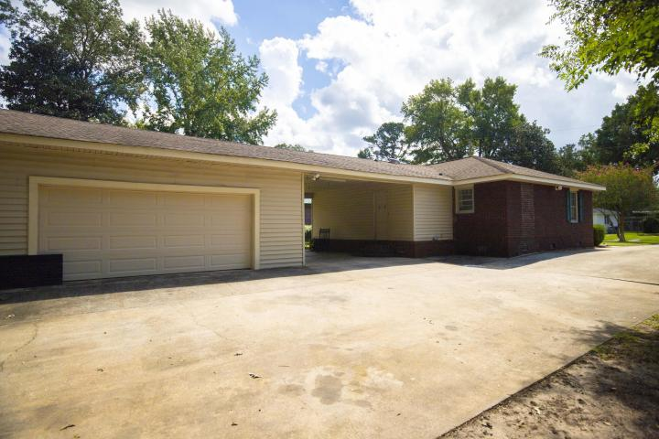


5324 Hartford Circle
North Charleston ~ MLS# 18024319 ~ $275,000
Custom home on beautiful lake!
Back on the Market!
Back on the market at no fault of the sellers! Great opportunity to live in the desirable Park Circle area. Minutes to I-526 and I-26. This 1958 single story brick home has 3 bedrooms and 2 full bathrooms. You will also find a separate Dining and Laundry/mud room. Cabinets have recently been repainted and homeowners added new tile floor in the kitchen. Off the back of the home, you will find a large car port, oversize 2 car garage, as well as a fenced-in backyard.
Scott Fulton
(843) 324-8845 O | (843) 324-8445 M
scott.fulton@agentownedrealty.com
AgentOwned Preferred Group | 824 Johnnie Dodds Blvd | Mt Pleasant, SC 29464

