Slide 1
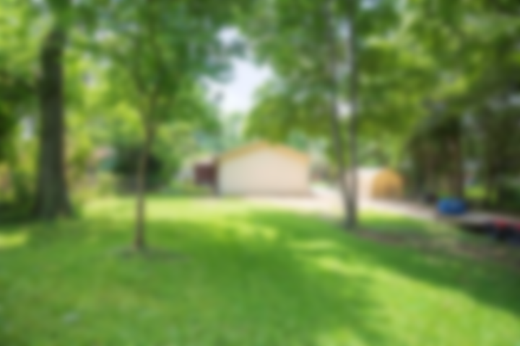
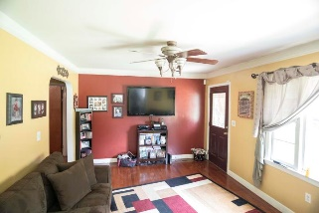
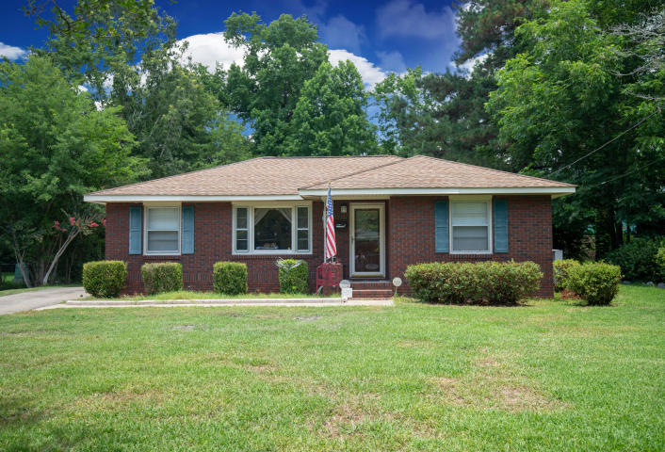
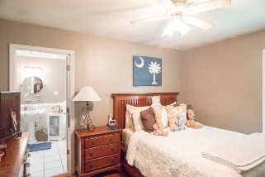
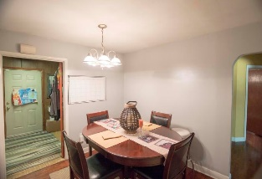
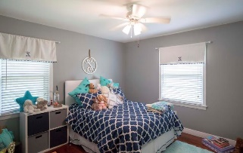
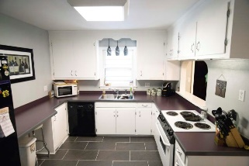
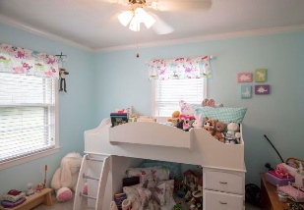
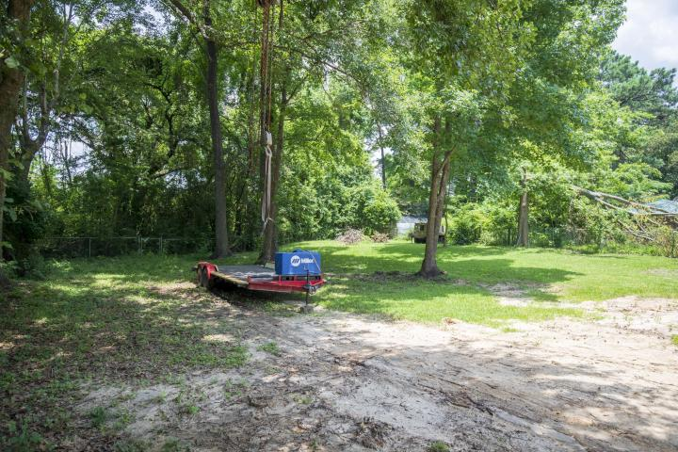
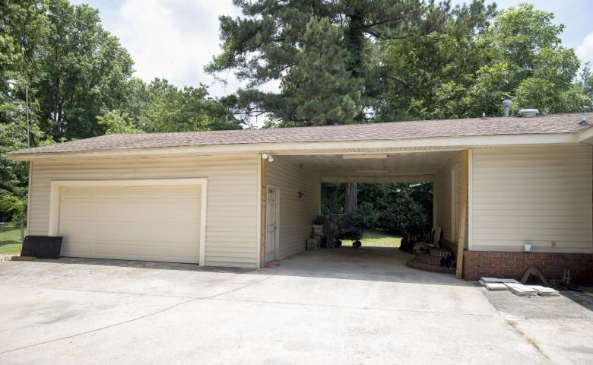


5324 Hartford Circle
North Charleston ~ MLS# 18024319 ~ $280,000
Custom home on beautiful lake!
Park Circle Home Minutes to I-26 and I-526
Great opportunity to live in the desirable Park Circle area.
Minutes to I-526 and I-26.
This single story brick home has 3 bedrooms and 2 full bathrooms. You will also find a separate Dining and Laundry/mud room.
Cabinets have recently been repainted and new tile floor was recently laid down in the Kitchen.
Off the back of the home, you will find a large car port, oversize 2-car garage, as well as a spacious, fenced-in backyard.
Scott Fulton
(843) 324-8845 O | (843) 324-8445 M
scott.fulton@agentownedrealty.com
AgentOwned Preferred Group | 824 Johnnie Dodds Blvd | Mt Pleasant, SC 29464

