Slide 1
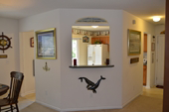
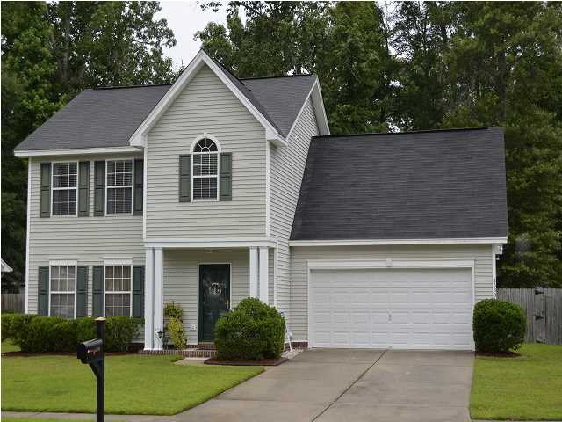
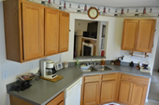
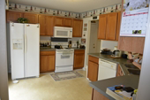





Open House
Thursday, Sept 25th from 12 to 4
Close To AFB & Boeing!
* Low HOA Fees *
Beautiful Back Yard With Hot Tub!
$175,500
3 Bedrooms
2 Full Baths
1 Half Baths
Marsh Side Subdiv
Sfd-Traditional Style
2 Story
Vinyl Siding Exterior
Built in 2003
1774 SqFt
2 Car Garage
5331 Tidewater Dr
MLS# 1415424
Fantastic Two Story Home With A Two Car Attached Garage Located In Marsh Side Subdivision. Featuring 3 Bedrooms Plus A Bonus Room. Large Spacious Living Room With A Gas Log Fireplace, Dining Area, Kitchen With Eat In Area. Upstairs Has A Master Bedroom & Bath, 2 Bedrooms Plus A Large Bonus Room.
Vicki Mangus
Million Dollar Club, Realtor
O: 843-875-5525
C: 843-540-6198
F: 843-832-8500
vicki.mangus@cbunited.com
www.VickiSellsCharleston.com
Coldwell Banker United, REALTORS

