Slide 1

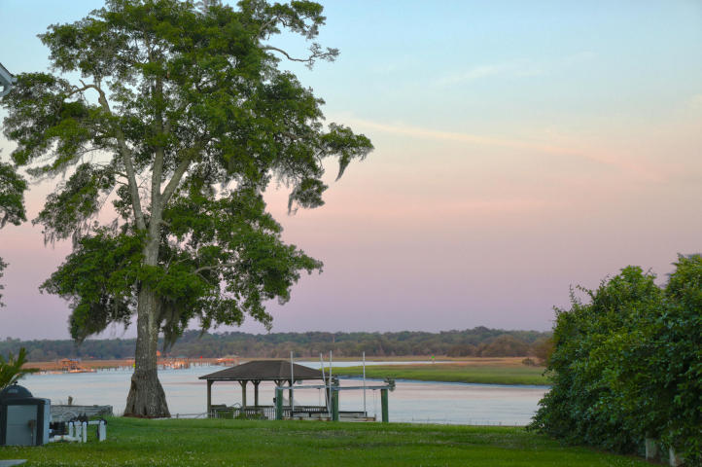
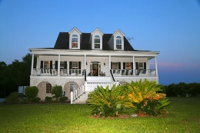
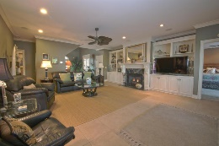
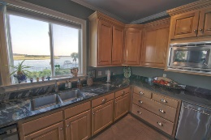
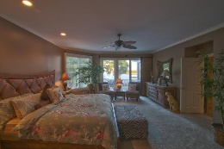
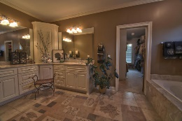
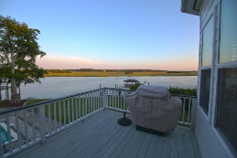
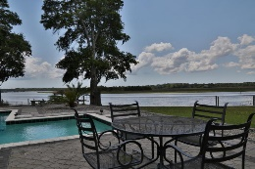
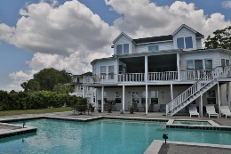
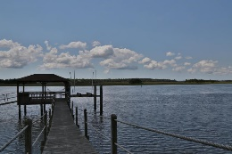
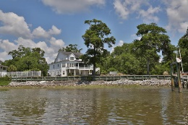


Deep Water & Spectacular Views
5336 Boone Run
The Bluff at Wide Awake Plantation • Hollywood
MLS# 16017217 • $1,675,000
VIEWS-VIEWS This magnificent home sits right on the ICW w/ views in both directions. 3 levels of living space to enjoy. 1st level has 3 parking spaces, tons of storage & a beautiful apartment could be 6th BR w/ views of the water & in-ground pool. 2nd level is your main living area with an open foyer & stairwell, study/office w/built-in cabinets, great room with gas FP and large doors to a screened-in porch. Formal dining room, laundry room, butlers pantry, eat-in custom kitchen w/an expansive view of the waterway. Large master BR w/large bath & walk-in closet & large windows w/views. 3rd level has 4 other BR's & a media room. Gorgeous flooring & attention to detail in the architecture. New 40 yr. arch. roof, dock & boat lift, heated in-ground pool w/hot tub.
See more at www.5336boonerun.2seeit.com
Lisa Stine, REALTOR
(843) 364-5359
lisastine61@gmail.com
Elaine Brabham and Associates, LLC • 1890 Sam Rittenberg Boulevard, Suite 217 • Charleston, SC 29407

