Slide 1
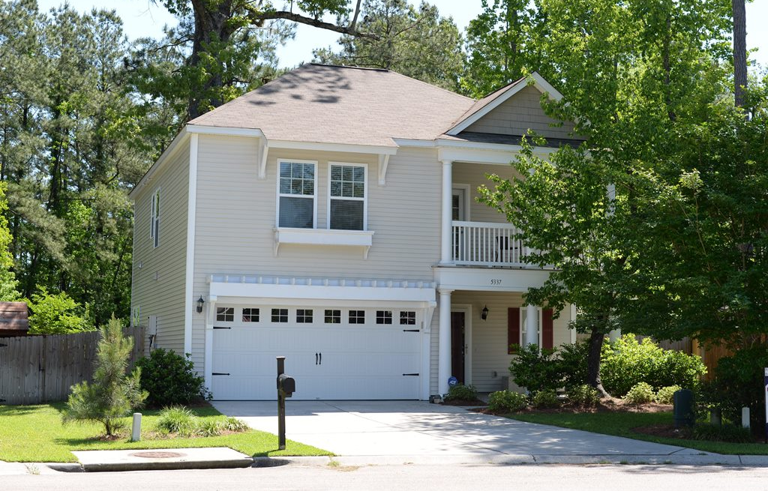
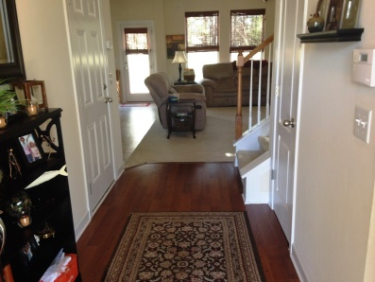
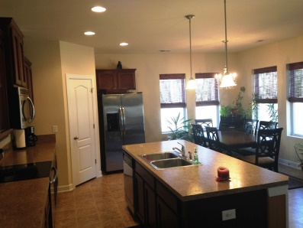
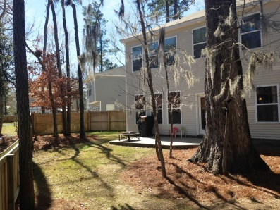
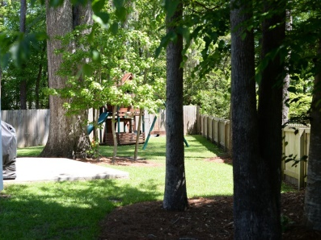


Ready To Sell!!
Price Reduced!
5337 Apollo Court
Appian Place ~ North Charleston ~ MLS# 15006752 ~ $205,000
This Beautiful 3 bedroom and 2.5 bath two story home located in Appian Place in the desirable Dorchester Two School District!!! This floorplan is the perfect place to call home... Your open family room serves as a great place for gathering with family and friends. The kitchen area features an oversized island/bar area with Stainless steel appliances, maple cabinets with crown molding and large pantry perfect for that chef. The master suite is located upstairs and features a walk in closet, double vanities and 5 foot shower. Also upstairs you will find the other two Bedrooms, Full Bath, Huge Loft area which could be used as another Living Area, Laundry Room and Porch that overlooks the front yard. The nice size patio and fenced in backyard are the perfect place to enjoy grilling out or playing with your family!! All lawn and planting bed areas are irrigated with automatic system to maintain your landscaping. This lovely home is minutes to Shopping, Boeing and Bosch and 3 miles from the Charleston Air Force Base! Don't miss out on this great house.... Call your agent today to schedule a showing.
Ryan Weekley, Realtor
843-303-3033
ryan.weekley@comcast.net
ERA Wilder Realty, 125-F Wappoo Creek Dr, Charleston, SC 29412

