Slide 1
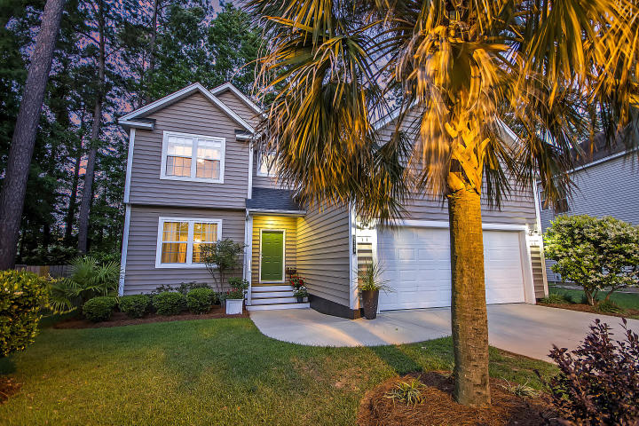



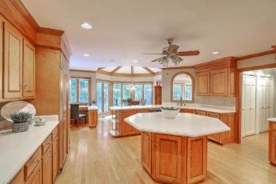
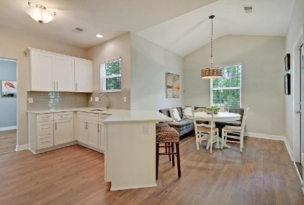



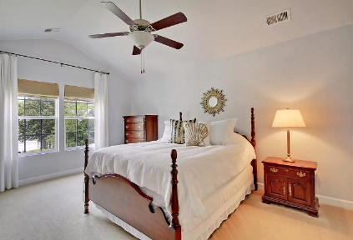

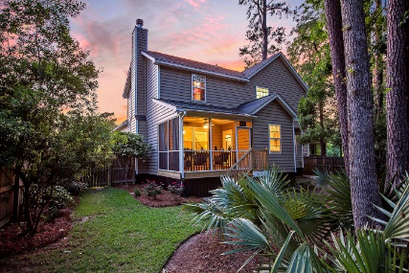
Parkshore Marshfront
Quiet Cul-de-sac Living
5339 Apollo Court
Appian Place ~ N Charleston, SC 29420 ~ MLS# 20011700 ~ $314,900
Situated on a cul-de-sac, this two story home is stunning and waiting for you!
This home is sure to impress from the moment you walk in with the two story foyer, Coretec plank flooring, the fireplace in the family room, an eat-in kitchen with subway tile backsplash, quartz countertops, breakfast bar seating, a new dishwasher, a double convection oven, & a formal dining room that flows into the light and bright, spacious living room.
The master suite features a cathedral ceiling, walk-in closet and luxurious en-suite bath with dual vanity, walk-in shower and relaxing garden tub. The FROG is a private bonus area that can be a flex space or 4th bedroom.
A screened-in porch looks over the wooded and fenced-in backyard. This home has been very well maintained and is absolutely move-in ready!
Christopher Smith christopher@mattoneillteam.com 843-267-0735

