Slide 1

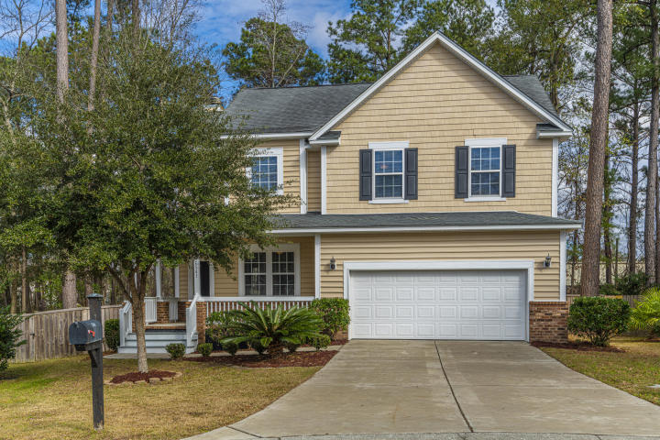
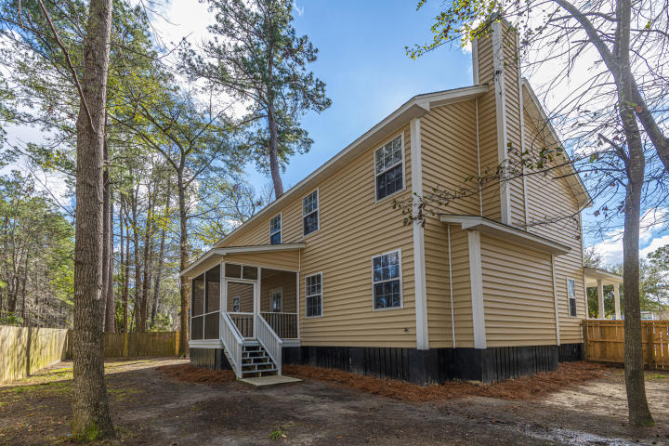
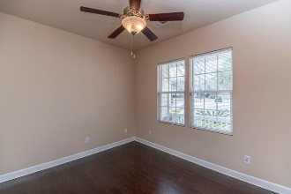
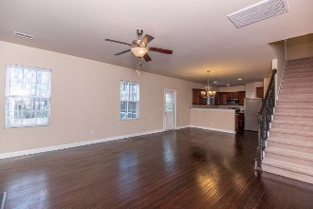
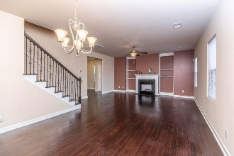
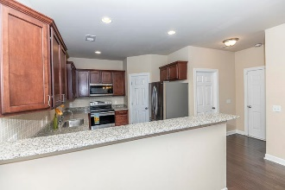
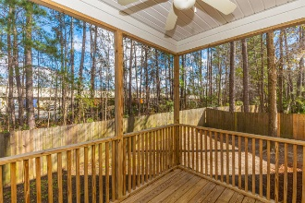
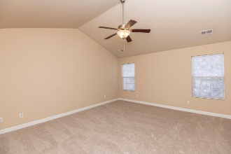
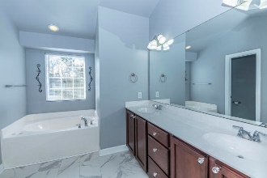
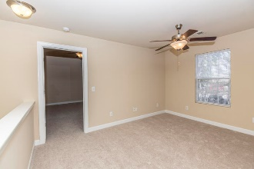
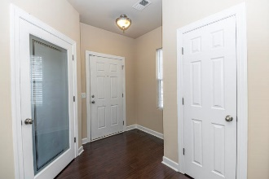
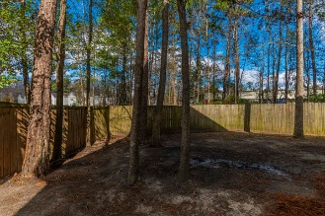


5341 Apollo Court Appian Place ~ North Charleston ~ MLS# 20002521 ~ $274,500
Come See This House Before It’s Gone!
Do not miss this stunning 5 bedroom 2.5 bathroom home, situated in a cul-de-sac in Appian Place. Driving up you will notice great curb appeal. Enjoy a cup of coffee on the front porch. As you enter, the beautiful foyer will greet you with dark wood bamboo floors, tall ceilings, office with frosted door (5th bedroom, no closet). The living room features a wood burning fireplace, with an open floor plan leading to the kitchen. The chef will adore this kitchen, with dark cherry cabinets, brand new granite countertops and stainless steel appliances. ( All convey) The peninsula offers a space for added seating. The bamboo floors span the entire first level. Upstairs, the master suite is spacious with plenty room for a king sized bed, dressers and a seating area. Walk through the impressive his and her walk in closets to the en-suite bathroom with it's jetted tub, separate shower and double sinks. The 3 secondary bedrooms are split from the master for added privacy and all good sized with large closet space. Guest bath is nestled between the 3 rooms for easy access, it boasts beautiful tile floors. Finishing up the upstairs is an expansive loft area; perfect for a play room, media room, or exercise area. Home has plenty of storage space, and ceiling fans in the living room, bedrooms, and even the screened in porch. Home features new carpets upstairs, fresh paint, new air handler(1/20), new granite countertops, new window blinds and more. Enjoy sitting outside in your screened in porch, with a backyard space just waiting for your personal touch. A $1400 Lender Credit is available and will be applied towards the buyers closing costs and pre-paids if the buyer chooses to use the seller's preferred lender. The credit is an addition to any negotiated seller concessions. Conveniently located near I-26 and I-526! This home is close to schools(zoned for DD2), shopping, dining, Boeing and the military base, and multiple historic Charleston sites! Schedule your appointment to see your new home today!
Jacqui Swain (843) 295-9484 jacqui.swain@carolinaone.com www.jacquisellscharleston.com
Carolina One Real Estate
1530 Old Trolley Road
Summerville, SC 29485

