Slide 1
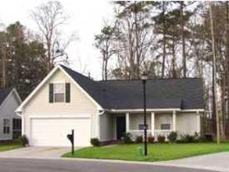
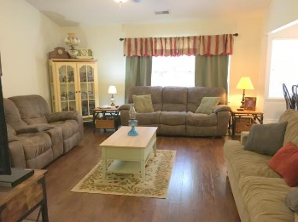
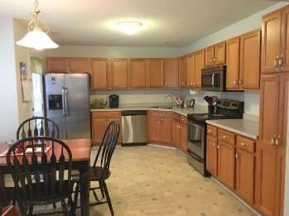
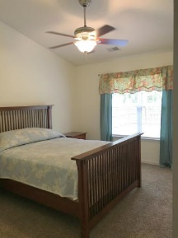
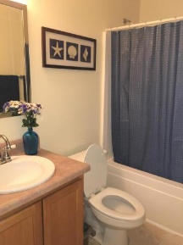
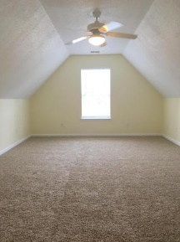
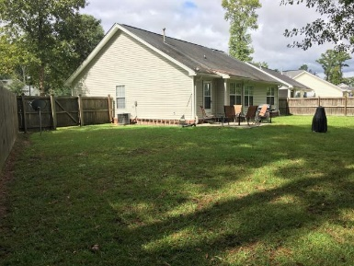
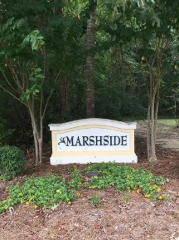
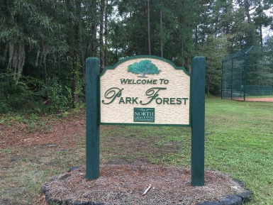



5344 Tidewater Drive Marsh Side North Charleston, SC 29420 MLS# 16025234 $199,000 3 Bedrooms ▪ 2 Baths ▪ 1,740 sq. ft.
Just Listed!
Move-in ready
Location, location! This adorable 3 bedroom, 2 bath, Ranch is within walking distance of restaurants, Publix grocery store, hair & nail salon, child care, and a Park. Move in ready with new carpeting in bedrooms, hardwood flooring in foyer and living room, a large kitchen with new stainless appliances and lots of cabinets and counter space. The living room has a cathedral ceiling and is open to the kitchen for easy entertaining. The first floor master also has a cathedral ceiling and is split from the other two downstairs bedrooms. Master bath with dual vanities and two master closets. Ceiling fans throughout. There is a bonus room/FROG that could be used as a 4th bedroom, a den, home office, you name it! All on a cul-de-sac, a large fenced backyard and desirable Dorchester II schools!
Jennifer Nipper, Realtor®
(843) 478-1800 | jen@AgentOwned.com
www.AgentOwned.com
The AgentOwned Realty Co | 824 Johnnie Dodds Blvd | Mt. Pleasant, SC 29464
Real Estate • Mortgage • Insurance

