Slide 1
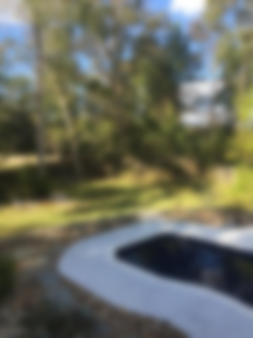
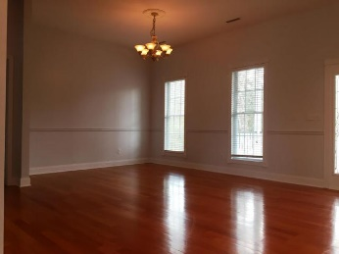
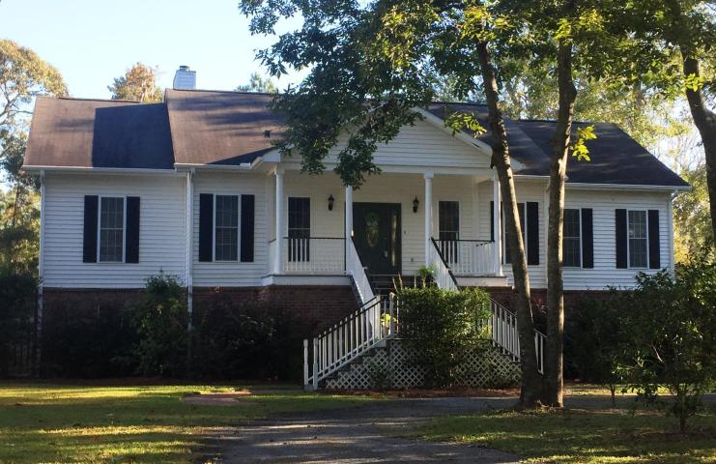
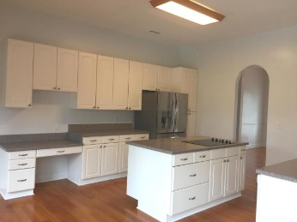
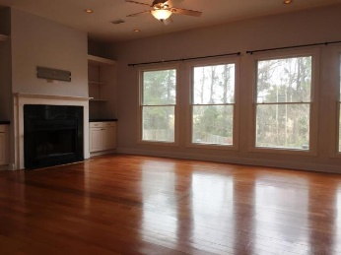
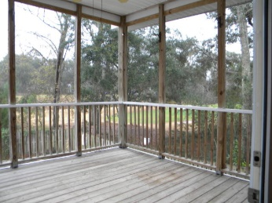
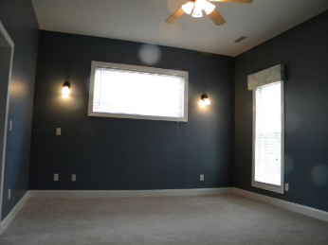
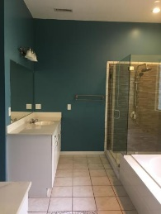
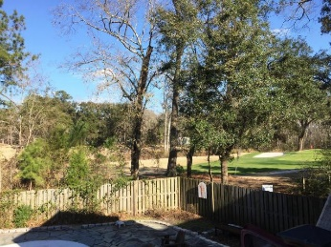
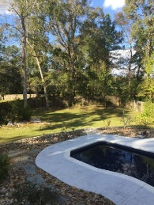
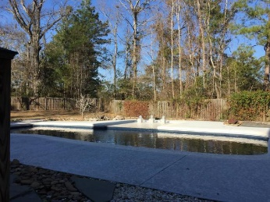


Realtor Open House & Luncheon Thursday 2/8/2018 11am - 1pm Register to win 1 of 2 $25 Target gift cards
5348 Boone Run
The Bluff at Wide Awake Plantation • Hollywood • MLS# 17029638 • $448,900
If you love to entertain, this is the home for you! Inside and out! Spacious open floor plan. Chefs Kitchen opens up into large great room with wood burning fireplace and built in bookcases. Kitchen offers lots of cabinets and counter space. Wall oven and Microwave. Large island has smooth cooktop. Walk out to the screened porch and deck with hot tub that overlook the tropical paradise backyard with salt water pool. Pool area has outdoor shower and lots of entertaining space. Pool can be heated and has tanning deck with bubblers. Yard backs up to Stono Ferry Golf course driving range and 11th tee box. Master bedroom has his and her walk in closets and master bath with dual vanities, Jetted tub and and large seamless glass tile shower. 2 more bedrooms, plus an additional room perfect for a study/office. Below this beautiful elevated home is the garage area 3 garage bays and enough parking for multiple cars, golf cart, boat and still have room for storage or entertaining area. It also has rough in for a bath.
Christina Garvin
(843) 270-7667 | cgarvin63@gmail.com
Elaine Brabham and Associates, LLC • 1890 Sam Rittenberg Boulevard, Suite 217 • Charleston, SC 29407

