Slide 1

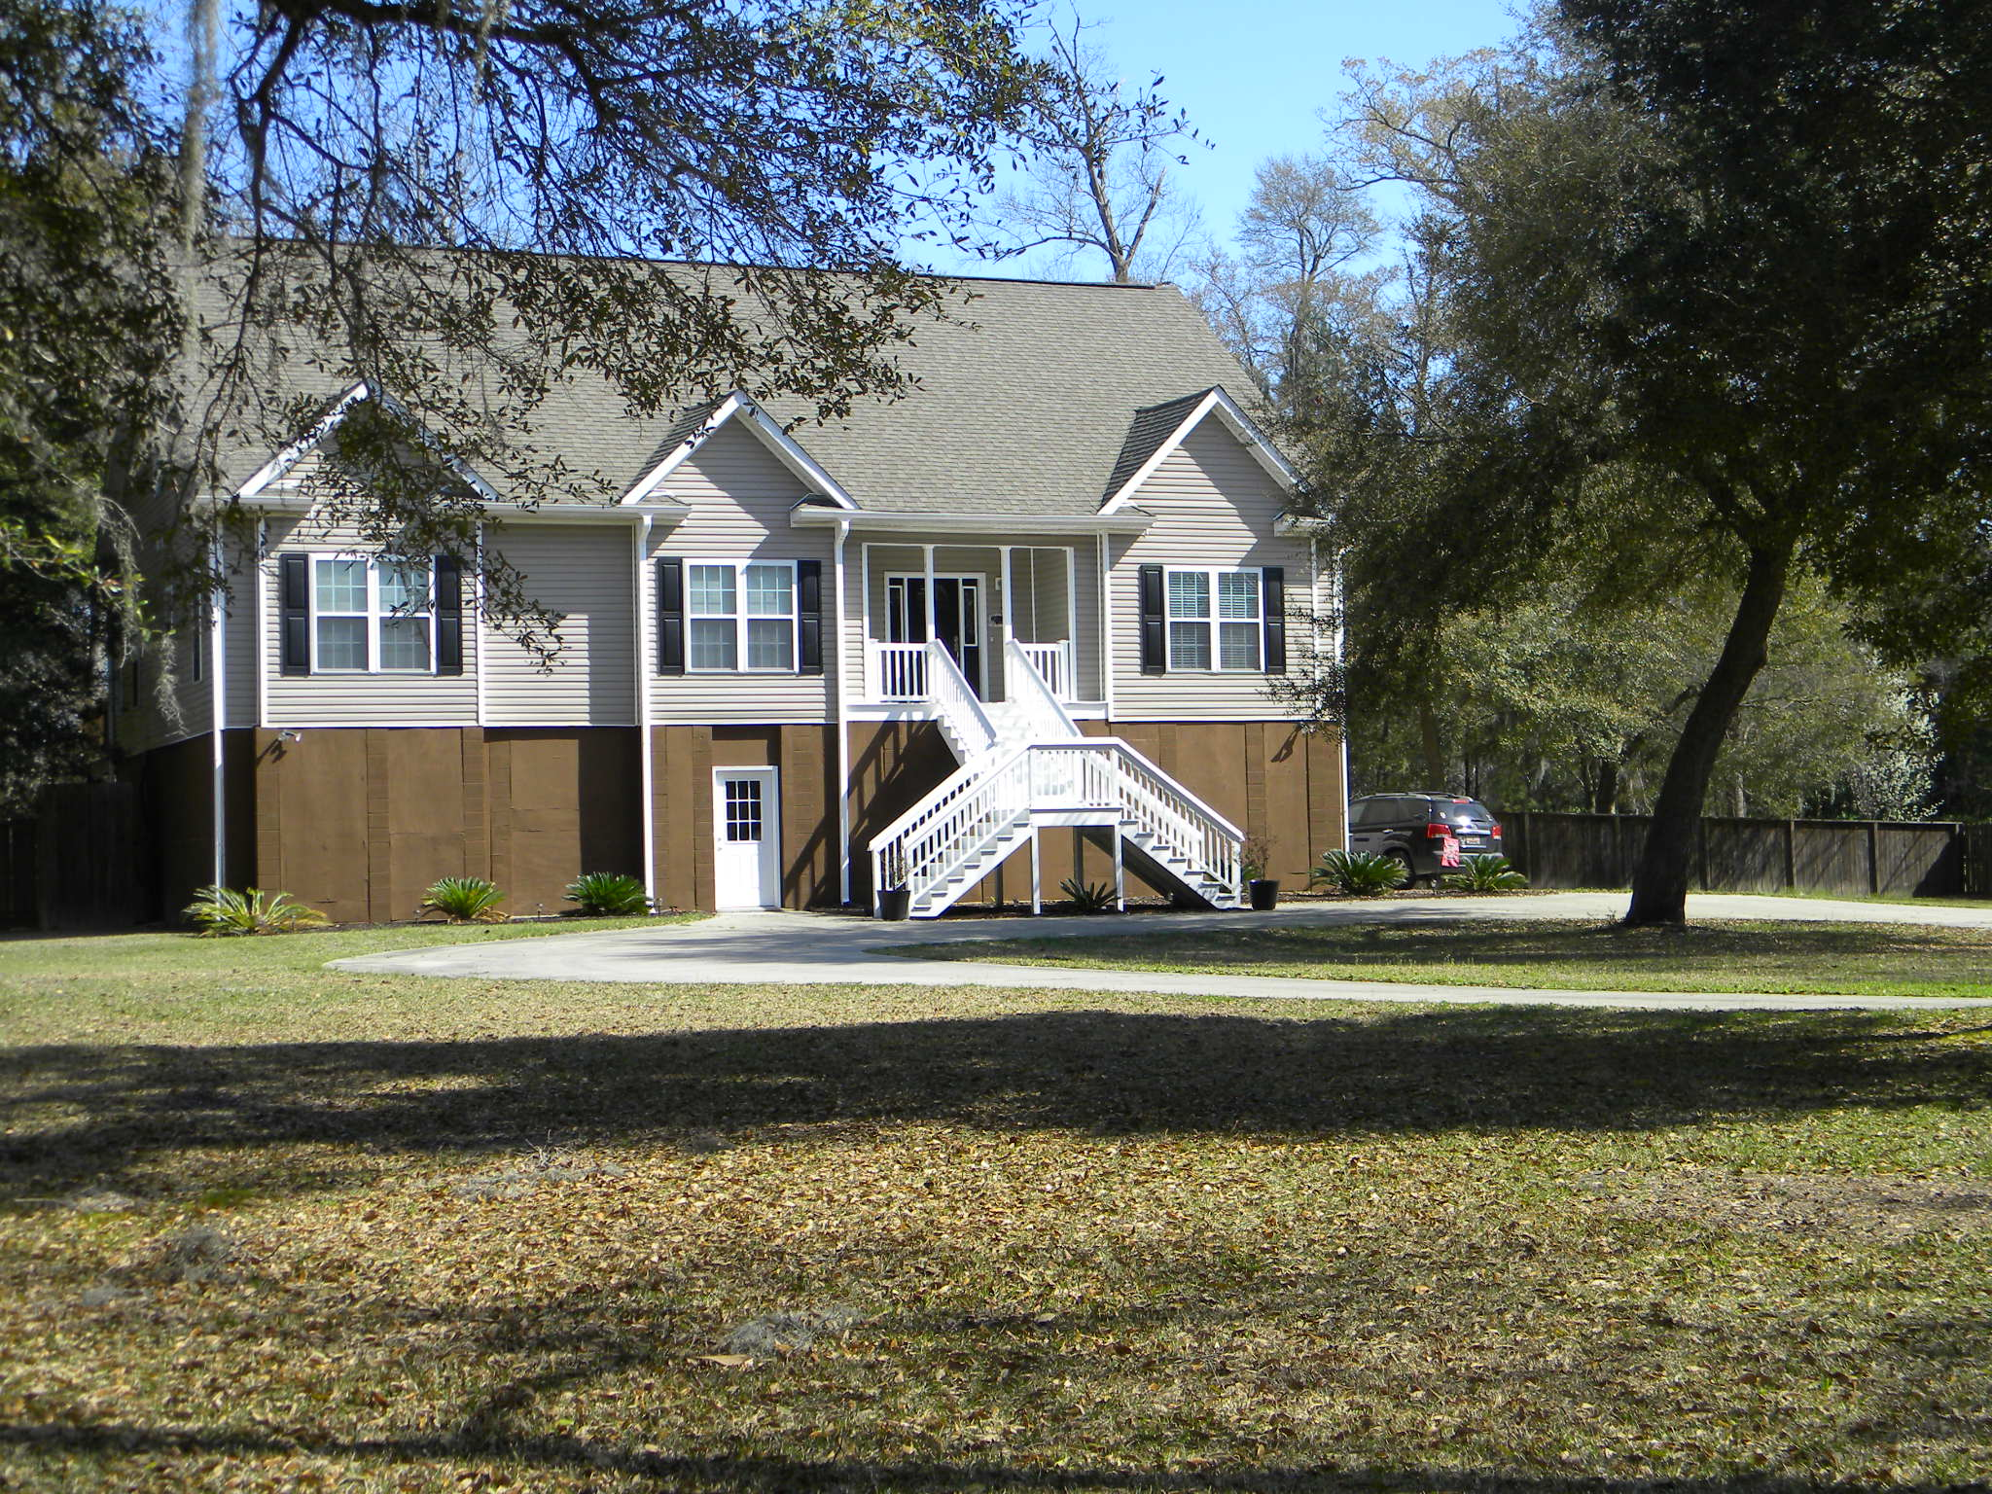
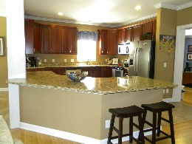
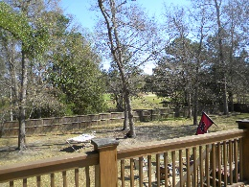
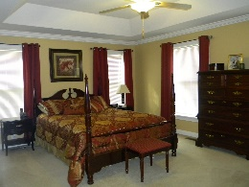
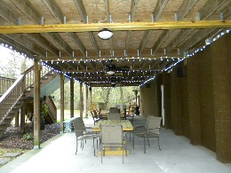
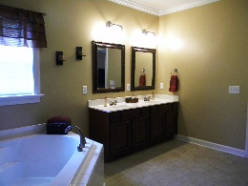
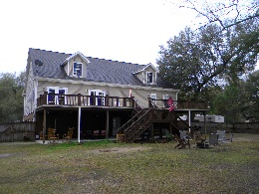


This is a must see
Over 1.5 acres!
Great Country Getaway
5352 Boone Run Road
The Bluff at Wide Awake Plantation • Hollywood • MLS# 15007321 • $429,500
A fantastic home for entertaining. Kitchen has stainless steel appliances, granite countertops, 42 inch cabinets. French doors lead from living and dining areas to sun deck stretching the entire back of home and overlooks large fenced in backyard with view of the Stono Ferry Golf Course’s 11th tee box and driving range. Beneath sun deck is a great entertaining area plumbed for water for outdoor kitchen area. Master bedroom has large walk in closet and large master bath with separate shower and soaker tub. Open floor plan with lots of space to expand. Go from 2345sq ft up to almost 6000 sqft within the home. 3rd floor could be finished to have up to 2 more bedrooms and 2 full baths. In addition to the 3 car garage area, the downstairs/ground floor area has room for the perfect Guest or mother in-law suite to include full bath and living area. NO FLOOD INSURANCE REQUIRED. Heart shape drive way. Convenient central vacuum system.
Christina Garvin
(843) 270-7667 | cgarvin63@gmail.com
Elaine Brabham and Associates, LLC • 1890 Sam Rittenberg Boulevard, Suite 217 • Charleston, SC 29407

