Slide 1
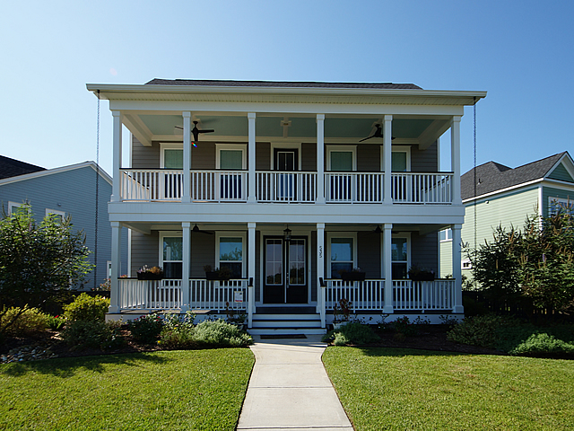
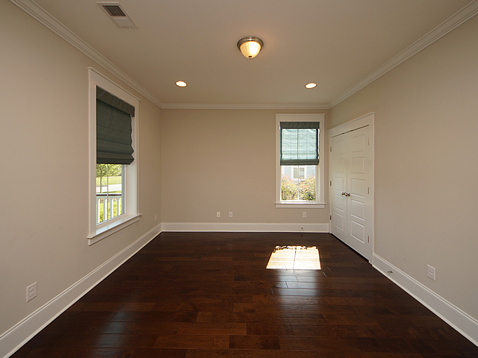
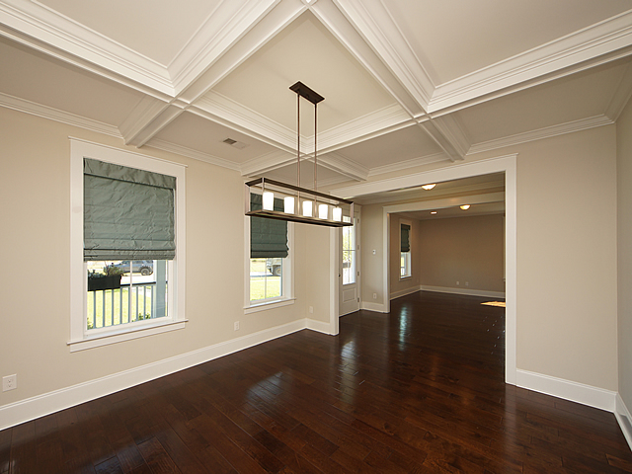
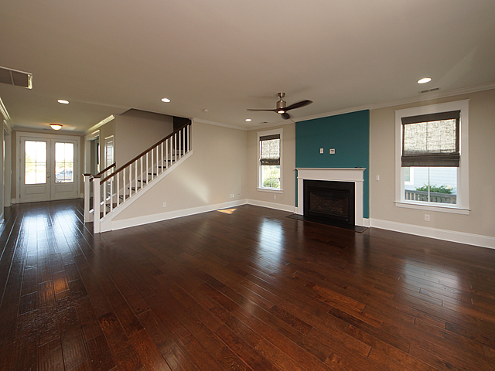
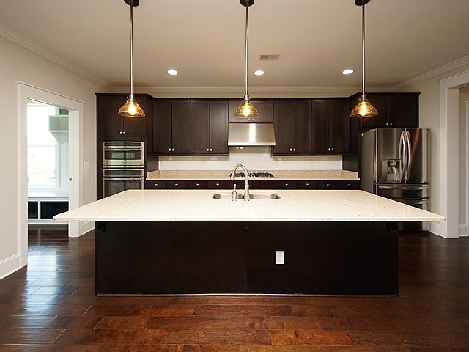
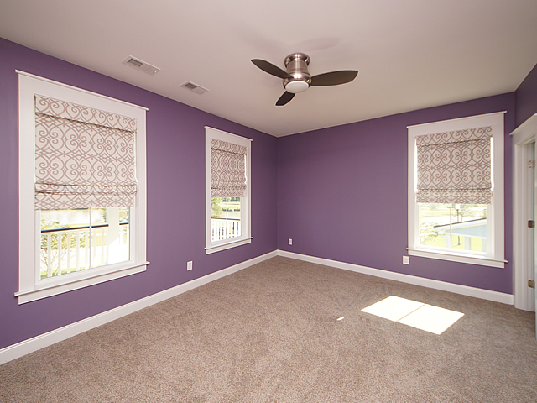
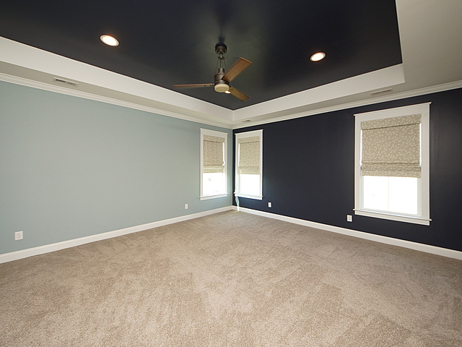
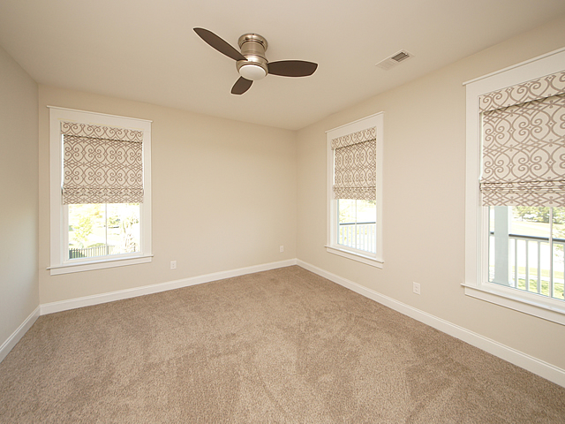
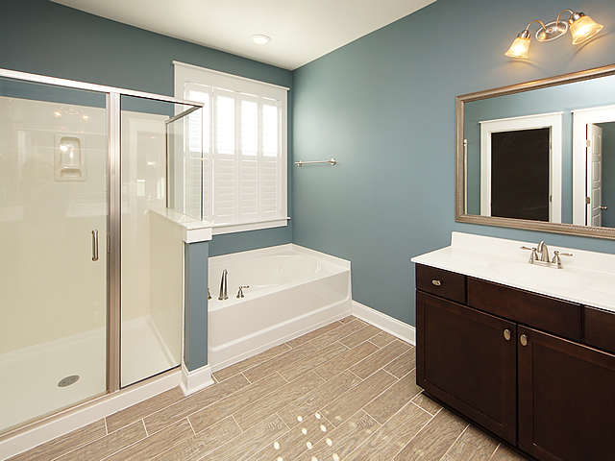
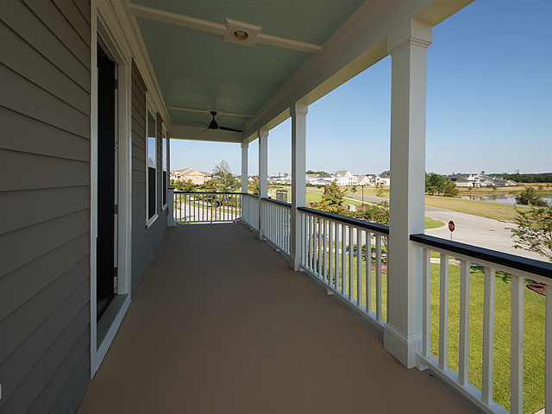
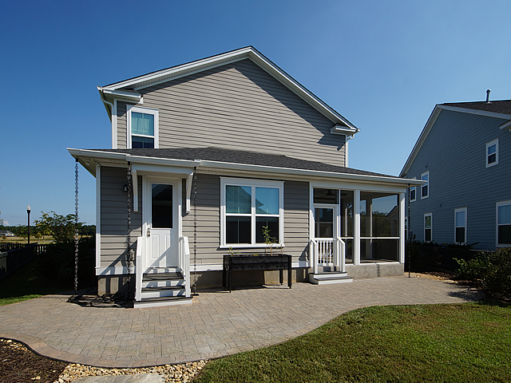

$4,000 AGENT BONUS!
Immediate Occupancy!
535 Carnes Crossing Blvd
Carnes Crossroads
Summerville, SC 29486
MLS# 18023398
$515,000
Welcome home to 535 Carnes Crossing in Beautiful Carnes Crossroads. The Radcliffe B Traditional Charleston single-style home boasts 4 bedrooms and 3.5 bathrooms. This home is located on a corner lot and from both the upstairs and downstairs porches you can enjoy a view of the large pond. Upon entry be impressed with the open spacious floor plan with the traditional formal sitting room/office and formal dining room on either side. As you continue into the home it opens up to the large family room with gas fireplace and the gourmet kitchen includes large center island, gas cooktop, stainless steel appliances including stainless range hood making this a chef's delight and opens up to the breakfast area. The butlers pantry beautifully done and large walk in pantry add additional storage. The large mud room is conveniently located off the kitchen and boasts wainscotting, additional storage for shoes and coats and cushioned bench is an added bonus. Be impressed by the handscrapped hardwood flooring throughout the main floor. On the second floor are two additional bedrooms and with a full bath, the large master bedroom with sitting area and large master bathroom with separate shower and soaking tub with tiled flooring and double sinks. The laundry room is also conveniently located on the second floor. The fourth bedroom and full bathroom nicely appointed are located on the third floor but could also be used as a man cave or bonus rooms for the kids. The location of the home is wonderful on a corner lot and directly across from the large pond. The backyard has been upgraded with a paver patio, stone walkway, heavy duty rain chains, which the seller added for optimal drainage as well as gutters. Beautiful landscaping all around the home was also added. Carnes Crossroads has great amenities and include a club house and pool with wonderful social events going on something for everyone, a play park for the kids, walking trails throughout the neighborhood, large lakes also throughout Carnes Crossroads. There are conveniently located businesses in Carnes Crossroads making this a very desirable community built by the same builders who developed Daniel Island. This is a must see home!
BHHS Carolina Sun Real Estate
1440 Ben Sawyer Blvd ste 1503
Mt Pleasant, SC 29464
Suzanne Conway
M (843) 814-6778
s.conway@bhhssun.com

