Slide 1
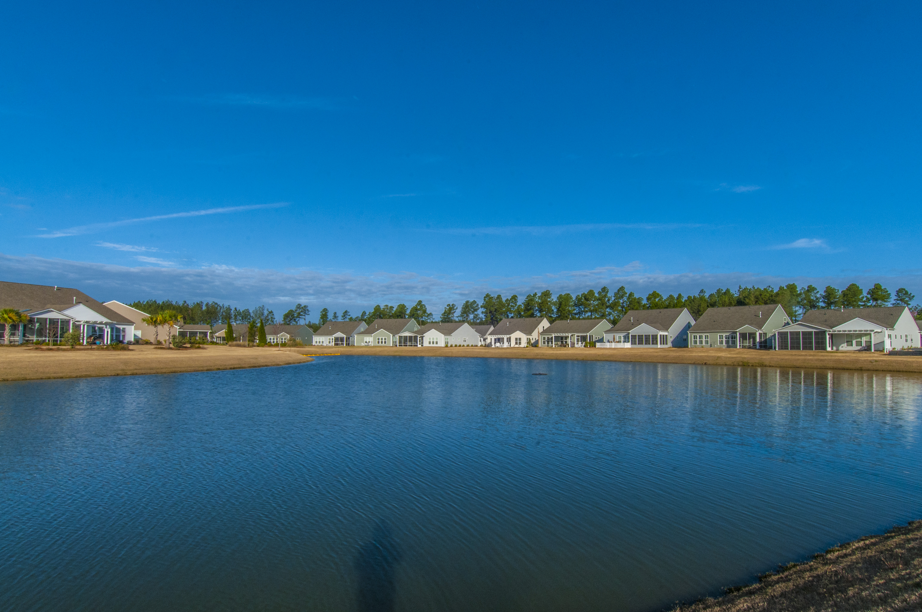
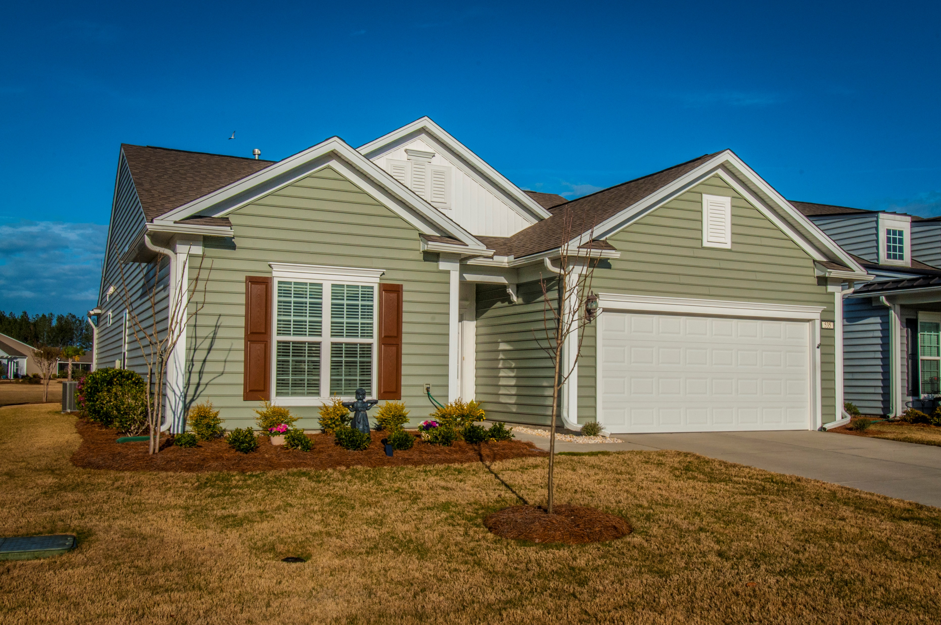
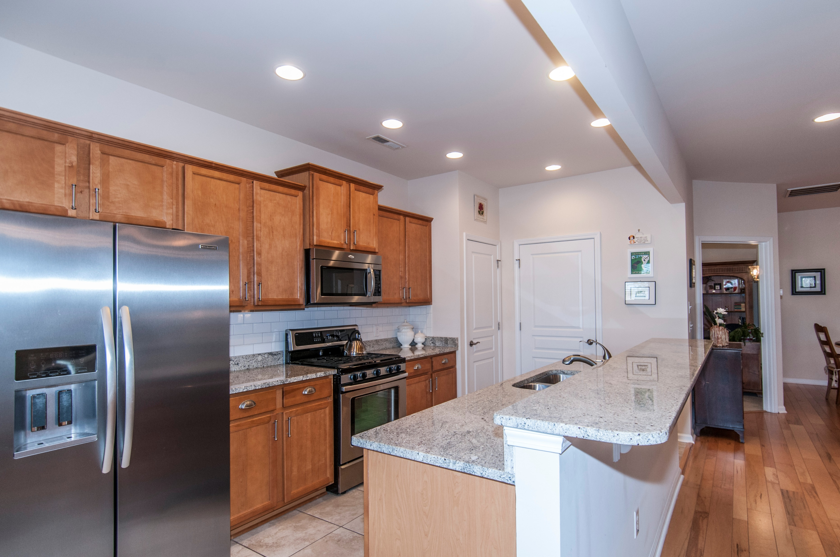
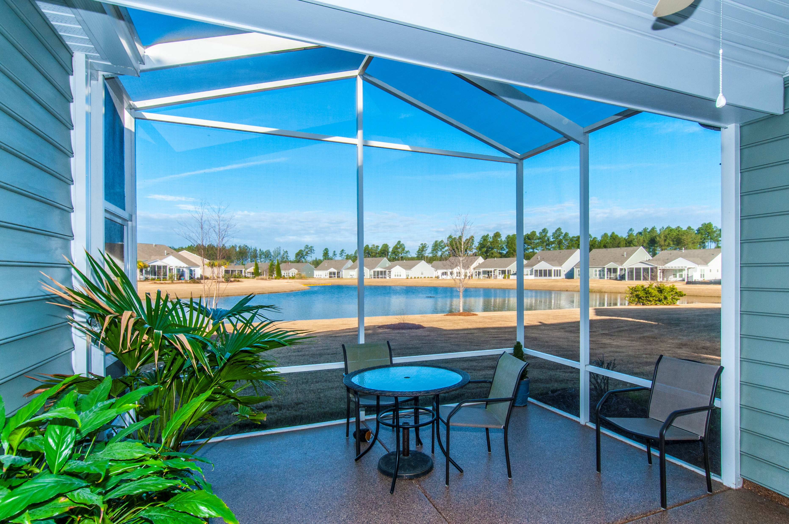


535 Tranquil Waters Way
Cane Bay Plantation ~ Summerville, SC 29486
MLS# 17004562 ~ $292,000
Agent Open House Thursday April 6th from 12-2
Stop by this lovely home for a light snack and see the beautiful view and open floorplan!
$550,000
Lovely, well maintained home in Del Webb's active over 55 planned community. Home boasts gorgeous views of a large pond with fountain and varied landscaping. The owners added a large screened lanai with custom flooring for enjoying the private view. The floorplan is open, with 3 bedrooms and a den currently used as an office. The tile entryway leads to handsome wide planked maple hardwoods, The kitchen has abundant birch cabinetry, granite counter tops, subway tile back splash, brushed nickel hardware, stainless steel appliances and a gas stove! All appliances along with 2 inch blinds and 6 ceiling fans convey. The 2 car garage also has a deep sink for convenience. Nine foot ceilings, recessed lighting and plenty of natural light make this home a pleasure to enjoy daily and for entertaining.
Please look under documents for a list of all the special features.
Linda Ett
M (843) 729-8718 | O (843) 884-1800
lett@carolinaone.com
www.lindaett.com
Carolina One Real Estate
195 W Coleman Blvd
Mt Pleasant, SC 29464-3495

